Slide 1


Empreendedorismo em ciências
2019/2020
1º CICLO DE ESTUDOS
AULA 4
07 e 10 OUT 2019
HELENA VIEIRA
Copyright ©

Slide 2
SUMÁRIO
DESIGN THINKING – PARTE II
  The Process
  Let’s be Design Thinkers!
BMC – Introduction
Types of Business Models

Slide 3

By Rita Tomé (TEC LABS)
Notes:
Design natural e design artificial
Design thinking como uma metodologia que estrutura e potencia a inovação para construirmos coisas tangíveis ou intangíveis que vão ao encontro das necessidades das pessoas

Slide 4


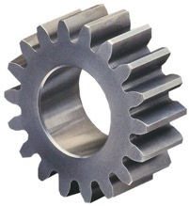
BUSINESS MODEL
Business Model
Idea
Value

Slide 5
Notes:
Onde vamos buscar as ideias?

Slide 6

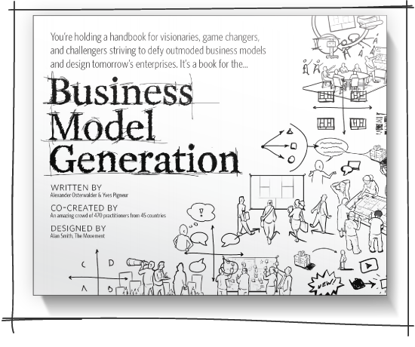
BUSINESS MODEL
ALEX OSTERWALDER
http://www.businessmodelgeneration.com/book

Slide 7
DEFINITION OF BUSINESS MODEL
“ A Business Model is a logic description of how an organization creates, distributes and captures value.”
Alex Osterwalder
COOL!! BUT HOW DO WE DO THAT?!

Slide 8
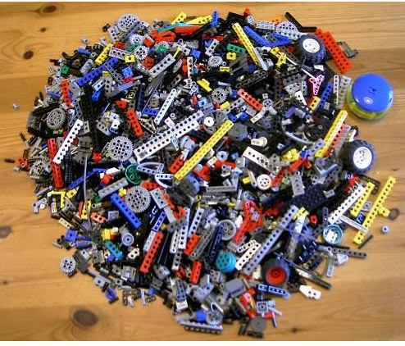
WHY USE A METHODOLOGY?

Slide 9
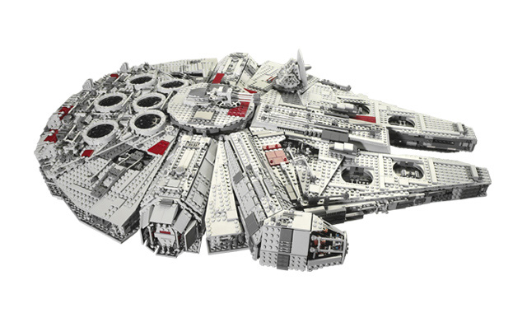
BUILD A STAR WARS SPACE SHIP!

Slide 10
GROUP A

Slide 11
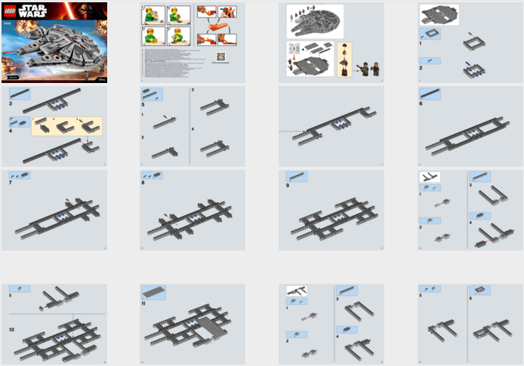
GROUP B

Slide 13
BUSINESS MODEL CANVAS
9 BUILDING BLOCKS

Slide 14
1
6
2
4
8
7
3
9
5

Slide 15
BUSINESS MODEL CANVAS
IT IS USED TO:
DESCRIBE
DESIGN
CHALLENGE
INVENT
INNOVATE!

Slide 16
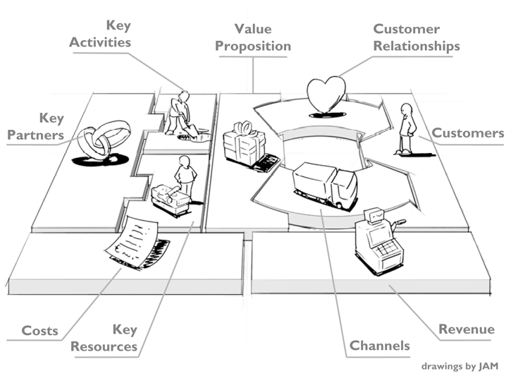
BUSINESS MODEL CANVAS
in: Business Model Generation, Alex Osterwalder & Yves Pigneur, 2009

Slide 17
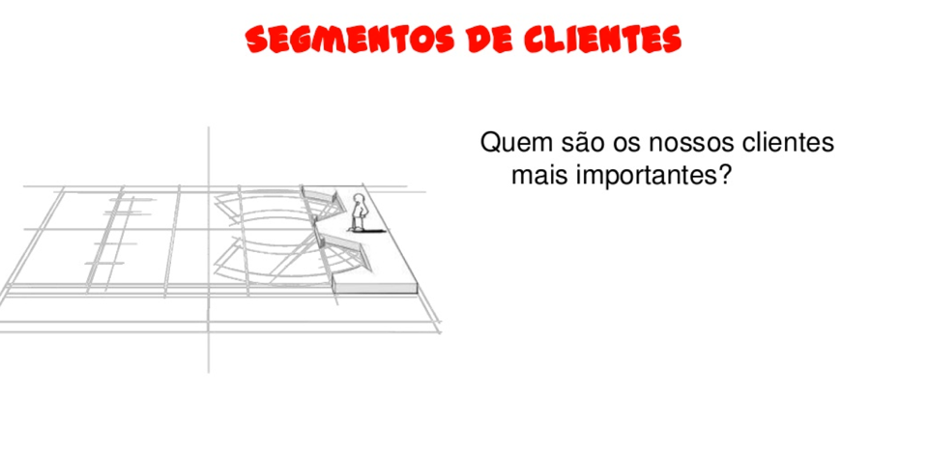
CUSTOMER SEGMENTS
Who are our most important clients?

Slide 18
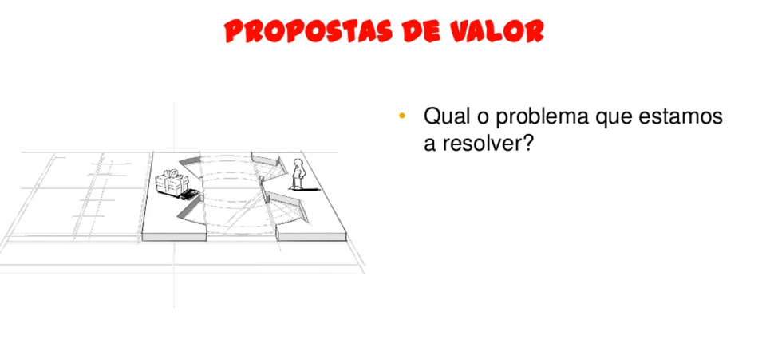
VALUE PROPOSITION
What is the problem we are trying to solve?

Slide 19
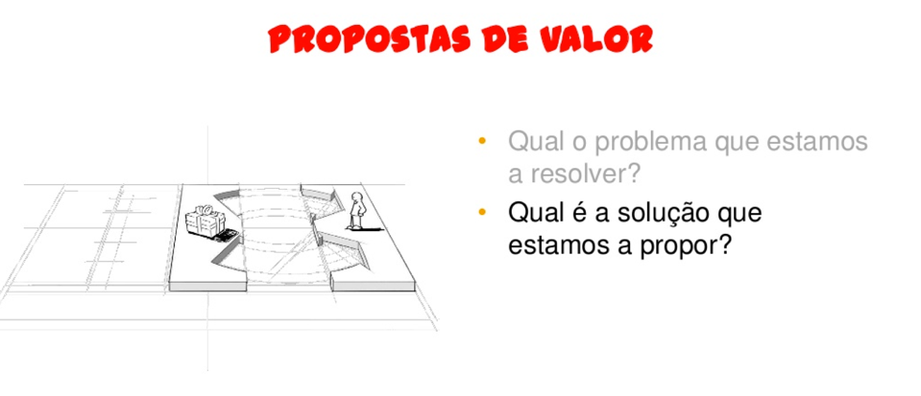
VALUE PROPOSITION
What is the problem we are trying to solve?
What is the solution we are proposing?

Slide 20
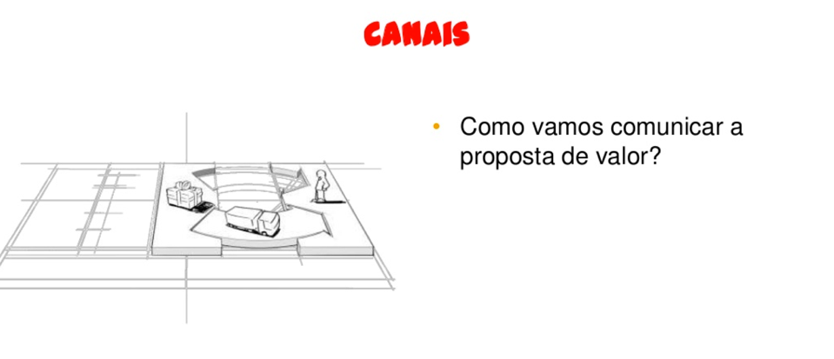
CHANNELS
How are we communicating the Value Proposition?

Slide 21
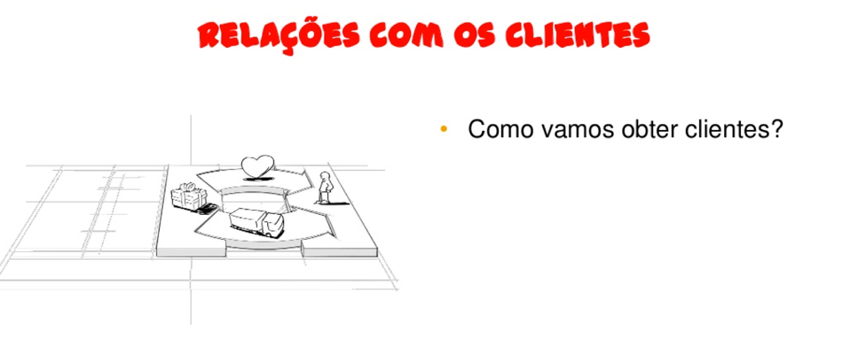
CUSTOMER’S RELATIONS
How will we obtain clients?

Slide 22
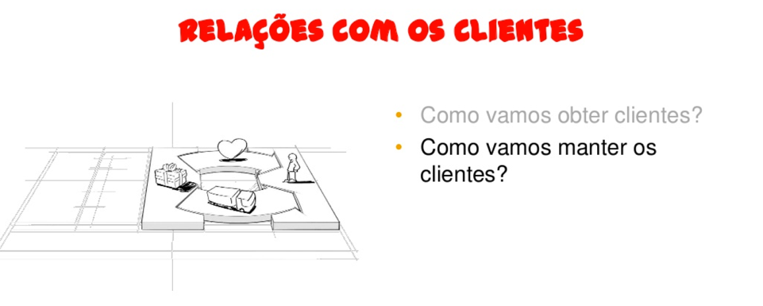
CUSTOMER’S RELATIONS
How will we obtain clients?
How will we maintain clients?

Slide 23
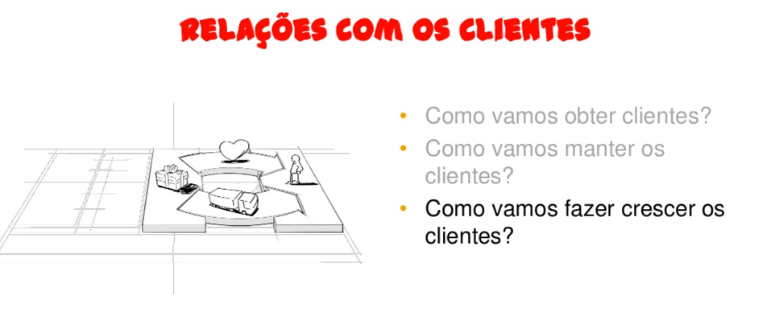
CUSTOMER’S RELATIONS
How will we obtain clients?
How will we maintain clients?
How will we grow clients?

Slide 24
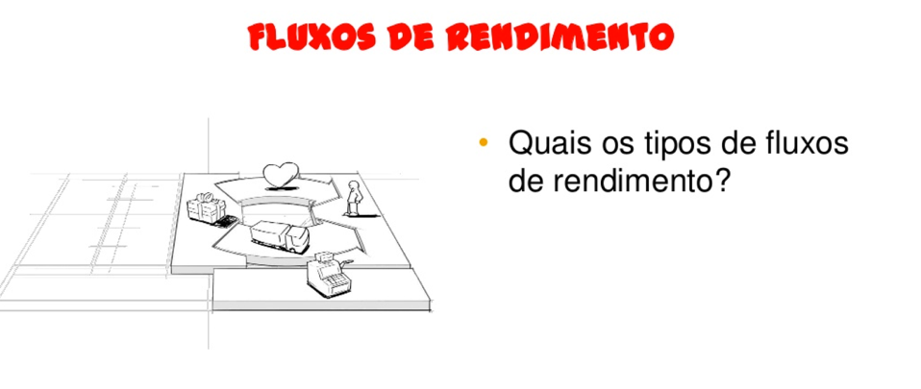
INCOME
What types of income flows can we identify?

Slide 25
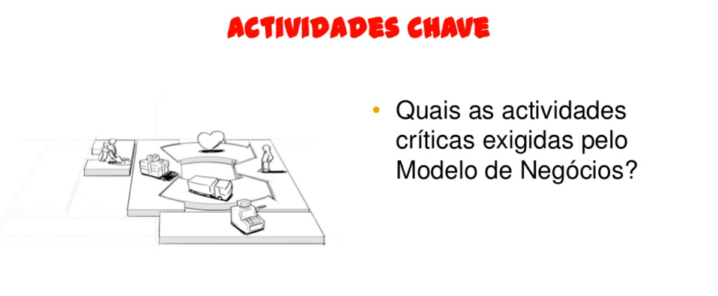
KEY ACTIVITIES
What are the critical activities demanded by my business model?

Slide 26
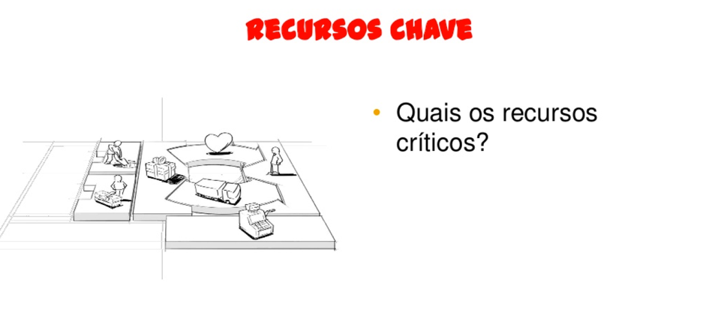
KEY RESOURCES
What are the critical resources demanded by my business model?

Slide 27
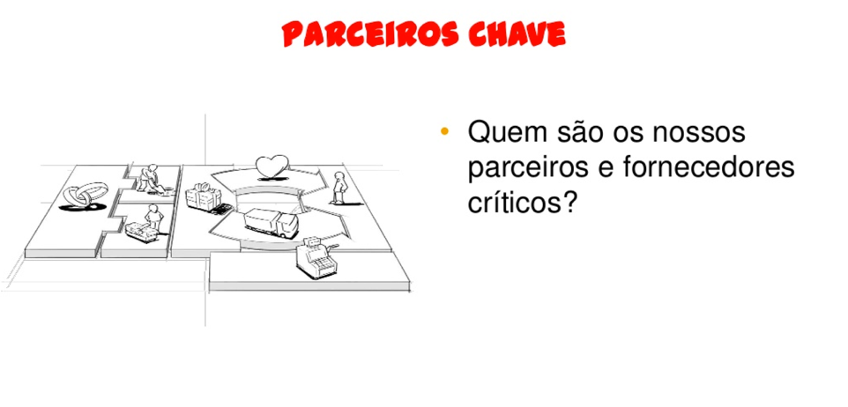
KEY PARTNERS
Who are the critical partners and suppliers of my business?

Slide 28
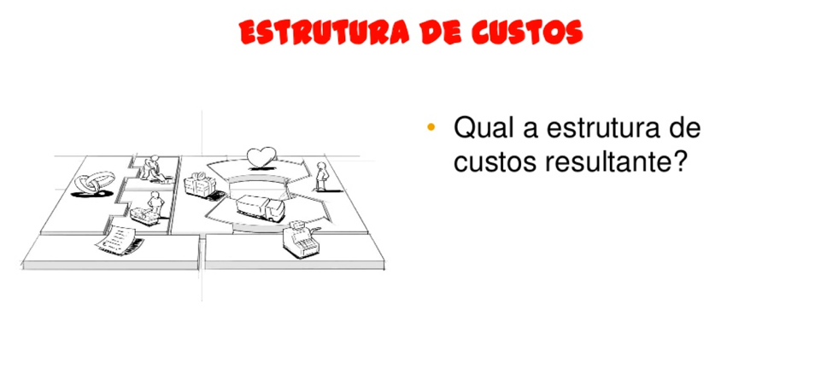
COSTS
What is the resulting cost structure?

Slide 29
BUSINESS MODEL CANVAS
in: Business Model Generation, Alex Osterwalder & Yves Pigneur, 2009

Slide 30
WHAT
HOW
WHO
MONEY

Slide 31
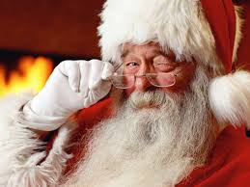

Slide 32
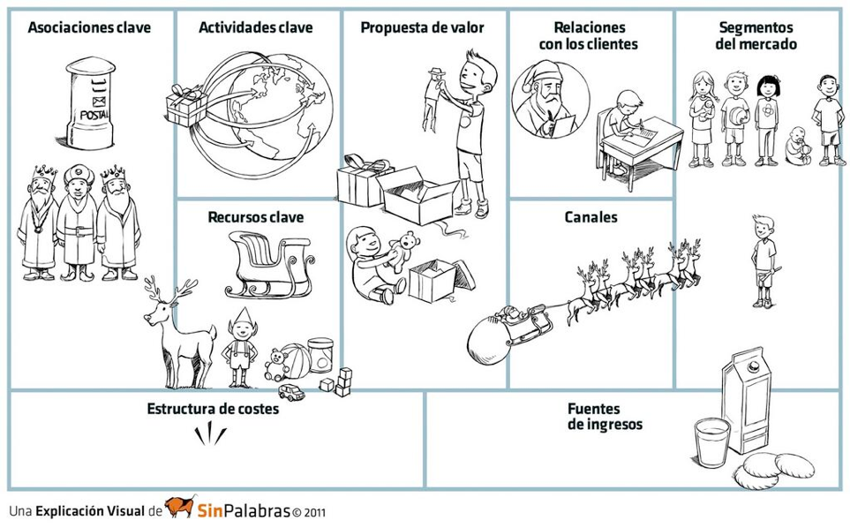
KEY PARTNERS
KEY ACTIVITIES
VP
CUSTOMERS RELATIONSHIP
CUSTOMERS
KEY RESOURCES
CHANNELS
COST STRUCTURE
REVENUE STREAM

Slide 34
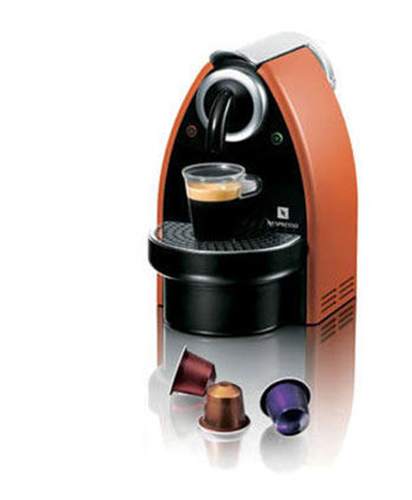
Nespresso altered the business model of expresso coffee
Helena Viera, PhD © 2017/2018
Notes:
Nespresso (owned by Nestlé) turned a transactional industry - selling coffee - into one that produces recurring revenues. Their business model is built around well designed coffee machines and aluminum pods that contain premium coffee.

Slide 35
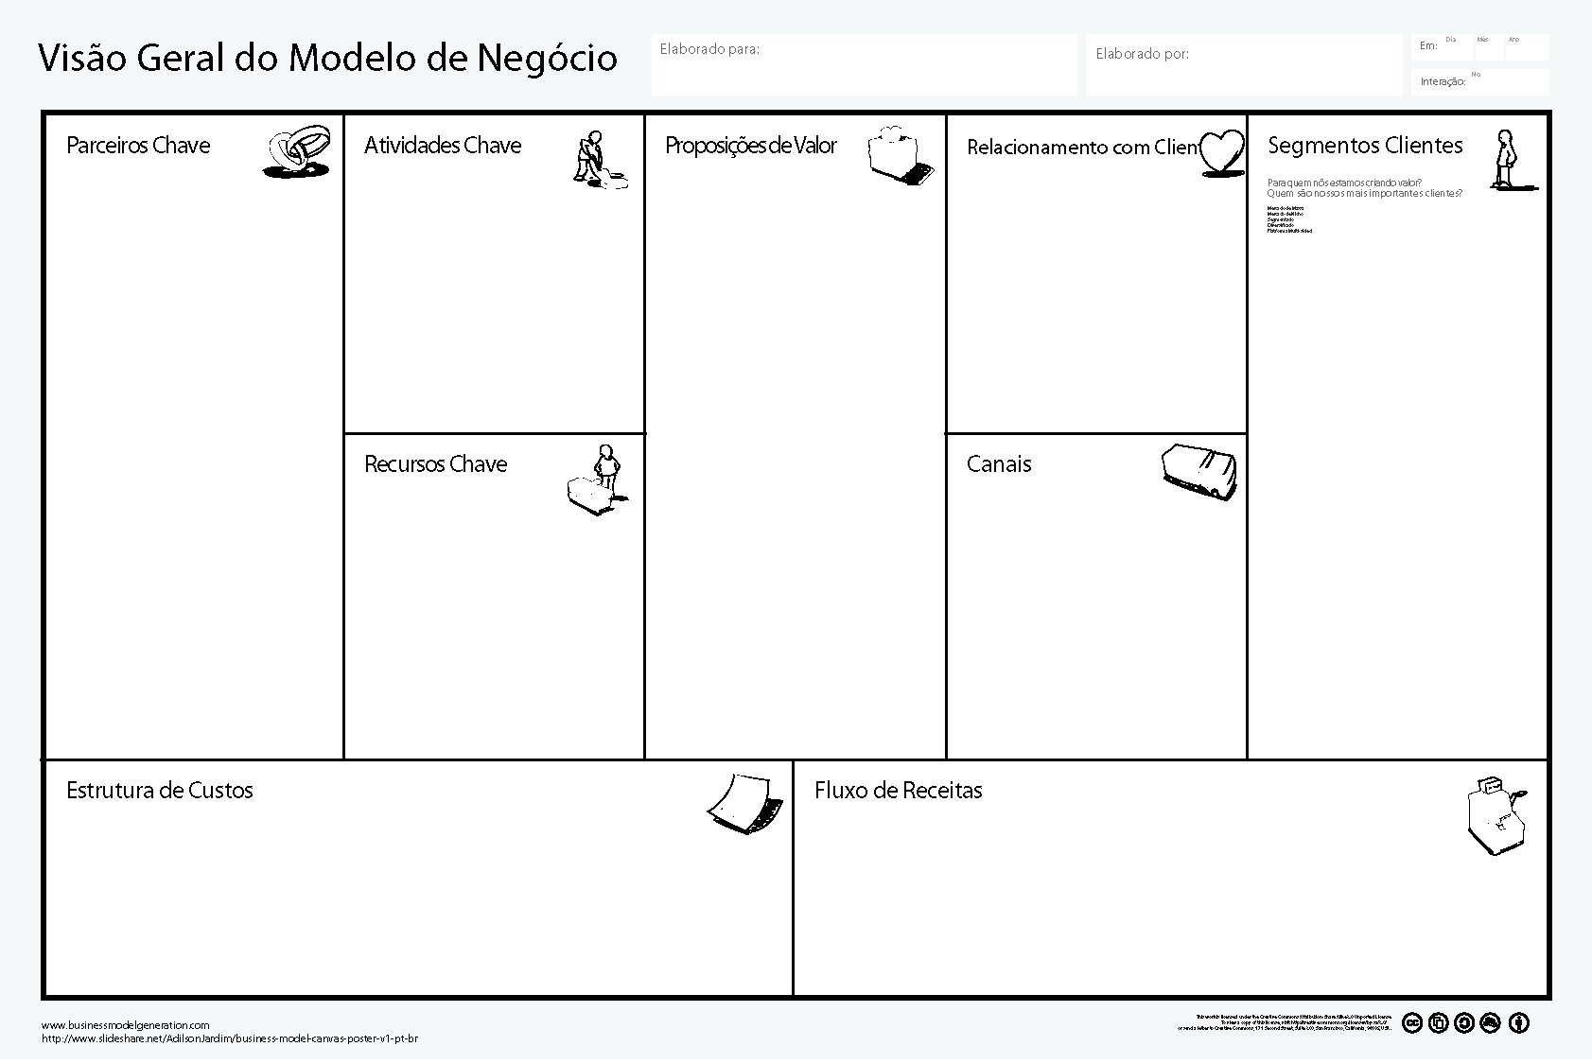
Helena Viera, PhD © 2017/2018

Slide 36

Individuals (Fans of Expresso)
Companies
Helena Viera, PhD © 2017/2018

Slide 37


Expresso at home like the caffé (no fuss, clean, easy and always right)
Individuals (Fans of Expresso)
Companies
Expresso at Company always good
Helena Viera, PhD © 2017/2018

Slide 38
Expresso at home like the caffé (no fuss, clean, easy and always right)
Individuals (Fans of Expresso)
Companies
Expresso at Company always good
retail shops
Order via mail
Nespresso.com
Order by phone
Nespresso shops
Helena Viera, PhD © 2017/2018

Slide 39
Expresso at home like the caffé (no fuss, clean, easy and always right)
Clube Nespresso
Individuals (Fans of Expresso)
Companies
Expresso at Company always good
retail shops
Order via mail
Nespresso.com
Order by phone
Nespresso shops
Helena Viera, PhD © 2017/2018

Slide 40
Expresso at home like the caffé (no fuss, clean, easy and always right)
Clube Nespresso
Individuals (Fans of Expresso)
Companies
Expresso at Company always good
retail shops
Order via mail
Nespresso.com
Order by phone
Nespresso shops
Sales of Nespresso Machines
Sales of Nespresso capsules
Helena Viera, PhD © 2017/2018

Slide 41
Distribution
“B2C”
marketing
Expresso at home like the caffé (no fuss, clean, easy and always right)
Clube Nespresso
Individuals (Fans of Expresso)
Production
Companies
Expresso at Company always good
retail shops
Order via mail
Nespresso.com
Order by phone
Nespresso shops
Sales of Nespresso Machines
Sales of Nespresso capsules
Helena Viera, PhD © 2017/2018

Slide 42

Distribution
“B2C”
marketing
Expresso at home like the caffé (no fuss, clean, easy and always right)
Clube Nespresso
Individuals (Fans of Expresso)
Production
Companies
Expresso at Company always good
retail shops
Distribution Channels
Order via mail
Nespresso.com
patents
Manufacturing facilities
Order by phone
Nespresso shops
Sales of Nespresso Machines
Sales of Nespresso capsules
Helena Viera, PhD © 2017/2018

Slide 43
Distribution
“B2C”
marketing
Expresso at home like the caffé (no fuss, clean, easy and always right)
Clube Nespresso
Individuals (Fans of Expresso)
Coffee machines manufacturers
Production
Companies
Expresso at Company always good
retail shops
Coffee grain suppliers
Distribution Channels
Order via mail
Nespresso.com
patents
Manufacturing facilities
Order by phone
Nespresso shops
Sales of Nespresso Machines
Sales of Nespresso capsules
Helena Viera, PhD © 2017/2018

Slide 44
Distribution
“B2C”
marketing
Expresso at home like the caffé (no fuss, clean, easy and always right)
Clube Nespresso
Individuals (Fans of Expresso)
Coffee machines manufacturers
Production
Companies
Expresso at Company always good
retail shops
Coffee grain suppliers
Distribution Channels
Order via mail
Nespresso.com
patents
Manufacturing facilities
Order by phone
Nespresso shops
Distribution
“B2C”
Sales of Nespresso Machines
Manufacturing
Marketing
Sales of Nespresso capsules
Helena Viera, PhD © 2017/2018

Slide 45


Slide 46
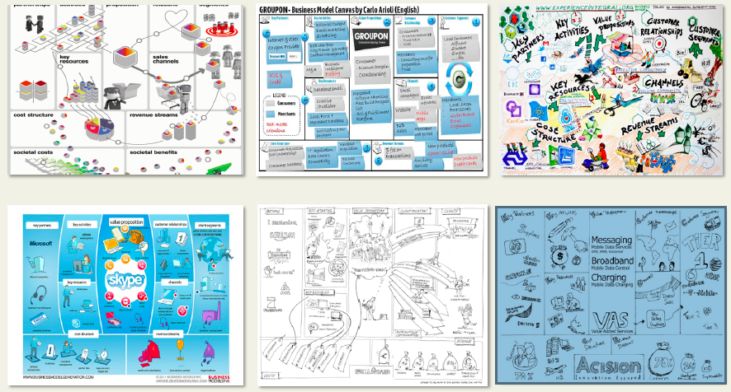
BMC – Universal Language!

Slide 47
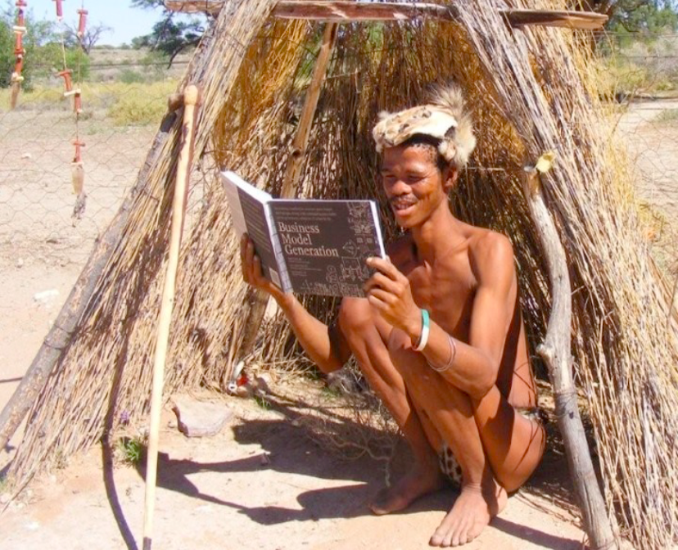

Slide 48
1
6
2
4
8
7
3
9
5

Slide 49
HOMEWORK EXERCISE & TEST
Draft your 1st BMC.
Helena Viera, PhD © 2017/2018

Slide 50
Notes:
Chega a gora de escolher o vosso modelo negócio.
Como é que o fazem?
A mensagem que tenho para vocês é esta...
Há imensas startups, principalmente, a partirem a cabeça a inventar uma maneira completamente nova de fazer negócio. O que acontece a maior parte das vezes é que baralham o cliente.
Keep it simple.
Vamos ver alguns modelos.

Slide 51
BUSINESS MODEL TYPES
ANALOGY | HOW IT WORKS
BROKERAGE | Bring together and facilitate transactions between buyers and sellers, charging a fee for each successful transaction.

Slide 52
BUSINESS MODEL TYPES
ANALOGY | HOW IT WORKS
CROUDSOURCING | Outsource tasks to a broad group who contribute content for free in exchange for access to other users’ content.

Slide 53
BUSINESS MODEL TYPES
ANALOGY | HOW IT WORKS
FREEMIUM | Offer basic services for free but charge for upgraded or premium services.

Slide 54
BUSINESS MODEL TYPES
ANALOGY | HOW IT WORKS
LEASING | Make high-margin, high-cost products affordable by having the customer rent them rather than buy them.

Slide 55
BUSINESS MODEL TYPES
ANALOGY | HOW IT WORKS
LOW-TOUCH | Offer low-price, low-service version of a traditionally high-end offering.

Slide 56
BUSINESS MODEL TYPES
ANALOGY | HOW IT WORKS
NEGATIVE OPERATING CYCLE | Generate high profits by maintaining low inventory and having the customer pay up front for a product or service to be delivered in the future.

Slide 57
BUSINESS MODEL TYPES
ANALOGY | HOW IT WORKS
PAY-AS-YOU-GO | Charge the customer for metered services based on actual usage metrics.

Slide 58
BUSINESS MODEL TYPES
ANALOGY | HOW IT WORKS
HOOK & BAIT (RAZORS/BLADES) | Offer the higher-margin “razors” for low or no cost to make profits by selling high-volume, low-margin “blades”.

Slide 59
BUSINESS MODEL TYPES
ANALOGY | HOW IT WORKS
REVERSE HOOK & BAIT (RAZORS/BLADES) | Offer the low-margin “blades” for low or no cost to encourage sales of the higher-margin “razors”.

Slide 60
BUSINESS MODEL TYPES
ANALOGY | HOW IT WORKS
SUBSCRIPTION | Charge the customer a subscription fee to gain access to a product or service.

