Slide 2
^{Eng Energy & Environment}

Slide 3
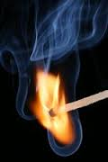
Combustion

Slide 4
Carla Silva (Teóricas e práticas) /Theory and practice
camsilva@ciencias.ulisboa.pt
Thursday
8h-12h 6.2.44
Watch recorded lessons
Doubts, experiments
4 assignements + oral evaluation

Slide 5
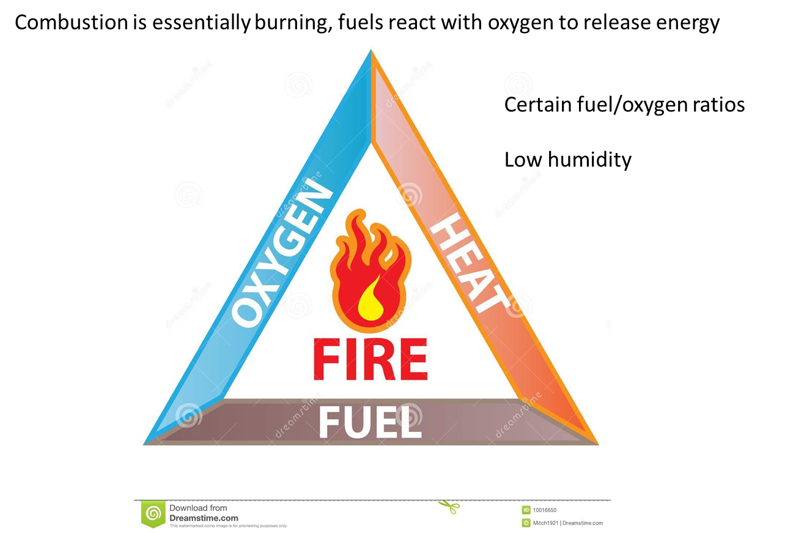
Combustion

Slide 6
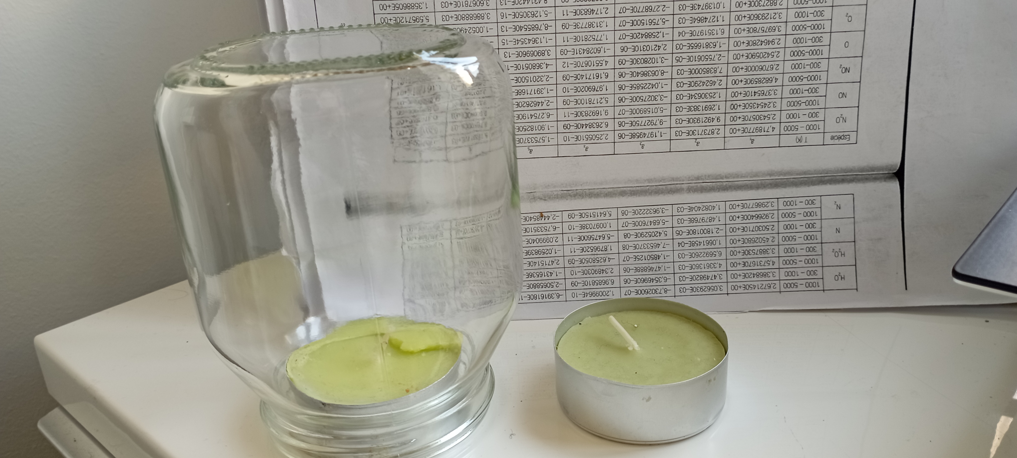
Candle (birthday, sent, etc)
Glass limiting

Slide 7
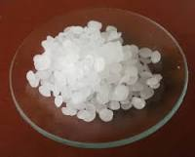
Candle (birthday, sent, etc)
Parafine wax C_{n}H_{2n+2}, n >=20
C₂₁H₄₄

Slide 8
Candle (birthday, sent, etc)
How much time does it take to burn 100 g of paraffin wax, based on experiments??
Volume??
C₂₁H₄₄
Burn stopped at …. s……

Slide 9
Candle (birthday, sent, etc)
How much time does it take to burn 100 g of paraffin wax, based on experiments??
1st Write chemical equation of complete combustion
C₂₁H₄₄ + a(O₂+3.76N₂)
bCO₂+cH₂O+dN₂
2nd Find a, b, c, d from mass balance
3rd find ratio mass of air to mass of fuel (A/F)mass and volume of air to volume of fuel (A/F)molar

Slide 10
Candle (birthday, sent, etc)
How much time does it take to burn 100 g of paraffin wax, based on experiments??
4th the volume of air consumed in 20 s was? That volume of air corresponds to mass of pV=mRT, T = 20ºC and P = 1 atm, using (A/F) the fuel consumed in 20 s is? And the ratio fuel/time is, for 100 g…..

Slide 11
Candle (birthday, sent, etc)
How much time does it take to burn 100 g of paraffin wax, based on experiments??
Ans:
C₂₁H₄₄

Slide 12
Candle (birthday, sent, etc)
C₂₁H₄₄
Products
Air
5th Represent mass balance
6th And candle from waste cooking oil??? Chemical composition???

Slide 13
Candle (birthday, sent, etc)
SOLID → LIQUID → GAS
Experiment…..weight candle, burn, weight at the end, control time, estimate the candle burning rate
25 - 30 hours per 100 g

Slide 14
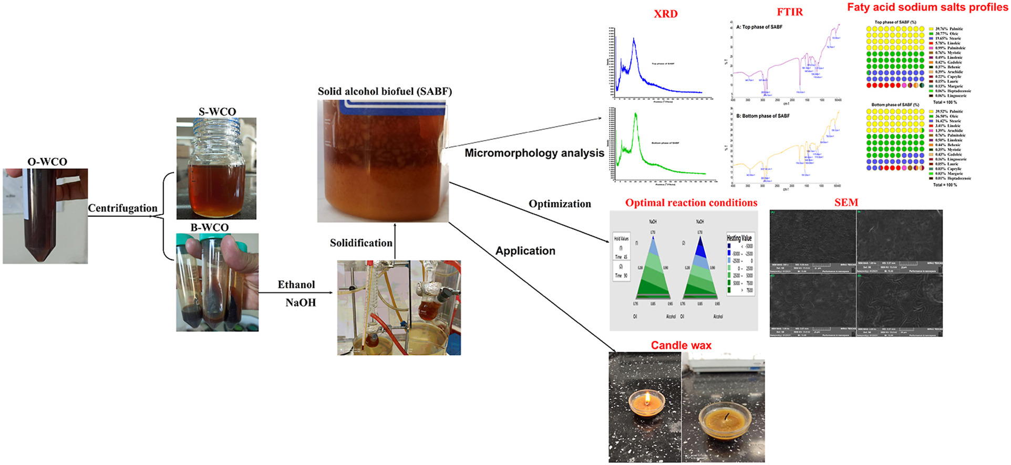
Candle (birthday, sent, etc)
Paraffin candle burning rate
Min/g??????
Waste cooking oil??
candle burning rate, A/F ratio

Slide 15
Candle (birthday, sent, etc)
DIFFUSION FLAME

Slide 16
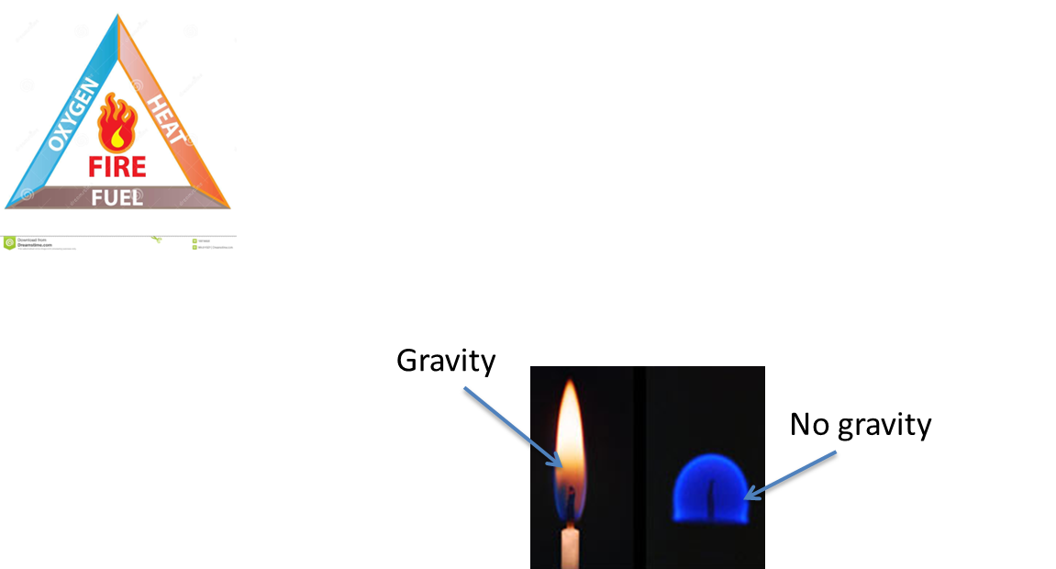
Candle (birthday, sent, etc)

Slide 17
Candle (birthday, sent, etc)
$$fuel+oxidizer→products$$
Air composition
_{21% O2 and 79% N2}
_{(by volume)}
$$C_{x}H_{y}O_{z}+n\left({0.21O}_{2}+0.79N_{2}\right)→xCO_{2}+y/2H_{2}O+0.79∗nN_{2}$$
λ=$\frac{\frac{A}{F}}{{\left(\frac{A}{F}\right)}_{s}}$ excess air coefficient
λ<1 No sufficient air; fuel is not completely burned
λ=1 Exact amount air, fuel is completely burned
λ>1 Excess air; fuel is completely burned
φ=$\frac{1}{\text{λ}}$ equivalence ratio
e(%)=$\frac{\frac{A}{F}−{\left(\frac{A}{F}\right)}_{s}}{{\left(\frac{A}{F}\right)}_{s}}$ *100%=$\frac{1−φ}{φ}$= excess air in %

Slide 18
1st assignment
Retrive the coal consumption, natural gas consumption and diesel for road, maritime and aviation consumption in the years 2017 to 2022. (DGEG - https://www.dgeg.gov.pt/pt/estatistica/energia/petroleo-e-derivados/vendas-mensais/
https://www.dgeg.gov.pt/pt/estatistica/energia/gas-natural/consumos/
https://www.dgeg.gov.pt/pt/estatistica/energia/carvao/consumos/)
Coal is mainly used where?
Natural gas is mainly used where?
Coment COVID-19 impact, coal powerplant deactivation and decarbonization targets Effect on the evolution of fóssil fuel consumption.
excel and pdf 10 min presentation until 2 March

Slide 19
1st assignment
55366 Ana Catarina Pereira Brioso
54868 Duarte Elias Fernandes Gomes da Costa
55494 Evanilson Da Luz Gomes
51520 Francisco Dias Roque
54872 Gonçalo João Ferro Fernandes
54885 Ivan Nery Brito Ramos
56818 João Guilherme Carvalho dos Reis Silva Vasconcelos
57000 José Maria Felkai Galamba de Oliveira
56817 Leonor Diogo Reigada
55410 Liliany Marcelino dos Santos
56809 Manuel Jorge Reis de Sousa
56803 Margarida Fonseca Cavaleiro
56804 Miguel Afonso Mendes Santa-Rita
54675 Pedro Afonso da Silva Pereira Graça
54876 Pedro Manuel Valadas Bastos
52040 Rodrigo Concórdio dos Reis
56826 Santo Giuseppe Coccoluto Pestana
54660 Tomás Chora Castelo Ramos
2 March - 10 min presentation each

Slide 20
^{Thanks}

