Slide 1
INOVAÇÃO, EMPREENDEDORISMO E TRANSFERÊNCIA DE TECNOLOGIA
FCUL – 2018/2019
Mestrado em Microbiologia
IST/FCUL
AULA 7
30 OUTIBRO 2018
Helena Vieira
Copyright ©

Slide 2
1st K2B PITCH
VALUE PROPOSITION & BUSINESS CONCEPT

Slide 3
INNOVATION & NPD
FreshTEC - Revolutionizing Fresh Produce
Case study

Slide 4
FRESHTEC HBS CASE STUDY
3 parts
1 defends 1 opinion (founder)
1 defends other opinion (CEO)
1 acts as investors

Slide 5
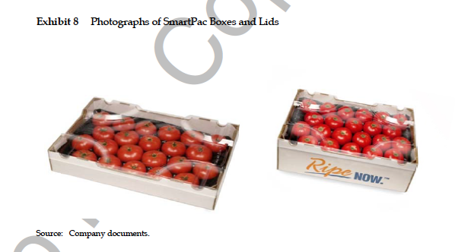

Slide 6
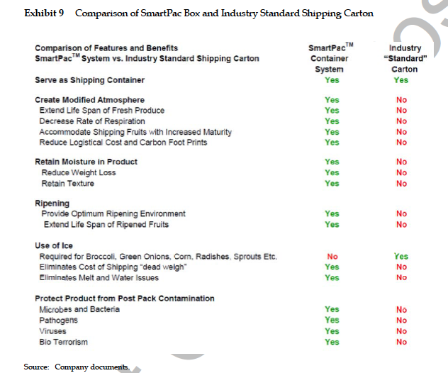

Slide 7
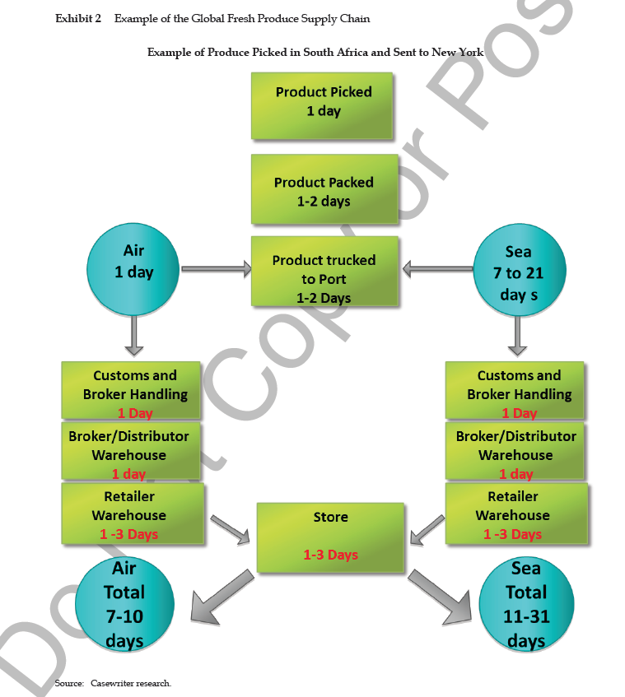

Slide 9
