Slide 1
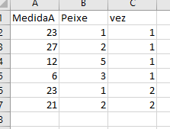
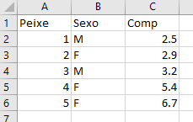
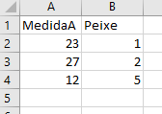
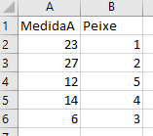
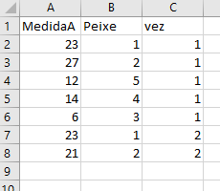
Task about merging data.frames
+
?
This task teaches you to join or merge data in different files, provided there is a common field that allows the merging

Slide 2
Explore the file “Data4merge.xlsx”
You have data on 5 fish (worksheet peixes), and then 4 examples of possible measures about those fish (in some all the fish were measure, in some not, in some some fish were measured more than once)
For your convenience, each of these excel worksheets was saved as a separate .txt file
Explore the use of function merge, and arguments by, all.x and all.y, so that you end up with a table that:
Includes each of the combinations of the 4 worksheets

