Slide 1
A Study on Data Policies in the Portuguese Public Administration in the context of SNIG
Alexandra Fonseca, Raquel Saraiva, Paulo Patrício, Mário Caetano

Slide 2
Goal
This presentation focuses on a study on Data Policies in Portugal that performed:
An overview of the legal framework and best practices for data and service sharing at the national and international level
Special focus on Open Data practices was given, considering the SNIG 2020 Vision main orientations.
A Survey on the present situation of SNIG entities in what concerns their data policies.

Slide 3
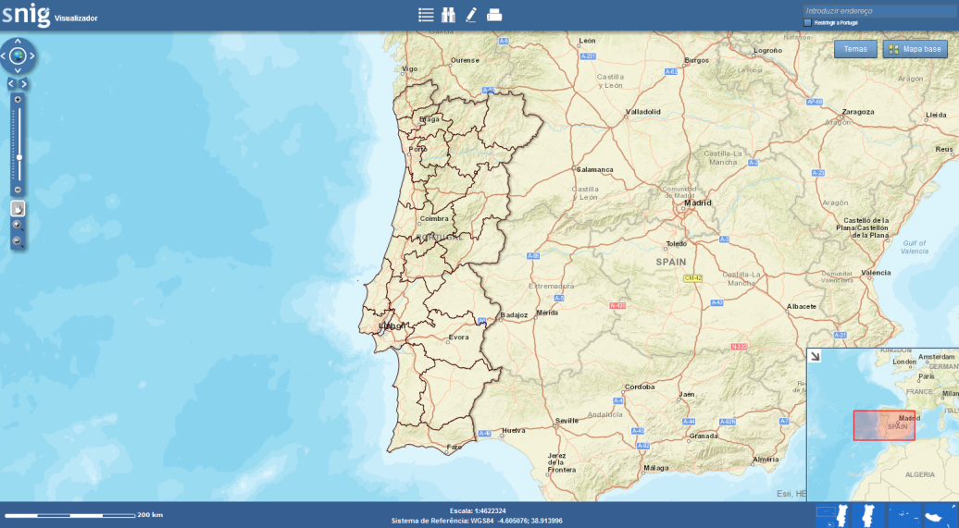
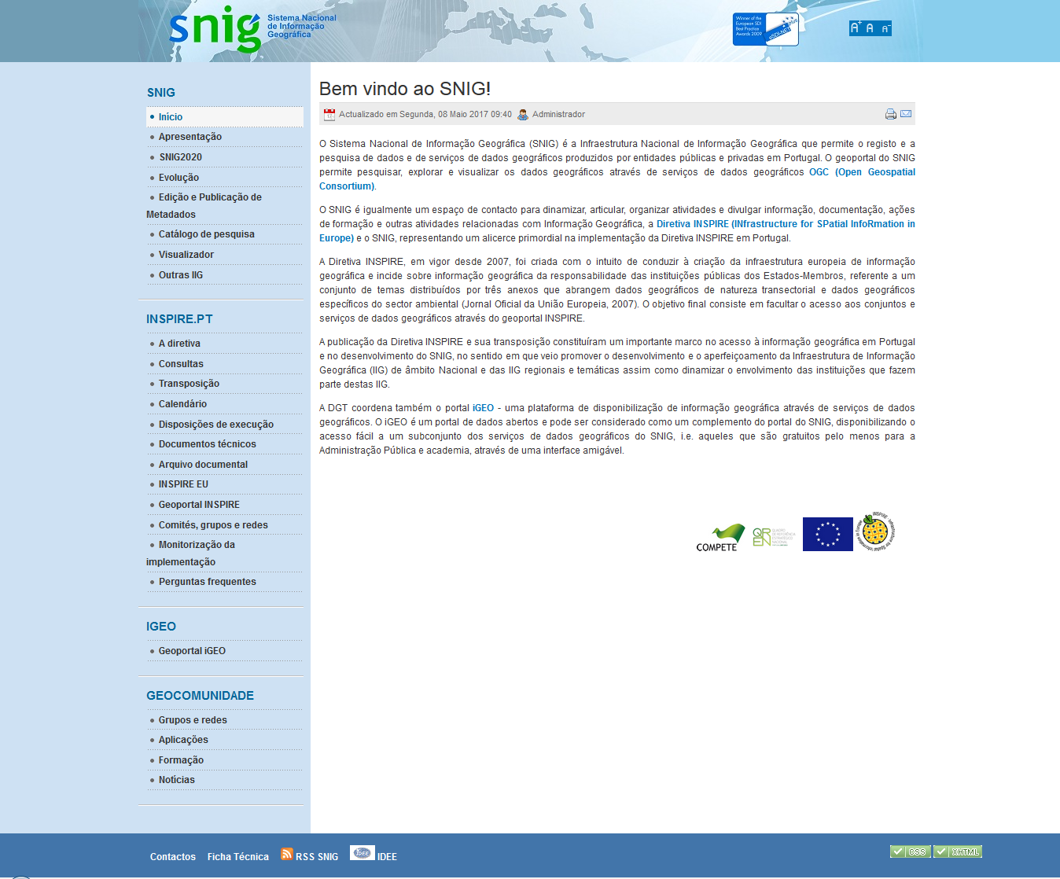
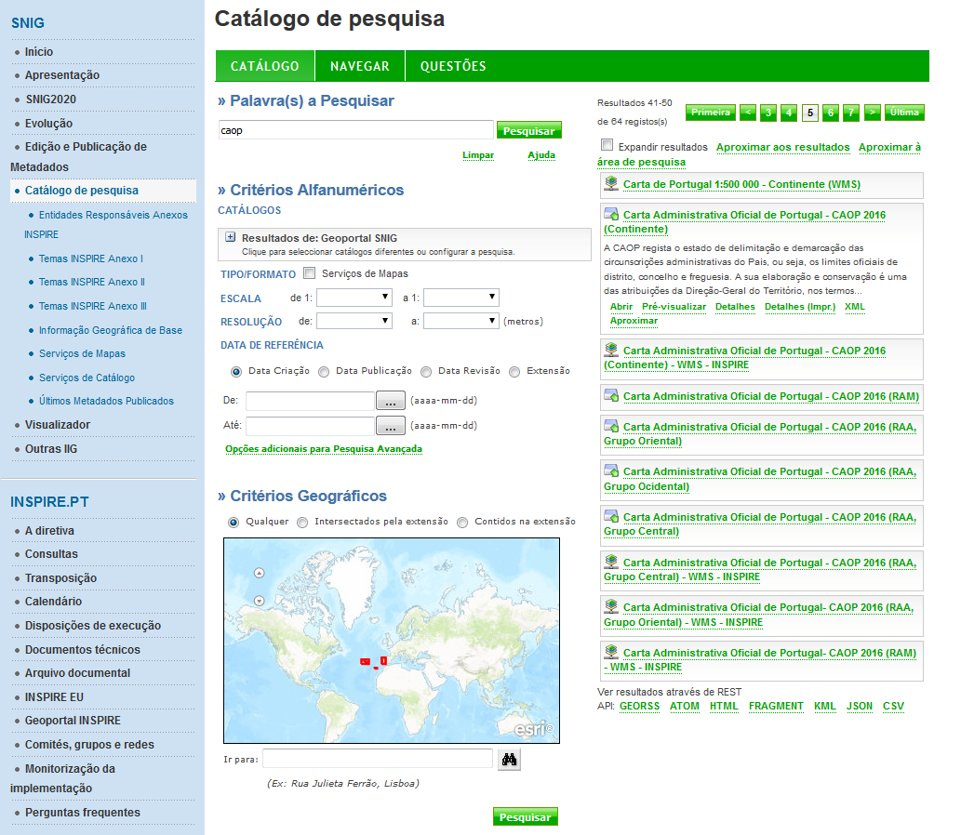
SNIG is the Portuguese National Spatial Data Infrastructure (NSDI) which is available on the Internet since 1995.
http://snig.dgterritorio.pt

Slide 4
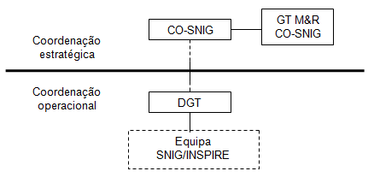
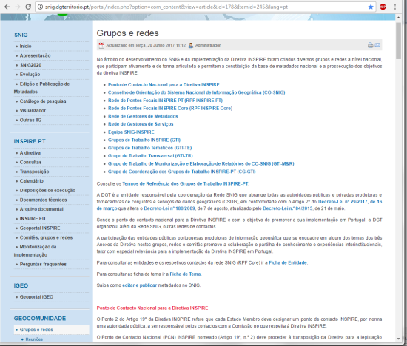
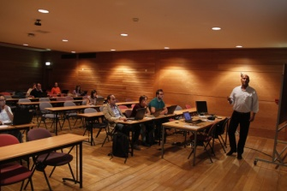
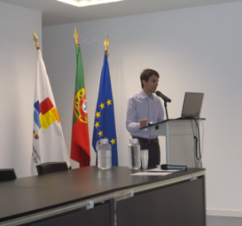
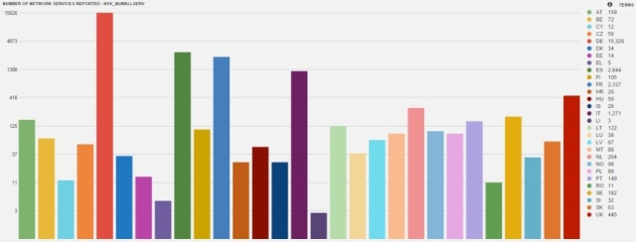
Ever since INSPIRE Directive entered into force in 2007 major efforts have been developed in Portugal to promote INSPIRE implementation activities
Setting the main organizational and operational structures involving the geographic data producers and users, most of them already involved in SNIG for several years.
Dissemination and capacity building on INSPIRE issues.
Metadata creation and compliance.
INSPIRE monitoring and reporting involving annually the main national geographic information (GI) data producers progressively getting involved in the development of services and in the discussion of data harmonization requirements and problems.
INSPIRE Focal Points Network
Metadata Managers Network
Thematic Working Groups
Horizontal Working Group
M&R Working Group

Slide 5
Since 2015 a strong emphasis is being given to participated and collaborative processes for SNIG development and INSPIRE implementation
2016
SNIG 2020 Action Plan
2014
SNIG Geoportal Renovation / iGEO Portal
2006
SNIG Geoportal
1986
Working Group for the creation of CNIG
1990
Creation of SNIG
1995
SNIG on the Internet
2004
Metadados Editor
2015
SNIG 2020 Vision
2001
ESDI Initiative
2008
Reformulation
1990
Creation of CNIG
2002
Creation of IGP
2007
INSPIRE Directive
2012
Creation of DGT
2017
Decreto-Lei 29/2017
2009
Transposição Diretiva INSPIRE
2017
New Geoportal

Slide 6
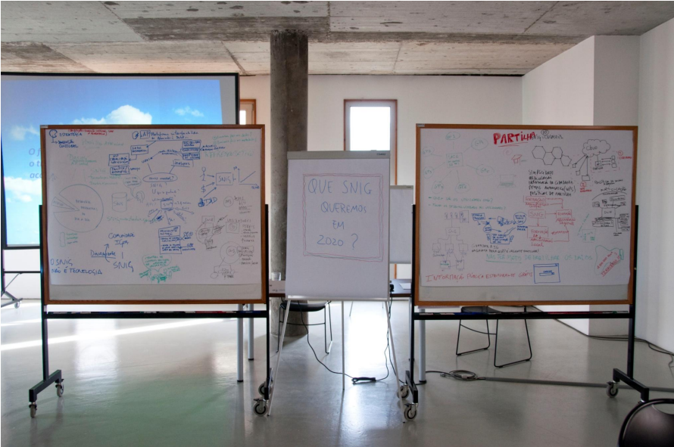
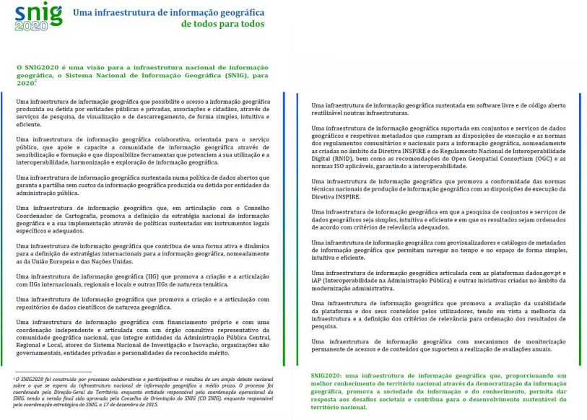
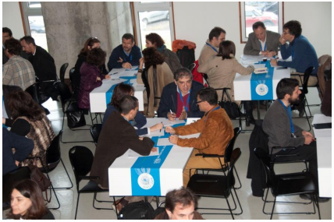
SNIG 2020 vision
Approved by CO-SNIG
A Spatial Data infrastructure based on an open data policy ensuring the free of costs sharing of geographic information produced by public administration entities.

Slide 7
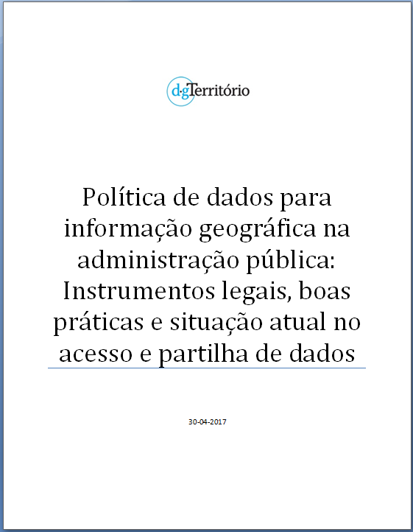
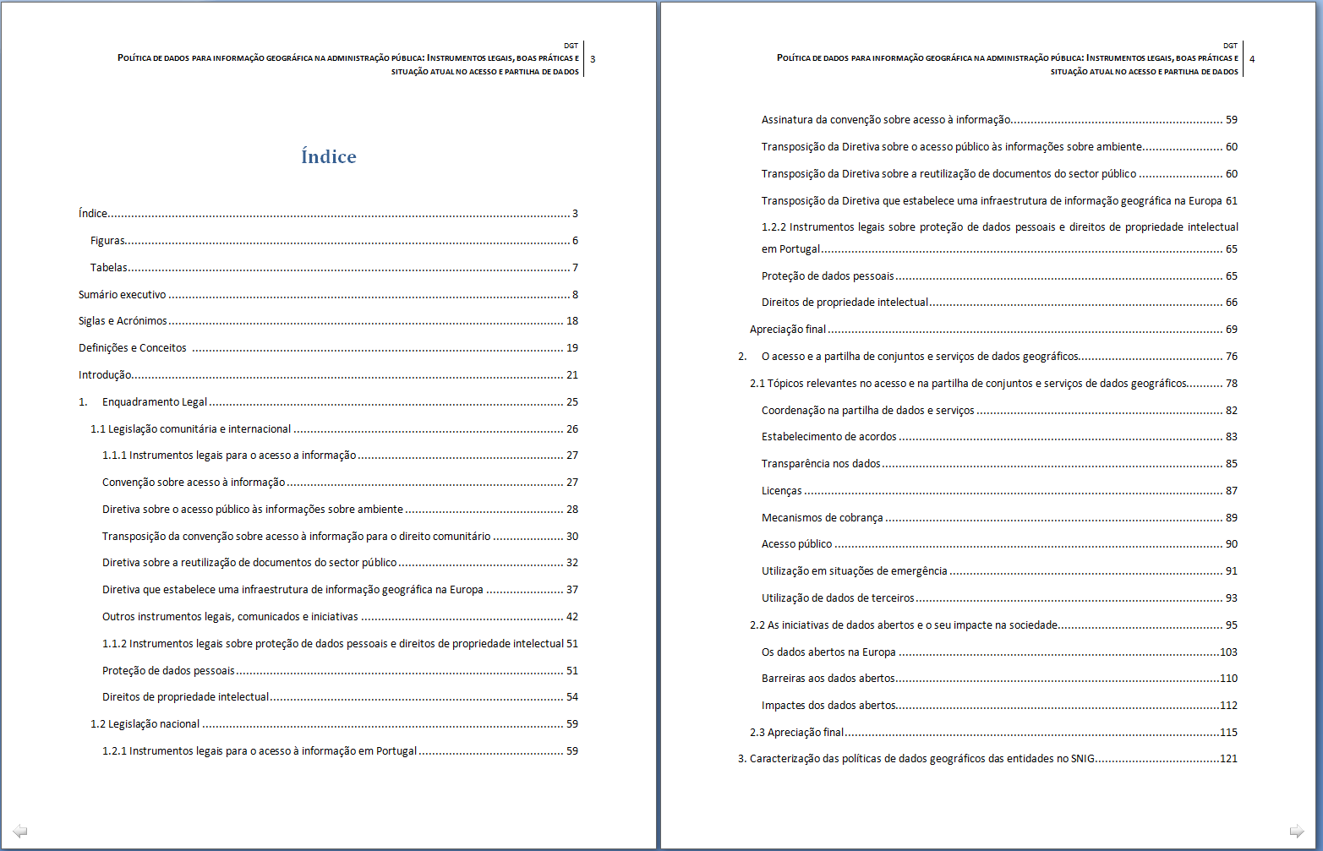
A Study on Data Policies in the Portuguese Public Administration in the context of SNIG
A Study on Data Policies in Public Administration was developed, which aims to support the definition of a Data Policy for SNIG to be adopted by SNIG entities.

Slide 8
A Study on Data Policies in the Portuguese Public Administration in the context of SNIG
Legal Instruments
Data Policy
Data Policies from the RPF INSPIRE CORE NetworK Entities
Data Sharing Good Practices

Slide 9
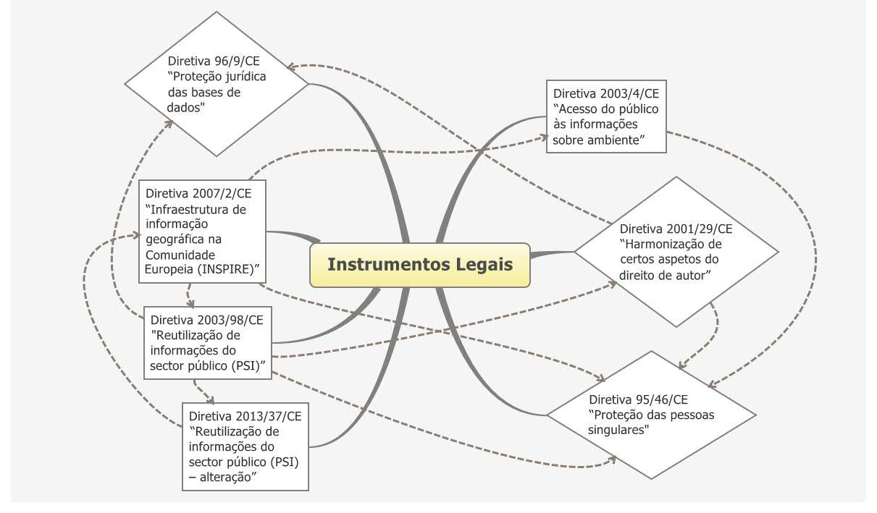
Legal Instruments
Data Policy
Legal Instruments
Data Sharing Good Practices
RPF INSPIRE Entities Data Policies
Legal Protection of
Databases Directive
DL 122/2000
Public Access to
Environmental
Information Directive
(Aarhus)
Lei 19/2006
INSPIRE
Directive
IPR
harmonization
Directive
DL 180/2009
DL 84/2015
DL 29/2017
Lei 50/2004
Re-use of
PSI Directive
Lei 46/2007
Protection of individuals personal data Directive
Lei 67/1998
DL 214-G/2015
Re-use of
PSI Directive
LI access and reuse
LI data protection and IPR

Slide 10
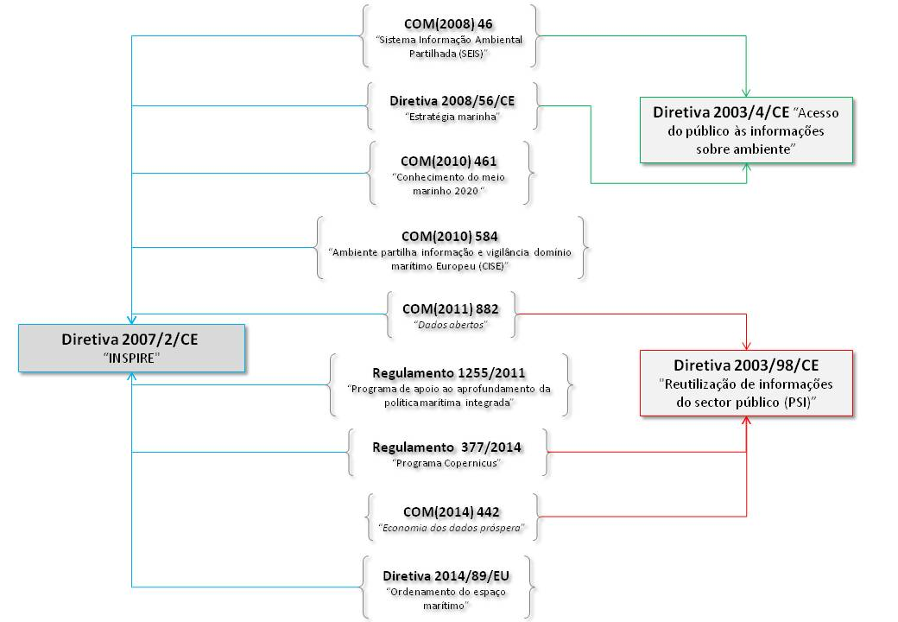
Legal Instruments
Data Policy
Legal Instruments
Data Sharing Good Practices
RPF INSPIRE Entities Data Policies
Aarhus
INSPIRE
PSI

Slide 11
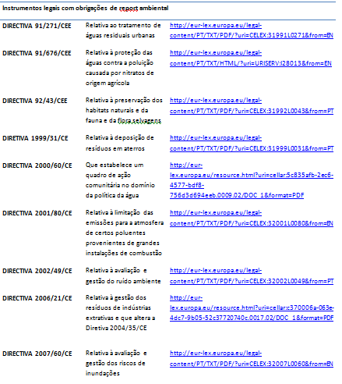
Legal Instruments
Data Policy
Legal Instruments
Data Sharing Good Practices
RPF INSPIRE Entities Data Policies
There are numerous legal instruments related to the access and reuse of information, referring to environmental reporting obligations that involve data sets relevant to the INSPIRE Directive.

Slide 12
Data Sharing Good Practices
Data Policy
Legal Instruments
Data Sharing Good Practices
RPF INSPIRE Entities Data Policies
The study on data sharing good practices focused:
The data sharing and access definitions highlighting the topics and key points for efficient data and service sharing;
Good examples in accessing and sharing geographic data at the international and national levels;
The importance of new open data initiatives for the geographic information user community and the economic impact of these initiatives on society.
Germany
Belgium
Denmark
Spain
Finland
France
Netherlands
Hungary
Italy
Norway
United
Kingdom
Sweden
Public
access
Public
access
Public
access
Public
access
Coordination
Licenses
Licenses
Agreements
Coordination
Agreements
Agreements
Coordination
Licenses
Third Party
Data
Public
access
Transparency
Licenses
Agreements
Emergency
Third Party
Data
Charging
Transparency
Third Party
Data

Slide 13
Data Sharing Good Practices
Data Policy
Legal Instruments
Data Sharing Good Practices
RPF INSPIRE Entities Data Policies
Coordination (of data and service sharing)
Framework Agreements (defining access and use conditions)
Transparency on the data (availability of relevant information on the data)
Licences (tools to specify the agreements’ terms)
Charging mechanisms (pricing policy)
Public access (public access to data and metadata)
Emergency Use (use of the data in case of natural disasters,…)
Third party data(use of third party data, OSM...)
K
e
y
P
o
I
n
t
s
Geo-geoss, Copernicus, One Geology, EUMETSAT, Geoplatform,
British Geological survey, Danish SDI

Slide 14
Data Sharing Good Practices
Data Policy
Legal Instruments
Data Sharing Good Practices
RPF INSPIRE Entities Data Policies
Data Sharing Good practices examples
Initiative Topic
Agree
ments
Transparency
Licenses
Charging
Public
Acess
Emergency
Third Party
Data
Coordination
GEO-GEOSS
Copernicus
One Geology
EUMETSAT
Geoplatform
British Geological Survey
IIG Dinamarquesa
Open data
Initiative | Link | Brief description
Open Knowledge Foudation | https://okfn.org/ | Worldwide non-profit network
European Union Open Data Portal | http://data.europa.eu/euodp/en/data/ | Point of access to data sets from institutions and other bodies of the European Union
Open Access in Horizon 2020 | https://www.openaire.eu/open-access-in-horizon-2020 | Initiative to make the data resulting from the Horizon 2020 projects, open, interoperable and reusable
Digital Single Market | https://ec.europa.eu/commission/priorities/digital-single-market_en | Single market to ensure the free movement of goods, capital, services and persons within the European Union
PSI directive | https://ec.europa.eu/digital-single-market/en/european-legislation-reuse-public-sector-information | Re-use of public sector information

Slide 15
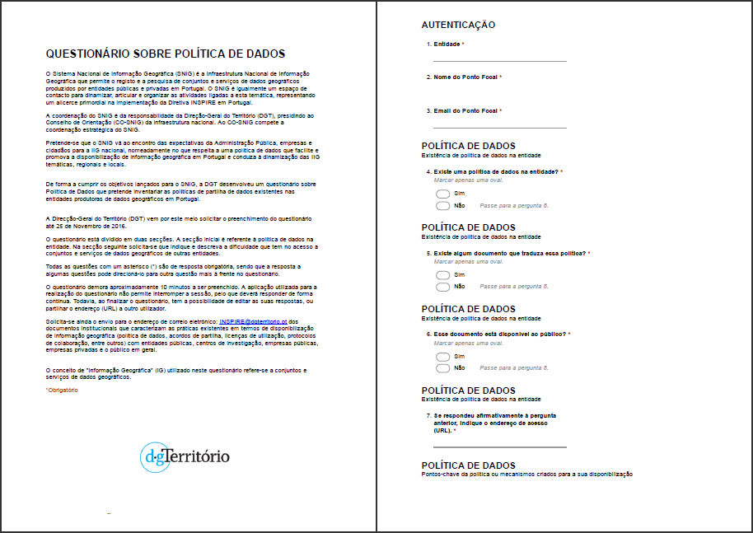
RPF INSPIRE CORE Network Entities Data Policies
Data Policy
Legal Instruments
Data Sharing Good Practices
RPF INSPIRE CORE Entities Data Policies
A questionnaire was prepared for SNIG public authorities focusing on the following issues:
Data Policy existence
Key points of the data policy or of the delivery mechanisms
GI Data Sharing documents
GI data access conditions
GI delivery (type of requests, response time , format, delivery support, type of data)
Feed-back on Public Administration GI data sharing present situation
Existence of restrictions to access and use GI data from other entities
Online survey on data sharing policies

Slide 16
RPF INSPIRE CORE Network Entities Data Policies
Data Policy
Legal Instruments
Data Sharing Good Practices
RPF INSPIRE CORE Entities Data Policies
53% of the entities that answered the questionnaire claimed to have a data policy, but only a small percentage have a document that characterizes this policy.
Data Policy Key points
The vast majority of entities identified as the fundamental key point for effective sharing and access to geographic information, the establishment of agreements.
Framework Agreements
It is more frequent the use of collaboration protocols for the sharing of geographic information between public entities.
There is still little cooperation among Public Administration institutions on data costs sharing.

Slide 17
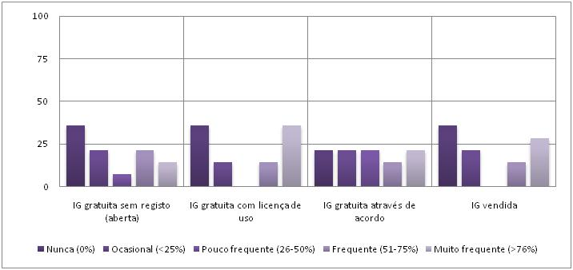
RPF INSPIRE CORE Network Entities Data Policies
Data Policy
Legal Instruments
Data Sharing Good Practices
RPF INSPIRE CORE Entities Data Policies
Frequency with which the GI is generally made available to third parties according to the type of user
It is frequent to make GI available to public entities.
There are still entities that never make information available to the general public.
The availability of GI to companies (both public and private) is practiced by almost half of the entities on a frequent basis.
The availability to the research centers is made more occasionally.
Frequency with which the GI of the entity is made available to third parties according to the conditions of access
The free availability with use license is the most frequent.
For 38% of the entities it is frequent selling GI

Slide 18
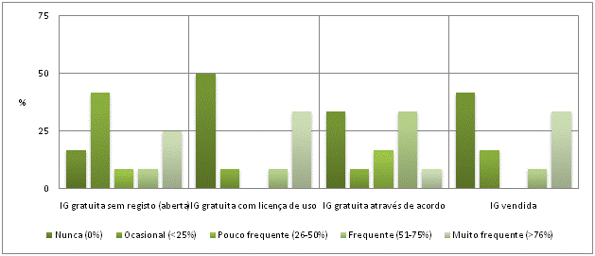
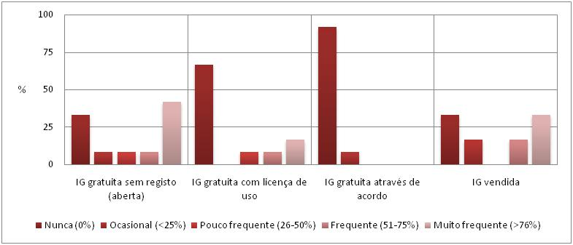
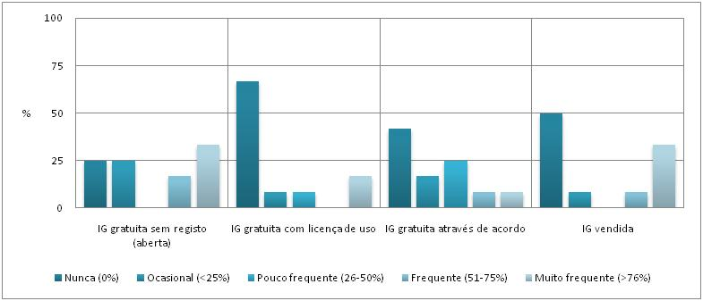
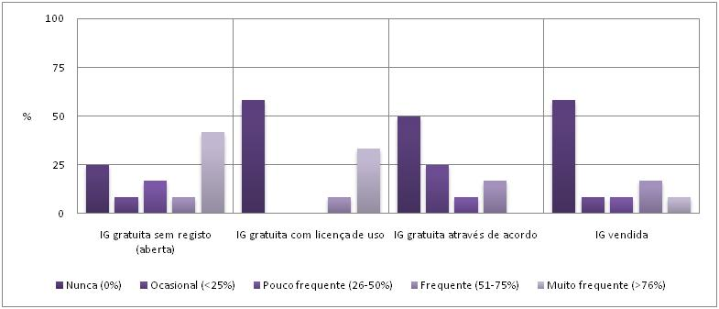
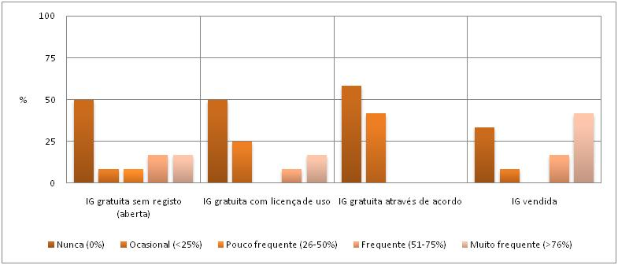
RPF INSPIRE CORE Network Entities Data Policies
Data Policy
Legal Instruments
Data Sharing Good Practices
RPF INSPIRE CORE Entities Data Policies
Frequency of GI made available according to the conditions of access:
to public entities
There is a greater frequency of availability of geographic information to public entities for free, through the use of a license, followed by the access and use through the payment of fees.
Availability to the general public is preferably done openly, without registration.
Research centers to GI is more often available by agreement or openly, and the widespread sale of geographic information for this type of user is not common.
For public companies, frequently occur GI availability both open and free of charge as well as through sale. For private companies the availability of GI is made more often through sale, and the availability for free is uncommon.
to the general public
to public companies
to research centers
to private companies

Slide 19
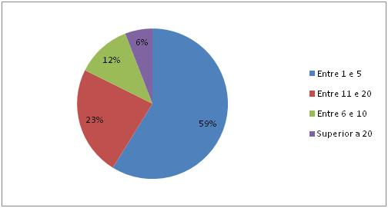
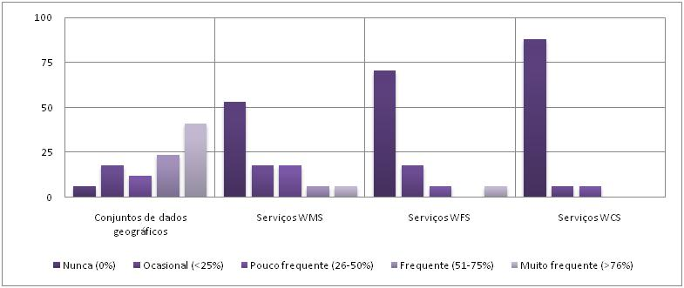
RPF INSPIRE CORE Network Entities Data Policies
Data Policy
Legal Instruments
Data Sharing Good Practices
RPF INSPIRE CORE Entities Data Policies
Regarding the average time available for the provision of geographic information to third parties, the vast majority of entities reported that the availability is usually between 1 and 5 working days.
As for the format of availability of geographic information, the vast majority of entities reported being sporadic or occasional the availability of geographic information through network services, with a greater frequency of the direct availability through geodatabase or shapefile datasets.
SNIG entities also mentioned difficulties in accessing to specific datasets and services from other public entities due to the high costs of the information or to problems in identifying or interpreting the applicable data policies.

Slide 20
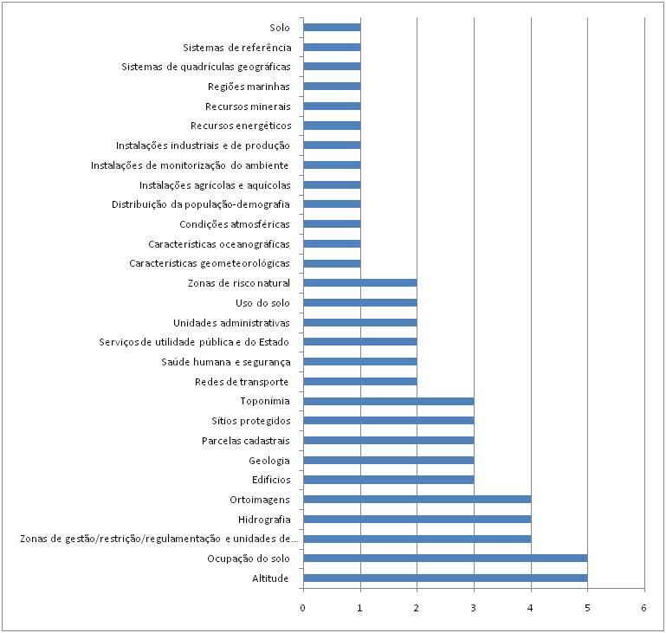
RPF INSPIRE CORE Network Entities Data Policies
Data Policy
Legal Instruments
Data Sharing Good Practices
RPF INSPIRE CORE Entities Data Policies
INSPIRE Annex Themes in which fits the information most sought by third parties
29 of the 34 INSPIRE Annex themes were identified by the entities.
The most referred INSPIRE Annex themes were :
Altitude (II.1)
Land cover (II.2)
Management / restriction / regulation areas and reference units (III.11),
Hydrography (I.8)
Orthoimages (II.3)

Slide 21
Conclusions
There are still many barriers to efficient information sharing in public administration in Portugal.
The study of on legal instruments and good practices on data and services sharing under the INSPIRE Directive and other approaches has made it possible to take stock of the situation at European and world/international level and to highlight key points for effective access and sharing of data.
Through the on-line survey it was verified that the SNIG entities do not evidence having a clear and meaningful data policy. Although 53% of the entities claim to be data policy holders, only a small percentage claim to have and provide a document characterizing that policy.
Key points for effective sharing and access to geographic information are the establishment of agreements, followed by bilateral protocols for data sharing between public administration entities.

Slide 22
Conclusions
There is a differentiation in the conditions of access according to the type of user and the type of information being the main criteria presented for the differentiation, the confidentiality and protection of personal data, the representation scale, the thematic detail and the study area.
The sale of GI among public entities is very frequent, a situation that should be the subject of debate and ample reflection on both the GI community and CO-SNIG.
The vast majority of entities reported being infrequent or occasional the availability of geographic information through spatial data services.
In general, the entities agree that it is necessary to create a specific legal basis for Public Administration in Portugal that establishes a simplified agreement for the sharing of geographic information without restrictions of access and use, free of costs, with a view to the development of public nature tasks.

Slide 23
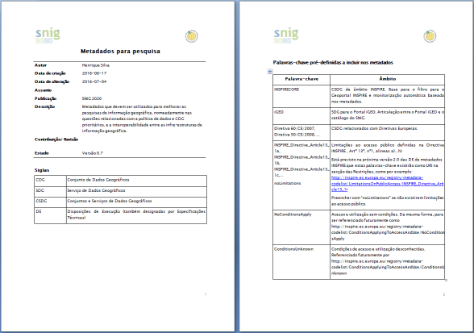
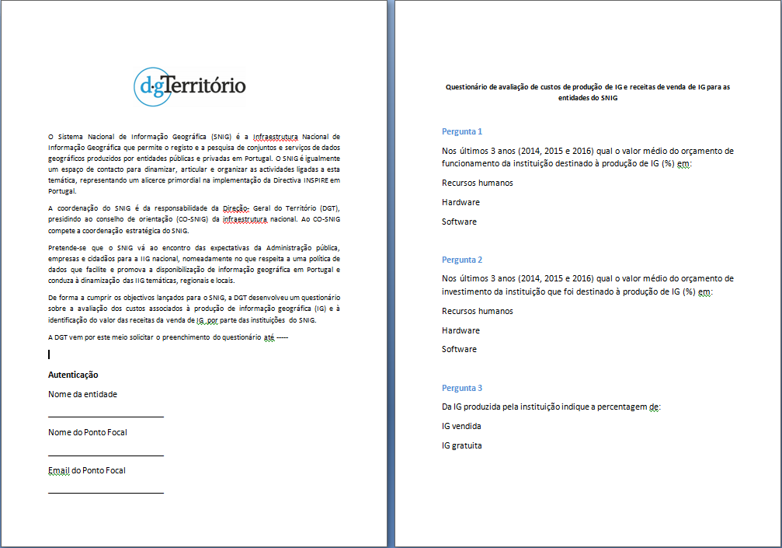
Next steps
SNIG aims to continue to evolve to an open, flexible, interoperable and participated SDI, able to guarantee an effective and reliable access to spatial data and services provided by public authorities in Portugal.
SNIG Data Policy Strategy discussion at CO-SNIG
Definition and adoption of a data sharing license template for SNIG
Updating of Data Policy fields in SNIG metadata catalogue
Survey on GI sales revenue

Slide 24
THANK YOU
Alexandra Fonseca
afonseca@dgterritorio.pt

