Slide 1
AuLA 22 11 2018
Modelação EcoLÓGICA
Aula 10 TP 7

Slide 2
Today’s Menu
FT3 – modelos de regressão (Modelos de base estatistica)
COLLECT SOME DATA? (if you are feeling bored!)

Slide 3
COLLECT SOME DATA
MATERIAL REQUIRED: (MANY FAKE MINIATURE) ANIMALS, 1 watch, 1 pencil, 1 ShEET of paper
Prepare tables with ANIMALS FOR THE “PREDATORS” to hunt
1 Table with just 10 animals, 1 with 20, one with 30, one with 40, one with 50, one with 60… (have as many tables as groups of 2 persons).
Then taking turns AT EACH TABLE, each group will RECORD, FOR EACH OF THE GROUP MEMBERS WITH THE EYES CLOSED, TRYING TO CAPTURE AN ANIMAL BY:
TOUCHING THE TABLE WITH THE OPEN HAND, THE NUMBER OF TIMES YOU NEED TO GET 3 ANIMALS (call this nt)
THE TIME IT TAKEs to GET tHE SAME 3 ANIMALS BY MOVING THE HAND OVER THE TABLE (Call this T)
PLOT tHE DATA (NUMBER OF TIMES NEEDED / TIME NEEDED as a FUNCTION OF THE NUMBER OF ANIMALS ON THE TABLE (call this N)
FIT MODELS TO THE DATA TO EXPLAIN THE RELATION BETWEEN THESE VARIABLES

Slide 4
What might one expect
Valor máximo condicionado pelo tempo médio que leva a encontrar os únicos 3 animais que lá estão, quando N=3
+
T or NT
Valor mínimo condicionado pelo tempo médio que leva a encontrar 3 animais quando N tende para infinito
-
-
N
+

Slide 5
Data for each group: format
Mesa | Person | C1 | C2 | C3 | T1 | T2 | T3
15 | 19549 | 1 | 2 | 4 | 1.2 | 1.8 | 2.7
30 | 19549 | 1 | 5 | 5 | 1.3 | 2.1 | 2.3
50
60
70
80
100
140
160
Um animal na vez 1 e 2 animais na vez 5, 1.3 segundos até ao 1º animal, mais 0.8 segundos até ao 2º, mais 0.2 até ao 3º
OLD FORMAT: Send me by email as a .csv (make in Excel, save as csv – file name = N???.csv, where ??? was the number of animals in your table, e.g. if you were table with 20 animals, N020.csv)
NEW FORMAT: SEE NEXT SLIDE

Slide 6
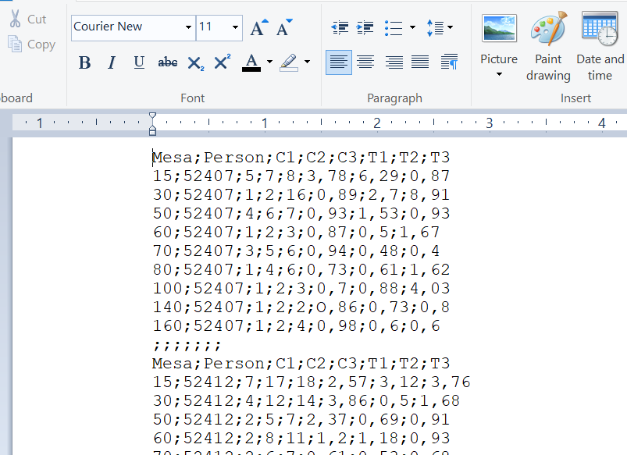
Import the data using the format shown in the previous file into R. CREATE A SINGLE OBJECT named N??? THAT CONTAINS THE DATA: THEN CREATE A TXT FILE NAMED N???.TXT, where the ??? Is the table number as before. THEN, EXPORT IT AS
And then email me the XLSX AND THE TXT fileS created!
DO NOT REPEAT NAMES OF COLUMNS
INSIDE THE DATA FILE;
DO NOT LEAVE BLANK LINES EITHER!
write.table(n???, file=“N???.txt”,quote=FALSE,row.names=FALSE)
NO!

Slide 7
For next Classes
Practice R and modelling in R

