Slide 1
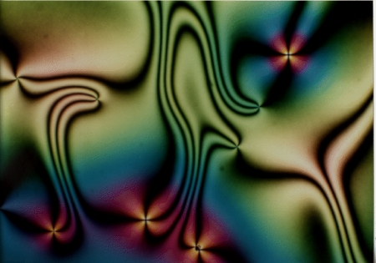
A Short Intro to Liquid Crystals (A part of the Soft Matter lecture class)
M. Tasinkevych
In the Department of Physics at Lisbon University
March, 2021

Slide 2
A brief historic overview
1888: Friedrich Reinitzer observed “two melting points “ in cholesteryl benzoate. At 145.5°C it melts to a milky liquid. At 178.5°C it melts again and liquid becomes clear
1890: Otto Lehmann identified a new and distinct state of matter - the „flowing crystal phase“
1922: Georges Friedel established the names of the three liquid crystalline phases:
nematic, smectic and cholesteric
Next 30 years: The scientific community gradually losses interest in LC materials, which were considered as an interesting, but essentially useless, laboratory curiosity
End of 1960s: Suggestion of cholesteric LCs as temperature indicators, analytical metrology, cancer diagnostics and non-destructive testing of materials
1968: George Heilmeier first prototype of a LCD
1970-71: Fergason, Schadt, Helfrich: Invention of the twisted nematic (TN) cell
$→$ extensive R&D efforts in LC materials and LCDs all over the world
1980s-1990s: LCDs replace conventional display devices in many applications
$→$ portable PCs, mobile telephones, electronic toys
Today: broad applications in display technology, high modulus fibres and opto-electronic devices
Notes:
1. F. Reinitzer: Austrian Botanist and Chemist In late 1880s, experimenting with cholesteryl benzoate, he discovered properties of liquid crystals (named later by Otto Lehmann).
2. Otto Lehmann (physicist): Otto used polarizers in a microscope so that he might watch for birefringence appearing in the process of crystallization.
(Birefringence is the optical property of a material having a refractive index that depends on the polarization and propagation direction of light.^{[1]} These optically anisotropic materials are said to be birefringent (or birefractive). The birefringence is often quantified as the maximum difference between refractive indices exhibited by the material.)
Lehmann received a letter from Friedrich Reinitzer asking for confirmation of some unusual observations. As Dunmur and Sluckin(2011) say
“
It was Lehmann's jealously guarded and increasingly prestigious microscope, not yet available off the shelf, which had attracted Reinitzer's attention. With Reinitzer's peculiar double-melting liquid, a problem in search of a scientist had met a scientist in search of a problem.”
The article "On Flowing Crystals" that Lehmann wrote for Zeitschrift für Physikalische Chemie addresses directly the question of phase of matter involved, and leaves in its wake the science of liquid crystals.
3. Friedel contributed his Mesomorphic States of Matter to the Annales des Physiques in 1922. This two-hundred-page work established much of the current terminology in mesophase physics.
First, the nematic phase he characterized as having microscopic threads (these threads are today interpreted as disclinations in the director-field in the mesophase).
Second, Friedel coined the term smectic phase for a layered mesophase having the structure of neat soap.
Third, Friedel use the term cholesteric phase for materials like cholesteryl benzoate, and noted that such mesophases "involve strong twists around a direction normal to the positive optical axis".^{[2]:252}
Scientists have followed Friedel's classification and the term mesophase for the intermediate states has also been adopted from him. He was of the conviction that the term liquid crystal did not bear scrutiny.
Indeed, The liquid crystals were not crystals at all, but peculiar liquids with some hint of solid properties

Slide 3
What are liquid crystals (LCs)?
The name suggests that it is a state of a matter in between the
liquid and the crystal
Liquid
Fluidity
Inability to support shear
Formation and coalescence of droplets
Crystal
Anisotropy in optical, electrical, and magnetic properties
Periodic arrangement of molecules in one spatial direction
LCs are composed of molecules (called “mesogens”) with the non-spherical shape: rods, discs, etc.
Thermotropic LCs obtained by melting a crystalline solid (temperature)
Lyotropic LCs are build from self-assembled surfactant molecules dissolved in water (concentration)

Slide 4
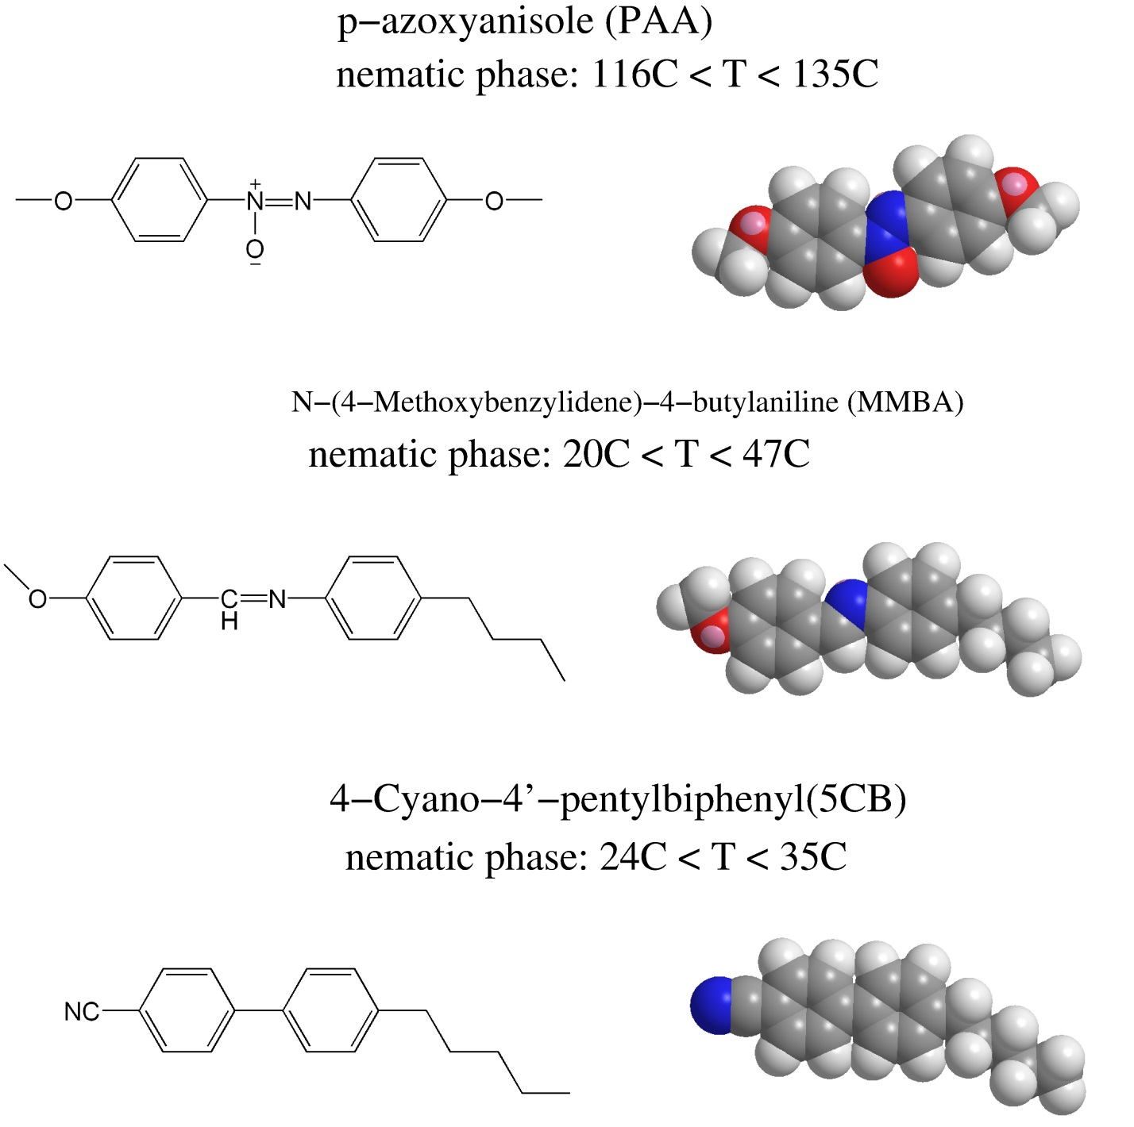
Molecules (mesogens)

Slide 5
Liquid crystalline phases: mesophases
Flow like liquids
Anisotropic like solid crystals
5CB
CN
Crystal Liquid Crystal Isotropic fluid
Average local molecular orientations in liquid crystals are described by the director with head-tail symmetry

Slide 6
Nematic phase
center of mass locations
n
director
Only orientational order (crystal), no positional order (liquid)

Slide 7
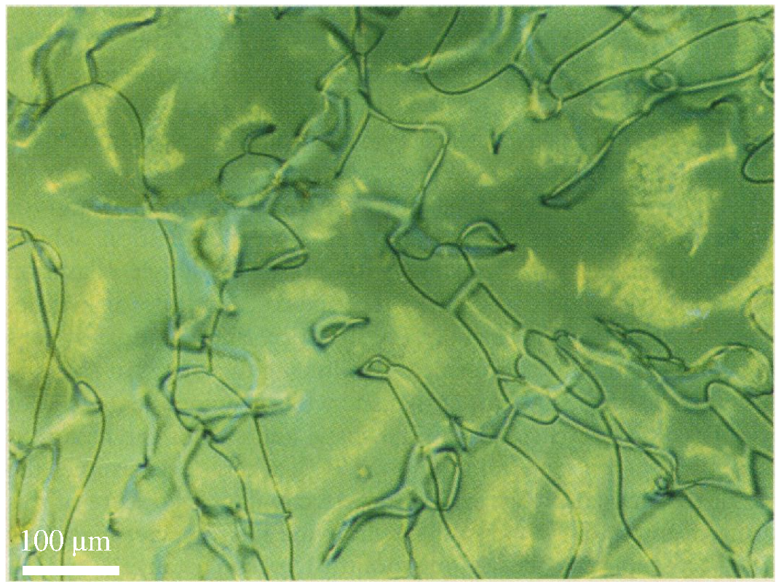
Nematic phase under microscope
nematic comes from the Greek νήμα (nema), which means "thread“
[I. Chuang et al., Science 251, 1336 (1991)]

Slide 8
Anisotropic Magnetic Susceptibility and Order Parameter Tensor

Slide 9
1-body angular distribution function
θ
$$w_{i}$$
Consider a system of N rod-like particles with positions $r_{i}$ and orientation $w_{i}$ , i = 1, .., N, in a volume V
$$r_{i}$$
$$ρ\left(r,w\right)=\sum_{i=1}^{N}{{\left\langle δ\left(r−r_{i}\right)δ\left(w−w_{i}\right)\right\rangle }_{T}}$$
1-body distribution function:
number density:
$ρ_{0}\left(r\right)=∫ρ\left(r,w\right)dΩ$
dΩ is the solid angle element, and integral is over two-dimensional sphere
$$f\left(r,w\right)≔\frac{ρ\left(r,w\right)}{ρ_{0}\left(r\right)}$$
1-body angular distribution function:

Slide 10
Molecular magnetic susceptibility tensor
$$H$$
We denotes by that η|| and η⊥ the molecular magnetic
susceptibilities along the molecular axis and the (degenerate) directions perpendicular to it.
Then in an arbitrary coordinates:
$$η_{ij}(w)=η_{⊥}δ_{ij}+\left(η_{\text{||}}−η_{⊥}\right)w_{i}w_{j}$$
$$w$$
For usual nematic mesogens η|| < 0 and η⊥ < 0, i.e. the material is diamagnetic.
H-induced molecular magnetic moment m:
$$m_{i}(w)=μ_{0}η_{ij}{(w)H}_{j}$$
where μ0 is the magnetic permeability of vacuum

Slide 11
Material magnetic susceptibility tensor $χ$
$$H$$
The local magnetization M(r) in a liquid crystal in a uniform field can be calculated as:
$$M_{i}\left(r\right)=∫ρ\left(r,w\right)m_{i}\left(w\right)dΩ=μ_{0}\left(∫ρ\left(r,w\right)η_{ij}(w)dΩ\right)H_{j}≔χ_{ij}{(r) H}_{j}$$
M
r
Material (macroscopic) susceptibility tensor $χ:$
$χ_{ij}\left(r\right)=μ_{0}$ $∫ρ\left(r,w\right)η_{ij}\left(w\right)dΩ=$
$μ_{0}ρ\left(r\right)\left(η_{⊥}δ_{ij}+η_{a}∫f\left(r,w\right)w_{i}w_{j}dΩ\right)$
ηa = η|| − η⊥ is the anisotropy of the molecular magnetic susceptibility
Notes:
Because magnetic interactions between molecules are small, the local magnetic field is given mostly by
the external magnetic field. This implies that the macroscopic magnetic susceptibility tensor χ can be
obtained from the sum of the molecular susceptibilities with appropriate averaging over the distribution
function ρ(r, w).

Slide 12
For uniaxial nematic phases, f (r, w) is rotationally symmetric with respect to n(r) and may be written as:
$$f\left(r,w\right)=\overline{f}\left(r,\cos{θ}\right),$$
Where θ is the angle between the director n(r) and the molecular axis w.
We introduce a local spherical coordinates with the polar axis parallel to n(r). Then the molecular axis
$$w=\left({\begin{aligned}\sin{θ}\cos{φ} \\ \sin{θ\sin{φ}}\end{aligned} \atop \cos{θ}}\right)$$
and
$$∫f\left(r,w\right)w_{i}w_{j}dΩ= \int_{0}^{π}{[\sin{θ\overline{f}\left(r,\cos{θ}\right)}}\int_{0}^{2π}{w_{i}w_{j}dφ}]dθ$$

Slide 13
Because
we obtain
$$\int_{0}^{2π}{ww^{T} dφ}=π\left[\begin{matrix}1 −\cos^{2}{θ} & 0 & 0 \\ 0 & 1 −\cos^{2}{θ} & 0 \\ 0 & 0 & 2\cos^{2}{θ}\end{matrix}\right]$$

Slide 14
recall that
$χ\left(r\right)=μ_{0}ρ\left(r\right)\left(η_{⊥}δ_{ij}+η_{a}∫f\left(r,w\right) ww^{T}dΩ\right)$
the expression for the magnetic susceptibility tensor takes the form
$$χ\left(r\right)=μ_{0}ρ(r)\left[\begin{matrix}η_{⊥}+\frac{η_{a}}{2}(1−{\left\langle \cos^{2}{θ}\right\rangle }_{θ}){ } & 0 & 0 \\ 0 & η_{⊥}+\frac{η_{a}}{2}(1−{\left\langle \cos^{2}{θ}\right\rangle }_{θ}){ } & 0 \\ 0 & 0 & η_{⊥}+η_{a}{\left\langle \cos^{2}{θ}\right\rangle }_{θ}\end{matrix}\right]$$
where ${\left\langle …\right\rangle }_{θ}≔∫f\left(r,w\right)…dΩ=2 π∫sin{θ}\overline{f}(r,\cos{θ)} …dθ$

Slide 15
We introduce χ|| (r) and χ⊥ (r) the magnetic susceptibilities along the local nematic director n(r) (assumed here to be along z−axis) and the two (degenerate) directions perpendicular to it.
From the above equation we obtain for the anisotropy $χ_{a}\left(r\right)$ = χ|| (r) − χ⊥ (r) of the macroscopic magnetic susceptibility tensor
$$χ_{a}\left(r\right)=μ_{0}ρ\left(r\right)η_{a}\frac{1}{2}\left(3 {\left\langle \cos^{2}{θ}\right\rangle }_{θ}−1\right)≔μ_{0}ρ\left(r\right)η_{a}S(r)$$
where we have introduced a scalar orientational order parameter
$S(r)$= $\frac{1}{2}\left(3 {\left\langle \cos^{2}{θ}\right\rangle }_{θ}−1\right)$.
χ|| (r) $={μ_{0}ρ(r)(η}_{⊥}+η_{a}{\left\langle \cos^{2}{θ}\right\rangle }_{θ}$)
χ⊥ (r)= $μ_{0}ρ(r)(η_{⊥}+\frac{η_{a}}{2}(1−{\left\langle \cos^{2}{θ}\right\rangle }_{θ}){ }$
It is easy to check that in the isotropic phase when $\overline{f}=\frac{1}{4π}$, S = 0 and as the result
also, $χ_{a}=0$, as supposed to be for an isotropic material.

Slide 16
Order parameter tensor
In arbitrary coordinate system:
$$χ_{ij}\left(r\right)=χ_{⊥}\left(r\right)δ_{ij}+χ_{a}\left(r\right)n_{i}\left(r\right)n_{j}(r)$$
In order to describe the nematic orientational ordering we introduce a tensorial order parameter Q defined as the deviatoric part of the susceptibility tensor χ:
$$Q\left(r\right)=χ\left(r\right)−\frac{1}{3}Tr χ\left(r\right)$$
For uniaxial susceptibility as in the 1st equation the order tensor may be presented in the form
$$Q_{ij}\left(r\right)=χ_{a}\left(r\right)\left(n_{i}\left(r\right)n_{j}\left(r\right)−\frac{1}{3}δ_{ij}\right)$$

Slide 17
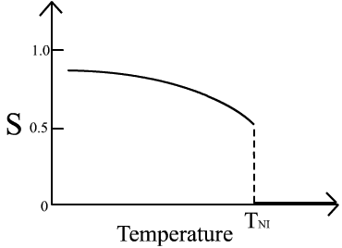
The nematic LC order parameter
To quantify just how much order is present in a material, an order parameter (S) is defined:
θ
no order
perfect order
LC-isotropic transition
perfect crystal
isotropic fluid
Orientational order represents the tendency of the molecules to align along the director on a long-range basis.

Slide 18
Elements of the Onsager theory for nematic-isotropic phase transition

Slide 19
Long cylindrical particles with the diameter D and the length L interacting pairwise via the hard-core potential V(1, 2) which depends on both positions and orientations of the molecules: ${1≔(r}_{1},w_{1})$
Onsager’s expression for the Helmholtz free energy functional $F[ρ(1)]$ is written in terms of the single-particle distribution function,
$$ρ\left(1\right)≔ρ_{0}\left(1\right)f(r_{1},w_{1})$$
Notes:
In this part we discuss a “simple” model introduced by Onsager in [1] in order to discuss the nematic-to-
isotropic phase transition. Consider an ensemble of long cylindrical particles with the diameter D and
the length L interacting pairwise via the hard-core potential V(1, 2) which depends on both positions and
orientations of the molecules: 1 = (r1, w1 ). Onsager has shown how the Mayer cluster theory may be used
to give an expansion for the equation of state of this system [1]. Onsager’s expression for the Helmholtz
free energy is written in terms of the single-particle distribution function,

Slide 20
for U (1) = 0, and constant density $ρ_{0}\left(r\right)=ρ_{0}$we have
$$βF\left[ρ\right]=Vρ_{0}\left(∫f\left(w\right)\left(\ln{ρ_{0}Λ^{3}} −1 −βμ+\ln{f\left(w\right)}\right)dΩ+\frac{ρ_{0}}{2}∫∫E\left(w_{1},w_{2}\right)f\left(w_{1}\right)f\left(w_{2}\right)dΩ_{1}dΩ_{2}\right)$$
with the excluded volume
$$E\left(w_{1},w_{2}\right)=−\int_{V}{f^{∗}\left(r,w_{1},w_{2}\right)d^{3}r}$$
of one particle oriented at $w_{1}$ with another particle oriented at $w_{2}$

Slide 21
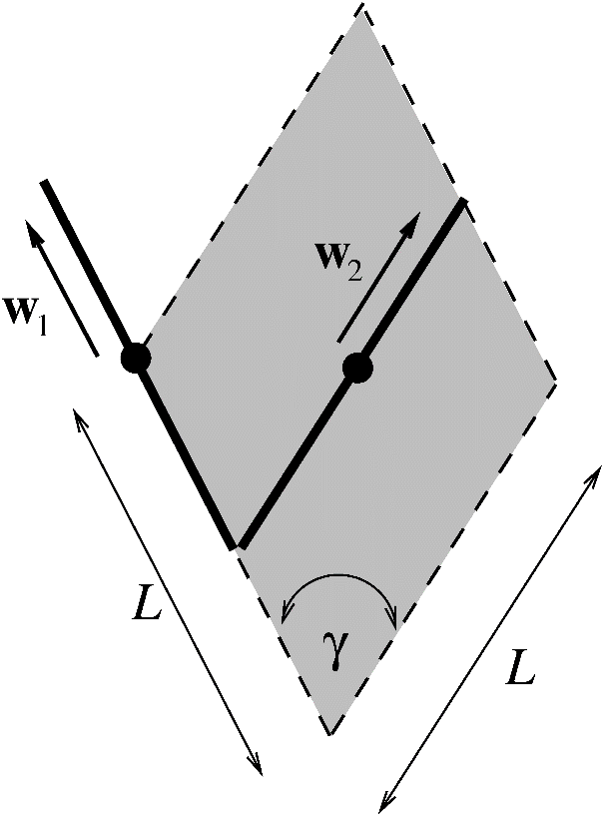
The excluded volume E of two hard rods depends on the angle γ between their axes $w_{1}$ and $w_{2}$
E is minimum for the parallel alignment, γ = 0, and maximum for perpendicular alignment γ = π/2.
For $D≪L$ we can neglect the ends effects leading to $E\left(w_{1},w_{2}\right)≈2DL^{2}|\sin{γ|}$
Because of $∫f\left(w\right)dΩ=1$ the f (w)−dependent part of the free energy functional has the form
$$F_{f}\left[f\left(w\right)\right]=∫f\left(w\right)\ln{f\left(w\right)}dΩ+ρ_{0}DL^{2}∫|\sin{γ}|f\left(w_{1}\right)f\left(w_{2}\right)dΩ_{1}dΩ_{2}$$
The objective is to minimize this functional with respect to the angular distribution function f (w) (normalized to unity)

Slide 22
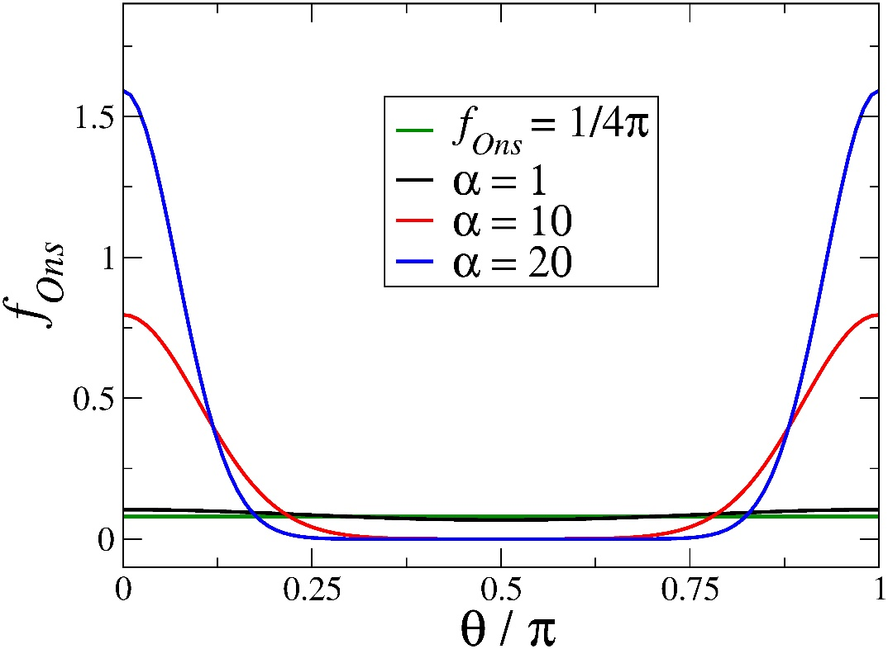
An “isotropic” solution f (w) = 1/(4π) is always a minimizer of the above functional However for large enough values of rods packing fraction $φ=\frac{ρ_{0}πD^{2}L}{4}$ anisotropic solution describing the nematic phase are also possible.
The exact solution is not known, and approximate one can be obtained numerically. Onsager employed a one-parameter variational Ansatz:
$$f_{Ons}\left(w,α\right)=\frac{α}{4π\sinh{α}}cosh({α\cos{θ})}$$
Notes:
In the isotropic phase α = 0, and α is large in the nematic phase αnem ' 19. Larger values of α
make the Ansatz function more peaked at θ = 0, π as is shown in Fig. 4. Onsager found that at the
coexistence the volume fractions of the nematic and isotropic phases φnem = 4.5D/L and φiso = 3.3D/L,
respectively. This values demonstrate that the transition occurs for rather large aspect rations L/D.
The free energy functional in Eq. (18) is based on the second-order virial expansion, therefore Onsager’s
results are applicable only for small volume fractions φ 1.
The physical mechanism responsible for the emergence of the nematic phase is related to the competi-
tion between translational and orientational entropies. Thus, the ideal-gas part in the Onsager functional,
the first integral in the rhs. of Eq. (23), is independent on the density ρ̄ and prefers the isotropic orienta-
tion of the rods. Contrary, the excluded volume part of Eq. (23) grows with ρ̄ and prefers orientational
configurations with as small volume per particle as possible, i.e. nematic phase. At sufficiently large
densities, the entropy loss caused by the restriction of the orientational degrees of freedom can be com-
pensated by the entropy gain due to the decrease of the excluded volume. In other words, in the isotropic
phase the orientational entropy dominates, while in the nematic phase – the translational one.

Slide 23
Orientational Entropy is the Packing Entropy
Lars Onsager:
Minimized both translational and rotational parts of entropy of rods
Translational entropy favors nematic-like order (due to smaller excluded volume).
Obtained nematic order at some critical concentration of the rods
n
director

Slide 24
Landau-de Gennes Theory

Slide 25
Free energy as a Taylor series in powers of $Q_{ij}, and ∂_{k}Q_{ij}$
We employ here such a scaling that the scalar order parameter S(r) is the eigenvalue of Q(r) corresponding to the nematic director n(r):
$$Q_{ij}\left(r\right)=\frac{S\left(r\right)}{2}\left({3 n}_{i}\left(r\right)n_{j}\left(r\right)−δ_{ij}\right)$$
In the spirit of phenomenological Landau approach to the phase transitions of second order, a free energy functional of a liquid crystalline system is postulated in the form:
The equilibrium Q(r) minimizes F [Q], and the corresponding minimum of F equals to the free energy of the system

Slide 26
The local free energy density
$f_{LdG}(Q)$ describes the nematic-isotropic phase transition in a spatially uniform system without external fields. According to the Landau phenomenological approach $f_{LdG}$is presented as a Taylor expansion in the scalar order parameter S.
Because $f_{LdG}$ is a scalar quantity, and Q is a second rank tensor with TrQ = 0, $f_{LdG}$ must contain only scalar combinations of the order tensor: $TrQ^{2}∝S^{2}$ and
$TrQ^{3}∝S^{3}$:
$f_{LdG}\left(Q\right)=f_{0}+a(T)$ $TrQ^{2}−b TrQ^{3}+c {\left(TrQ^{2}\right)}^{2},$
where $f_{0}$ is the free energy density of the isotropic phase. The presence of the term
$∝S^{3}$ reflects the fact that the nematic states described by S and −S are distinct, and therefore the free energy is notsymmetric with respect to the transformation S → −S

Slide 27
For spatially uniform systems S=const and $n=\hat{z}$we get:
$Q=\frac{S}{2}\left[\begin{matrix}−1 & 0 & 0 \\ 0 & −1 & 0 \\ 0 & 0 & 2\end{matrix}\right] →{ f}_{LdG}\left(S\right)=f_{0}+\frac{3}{2}a\left(T\right)S^{2}−\frac{3}{4}bS^{3}+\frac{9}{4}c S^{4}$
which should be minimized with respect to S. It is convenient to define the dimensionless temperature $τ=\frac{24a\left(T\right)c}{b^{2}}$. The equation $\frac{∂f_{LdG}}{∂S}=0$has three solutions:
$1: S_{I}=0$, isotropic phase
${2: S}_{N}=\frac{b}{8c}\left(1+\sqrt{1−\frac{8τ}{9}}\right)$, nematic phase
${3: S}_{3}=\frac{b}{8c}\left(1−\sqrt{1−\frac{8τ}{9}}\right)$, either maximum or a metastable minimum

Slide 28
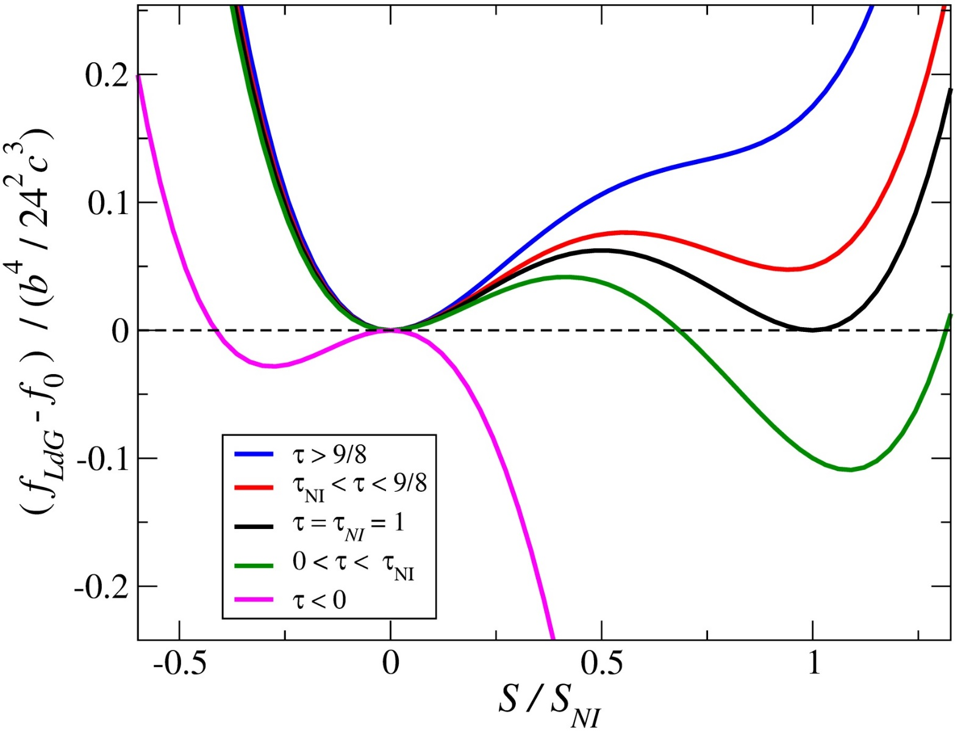
The transition temperature $T_{NI}$ and the corresponding value $S_{NI}$of the order parameter are defined from the condition that the free energy densities of the two phases are equal $f_{LdG}(S_{NI})=f_{0}$which gives
$$τ_{NI}=1, { S}_{NI}=\frac{b}{6c}.$$

Slide 29
The elastic free energy density
The order tensor Q can depend on the spatial coordinates, which means that either the director n or the order parameter S (or all together) vary from place to place. This variation can be due to external forces imposed on the system, thermal fluctuations, or boundary conditions.
Assuming these deformations to vary slowly in space relative to the molecular distance scale, it is possible to describe the response of the liquid crystal using continuum elastic theory. Then the elastic free energy density can be written as
$f_{el}\left(∇Q\right)=L_{1}∂_{k}Q_{ij}∂_{k}Q_{ij}+L_{2}∂_{j}Q_{ij}∂_{k}Q_{ik}+L_{3}∂_{k}Q_{ij}∂_{j}Q_{ik}+…$
where $L_{1},L_{2}, L_{3}$ are the phenomenological constant parameters and the summation convention is assumed.

Slide 30
Frank-Oseen elastic free energy density
In the case where the scalar order parameter S is constant, an expansion in terms of the director n is normally used to calculate elastic free energy density.
$$Q\left(r\right)=\frac{S\left(r\right)}{2}\left(3 n\left(r\right)⊗n\left(r\right)−\hat{I}\right)$$
$f_{el}\left(∇Q\right)=L_{1}∂_{k}Q_{ij}∂_{k}Q_{ij}+L_{2}∂_{j}Q_{ij}∂_{k}Q_{ik}+L_{3}∂_{k}Q_{ij}∂_{j}Q_{ik}+…$
The second line represents the famous Frank-Oseen elastic free energy density for nematics with the splay K1 , twist K2 and bend K3 elastic constants

Slide 31
$$f\left(r,w\right)≔\frac{ρ\left(r,w\right)}{ρ_{0}\left(r\right)}$$
1-body angular distribution function:
θ
$$w_{i}$$
$S(r)$= $\frac{1}{2}\left(3 {\left\langle \cos^{2}{θ}\right\rangle }_{θ}−1\right)$
$$r_{i}$$
$$Q_{ij}\left(r\right)=\frac{S\left(r\right)}{2}\left({3 n}_{i}\left(r\right)n_{j}\left(r\right)−δ_{ij}\right)$$
$f_{LdG}\left(Q\right)=f_{0}+a(T)$ $TrQ^{2}−b TrQ^{3}+c {\left(TrQ^{2}\right)}^{2}$
$f_{el}\left(∇Q\right)=L_{1}∂_{k}Q_{ij}∂_{k}Q_{ij}+L_{2}∂_{j}Q_{ij}∂_{k}Q_{ik}+L_{3}∂_{k}Q_{ij}∂_{j}Q_{ik}+…$

Slide 32
Frank-Oseen elastic free energy density
The characteristic dimensions of the deformations are large compared to molecular dimensions, and thus the spatial derivatives of the director $∂_{i}n_{j}$ are small quantities
The expansion of the free energy density up to terms $∼O\left({\left(∂_{i}n_{j}\right)}^{2}\right)$ is:
$f_{el}=f_{0}+$ $\sum_{i,j,k,l}{L_{ijkl}\left(n\right)∂_{i}n_{j}∂_{k}n_{l}}+…$
$L_{ijkl}\left(n\right)$ are constructed based on the symmetry argument: the free energy density must be invariant under the transformations from the point group of the nematic phase
$D_{∞h}$, for example:
$L_{ijkl}=δ_{ij}δ_{kl}$, and $L_{ijkl}=n_{i}n_{k}δ_{jl}$
For the purpose of qualitative calculations, it is useful to assume that
$K_{1}=K_{2}=K_{3}=K→$
$$f_{el}=\frac{K}{2}\left({\left(∇⋅n\right)}^{2}+{\left(∇×n\right)}^{2}\right)$$

Slide 33
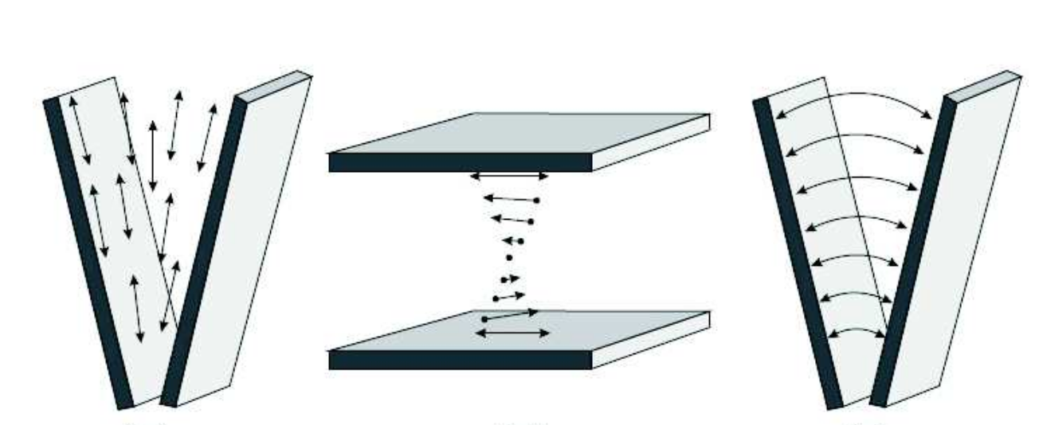
Independent elastic modes in the Frank-Oseen theory
splay
twist
bend
$$K_{1}{\left(∇ ⋅n\right)}^{2}$$
$$K_{2}{\left(n⋅\left(∇×n\right)\right)}^{2}$$
$$K_{3}{\left(n×\left(∇×n\right)\right)}^{2}$$
$$K_{i}∼{10}^{−11}N$$

Slide 34
Splay: $K_{1}{\left(∇ ⋅n\right)}^{2}$
$$n\left(r\right)=\left(\begin{matrix}x \\ y \\ 0\end{matrix}\right)$$
$$y$$
$$n\left(r\right)$$
$$\left(∇ ⋅n\right)=\frac{1}{√\left(x^{2}+y^{2}\right) }$$
$\left(n⋅\left(∇×n\right)\right)$ = 0
$n×\left(∇×n\right)$ = 0
$$z$$
$$x$$

Slide 35
Twist:${ K}_{2}{\left(n⋅\left(∇×n\right)\right)}^{2}$
$$n\left(r\right)=\left(\begin{matrix}\cos{qz} \\ \sin{qz} \\ 0\end{matrix}\right)$$
$$z$$
$$n\left(r\right)$$
$$y$$
$$\left(∇ ⋅n\right)=0$$
$$\left(n⋅\left(∇×n\right)\right)=−q$$
$n×\left(∇×n\right)$ = 0
$$x$$

Slide 36
Bend: $\left(n×\left(∇×n\right)\right)$
$$n\left(r\right)=\left(\begin{matrix}−y \\ x \\ 0\end{matrix}\right)$$
$$y$$
$$n\left(r\right)$$
$$\left(∇ ⋅n\right)=0$$
$\left(n⋅\left(∇×n\right)\right)$ = 0
$n×\left(∇×n\right)=\frac{2xy}{{\left(x^{2}+y^{2}\right)}^{2}}\left(\begin{matrix}x \\ y \\ 0\end{matrix}\right)$
$$z$$
$$x$$

Slide 37
Response to external fields
The director field is easily distorted and can be aligned by magnetic (electric fields). Recall that the magnetic susceptibility tensor of a uniaxial liquid crystal has the form:
$$χ_{ij}\left(r\right)=χ_{⊥}\left(r\right)δ_{ij}+χ_{a}\left(r\right)n_{i}\left(r\right)n_{j}(r)$$
where $χ_{a}\left(r\right)$ = χ|| (r) − χ⊥ (r) is the anisotropy of the magnetic susceptibility
The presence of a magnetic field H contributes to the free energy density the following term
$$f_{H}=−\frac{1}{2}H⋅M=−\frac{μ_{0}}{2}H_{j}χ_{ij}H_{j}=−\frac{μ_{0}}{2}χ_{⊥}H^{2}−\frac{μ_{0}}{2}χ_{a}{\left(n⋅H\right)}^{2}$$
The first term in the r.h.s. can be omitted as it is independent of n. The last term gives rise to a torque on the liquid crystal, for $χ_{a}>0 , n$ will align parallel to the field.

Slide 38
Electric field
The dielectric permittivity tensor $ε_{ij}=ε_{⊥}δ_{ij}+ε_{a}\left(r\right)n_{i}\left(r\right)n_{j}(r)$of a liquid crystal is also anisotropic and has similar form as the magnetic susceptibility. In external electric field E there will be an additional free energy contribution
$$f_{E}=−\frac{1}{2}E⋅D=−\frac{ε_{0}}{2}E_{j}ε_{ij}E_{j}=−\frac{ε_{0}}{2}ε_{⊥}E^{2}−\frac{ε_{0}}{2}ε_{a}{\left(n⋅E\right)}^{2}$$
where ε⊥ and ε|| are the components of the relative dielectric permittivity tensor in the directions perpendicular and parallel to the director, εa = ε|| − ε⊥ is the dielectric anisotropy, and ε0 is the vacuum permittivity.
In practice the alignment of a liquid crystal by an electric field is complicated by the presence of conducting impurities which make it necessary to use alternating electric fields.
Strong polarization effects , local field differs from the external one, need to solve Maxwell equations

Slide 39
Freedericksz transition
in
external magnetic field

Slide 40
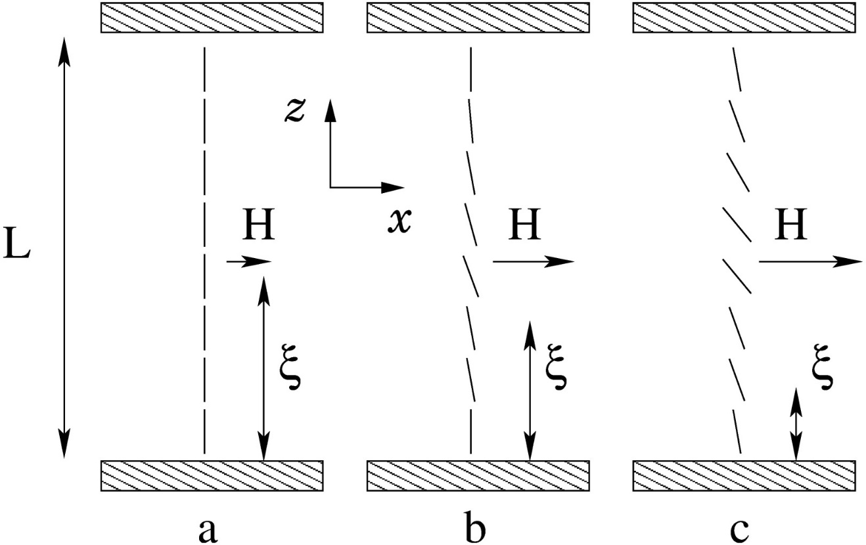
Nematic LC between two surfaces. When a magnetic field, applied perpendicular to the director, exceeds a certain critical value Hc , the optical properties of the system change abruptly, when n in the bulk aligns parallel to H. This effect first observed by Fréedericksz and Zolina and can be used to measure some of the LC elastic constants.
The length $ξ=\frac{1}{H}\sqrt{\frac{\overline{K}}{μ_{0}χ_{a}}}$ is called the magnetic coherence length and it defines the distance which a disturbance can propagate into the liquid crystal in the presence of an ordering field

Slide 41
Let the z axis be perpendicular to the glass surfaces and the field H lie along the x−direction We parametrize the director as:
$$n\left(r\right)=\left(\begin{matrix}\sin{θ(z)} \\ 0 \\ \cos{θ(z)}\end{matrix}\right)$$
so that θ is the angle between the director and the z axis.
$$∇∙n=−\sin{θ\frac{∂θ}{∂z} }$$
$$∇×n= {\hat{e}}_{y}\cos{θ\frac{∂θ}{∂z} }$$
$n⋅\left(∇×n\right)=0$
$n×\left(∇×n\right)=({\hat{e}}_{z}n_{x}−{\hat{e}}_{x}n_{z}$) $\cos{θ\frac{∂θ}{∂z} }$

Slide 42
The elastic energy per unit area now takes the form
In the undistorted structure, $θ=0$, the field does not exert a torque on the molecules they are in metastable equilibrium. Near the threshold $H_{c}$, distortions are weak,
$$θ≪1→$$
where $ξ=\frac{1}{H}\sqrt{\frac{K_{3}}{μ_{0}χ_{a}}}$

Slide 43
In order to estimate the threshold value of the field $H_{c}$we use a variational Ansatz
$$θ\left(z\right)=θ_{0}\sin{\frac{πz}{L}}$$
Which renders the following elastic free energy
$$F_{el}≃\frac{π^{2}K_{3}}{4L}\left[1−{\left(\frac{L}{πξ}\right)}^{2}\right]θ_{0}^{2}$$
For ξ > L/π the free energy above is minimized at $θ_{0}=0$, i.e., undistorted director configuration.
We conclude that for weak fields
$H<H_{c}≡$ $\frac{π}{L}\sqrt{\frac{K_{3}}{μ_{0}χ_{a}}}$
the orienting strengths of the bounding surfaces “beats” the external field.

Slide 44
For ξ < L/π, the prefactor in front of $θ_{0}^{2}$ is negative, signaling the instability of the undistorted θ = 0 solution. This phenomena is named the Fréedericksz Transition. By measuring the threshold field $H_{c}$it is possible to calculate the bend elastic constant
$$K_{3}=μ_{0}χ_{a}{\left(\frac{H_{c}L}{π}\right)}^{2}$$
In the similar way it is possible to measure the splay $K_{1}$ and the twist $K_{2}$ elastic constants.

Slide 45
Optical Properties

Slide 46
Recall the relative dielectric permittivity tensor for uniaxial nematic:
$$ε_{ij}=ε_{⊥}δ_{ij}+ε_{a}n_{i}n_{j}.$$
Correspondingly, we can introduce ordinary and extraordinary refractive indexes
$n_{e}=\sqrt{ε_{∥}}, n_{o}=\sqrt{ε_{⊥}}$, $Δn=n_{e}−n_{o}.$
For typical nematic liquid crystals, $n_{o}$ is approximately 1.5 and the maximum difference ∆n may range between 0.05 and 0.5.
Thus, when light enters a birefringent material, such as a nematic LC, the process is modeled in terms of the light being broken up into the fast (called the ordinary ray) and slow (called the extraordinary ray) components.

Slide 47
The plane of polarization of the e-wave always contains the director n, and the o-wave is always polarized normally to n.
Because the two components travel at different velocities, the waves get out of phase. When the rays are recombined as they exit the birefringent material, the polarization state has changed because of this phase difference.
The thickness of the sample is another important parameter because the phase shift accumulates as the light propagates in the birefringent material.
Any polarization state can be produced with the right combination of the birefringence and length parameters.

Slide 48
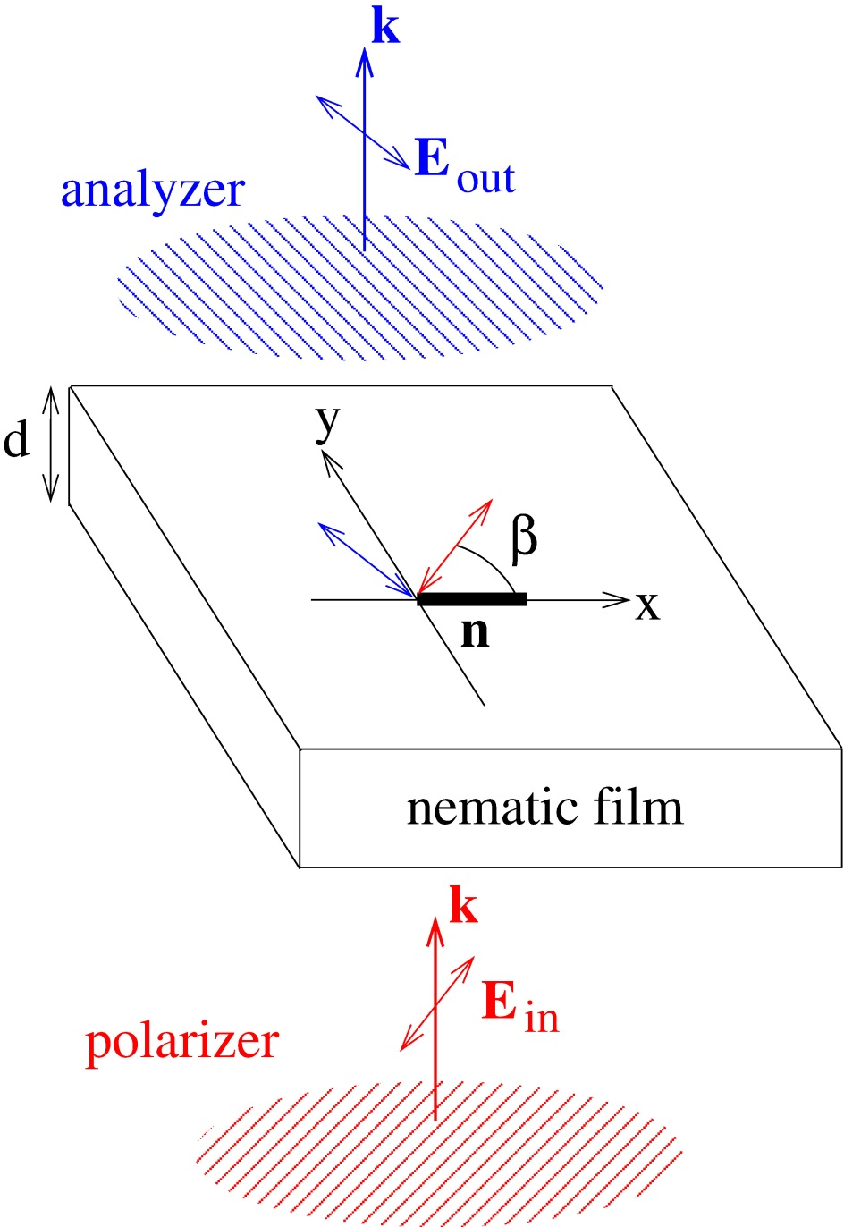
Nematic film between crossed polarizers
$$P_{out }=\left(\begin{matrix}−sin{β} \\ \cos{β}\end{matrix}\right)$$
$$n\left(x,y\right)$$
$$I_{out}={\left|E_{out}\right|}^{2}=I_{in}\sin^{2}{2β\sin^{2}\left(\frac{πd}{λ_{0}}\left(n_{e}−n_{o}\right)\right)}$$
$$P_{in }=\left(\begin{matrix}\cos{β} \\ \sin{β}\end{matrix}\right)$$

Slide 49
Upon entering in the nematic the wave splits into the ordinary $E_{o}$ and extraordinary $E_{e}$ waves:
$$E_{in}{\left.​\right|}_{z=0 }=\left(E⋅P_{in}\right)P_{in}=E_{o}+E_{e}=E_{0}\left(\begin{matrix}0 \\ \sin{β }\end{matrix}\right)+E_{0}\left(\begin{matrix}\cos{β} \\ 0\end{matrix}\right)$$
At the point of entry z = 0 into the nematic both waves are in phase.
The two waves will need times $\frac{n_{o}d}{c}$ and $\frac{n_{e}d}{c}$ in order to pass through the film.
At the exit point at z = d, but just before entering the analyzer we have
$$E_{o}{\left.​\right|}_{z=d }=E_{0} e^{−iωt}sinβ\left(\begin{matrix}0 \\ e^{ik_{o}d}\end{matrix}\right)$$
$$E_{e}{\left.​\right|}_{z=d }=E_{0} e^{−iωt}sinβ\left(\begin{matrix}e^{ik_{e}d} \\ 0\end{matrix}\right)$$
where $k_{i}=\frac{2πn_{i}}{λ_{0}}$are wave numbers of the ordinary i = o and extraordinary i = e waves, and $λ_{0}$ is the wave length in vacuum.
At the exit point the two waves will gain a phase shift $δφ=\left(k_{e}−k_{o}\right)d$.

Slide 50
Projecting the two waves onto the polarization direction of the analyzer and adding
them we obtain the wave amplitude behind the analyzer
$E_{out}{\left.​\right|}_{z=d }=\left({[E}_{o}\left(z=d\right)+E_{e}\left(z=d\right)]⋅P_{out} \right){ P}_{out}=$ $E_{0} e^{−iωt}sinβ\cos{β}(e^{ik_{o}d}−e^{ik_{e}d}) \left(\begin{matrix}−\sin{β} \\ \cos{β}\end{matrix}\right)$
The intensity of light $I_{out}={|\left|E_{out}|\right|}^{2}$ passed through the system of crossed polarizers and the nematic films is
$$I_{out}={\left|E_{out}\right|}^{2}=E_{0}^{2}\sin^{2}{2β\sin^{2}\left(\frac{πd}{λ_{0}}\left(n_{e}−n_{o}\right)\right)}$$

Slide 51
The intensity pattern $I_{out}(x, y)$of the transmitted light is determined by $β(x, y),$i.e., by the in-plane configuration of the director field. In other words, the system of crossed polarizers maps the director field $n(x, y)$onto the transmitted light intensity $I_{out}(x, y)$.
If the transmission axis of the first polarizer is parallel $(β = 0$) or perpendicular ($β = ±π/2$) to the nematic director $n$, the light is not broken up into components, and the corresponding region of the texture appears dark.

Slide 52
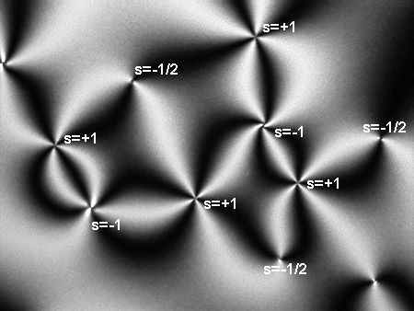
Schlieren texture of a nematic film
Points where two or four dark brushes meet are centers of topological defects. We note, that point topological defects can only exist in pairs.

Slide 53
$I_{out}$ also depends on the wavelength $λ_{0 }$ and, therefore, for white light, the transmitted intensity will exhibit colorful textures.
One can distinguish two types of defects with “opposite sign of the topological charge”; one type with yellow and red brushes, the other kind not that colorful. The difference in appearance is due to different core structures for these defects of different “charge”.

Slide 54
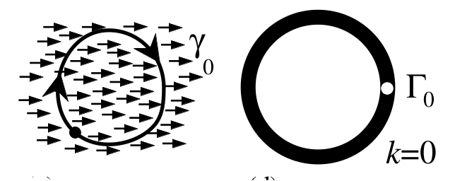
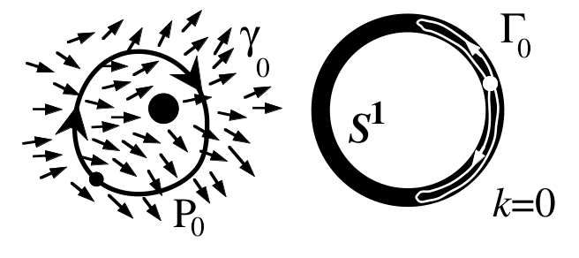
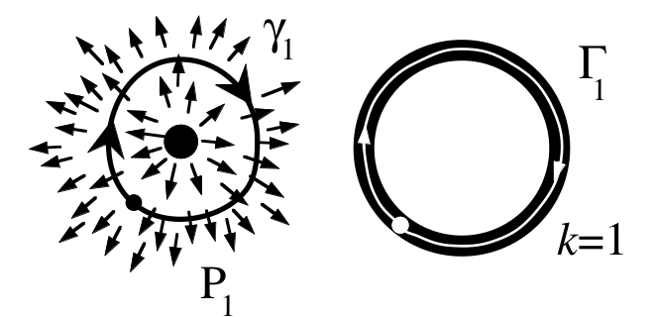
Point defects with different topological charges k in a polar 2D ferromagnet
The OP space of the 2D Heisenberg isotropic ferromagnet is a circle $S^{1}$
An oriented loop $γ_{0}$drawn in in real space is mapped by the vector field into the OP space and produces a contour (trivial in this case) in $S^{1}$
$$S^{1}$$
$Γ_{0}$ can be continuously contracted (without leaving the circle $S^{1}$ ) into a single point
The loop $Γ_{1}$runs around the entire circle $S^{1}$ and cannot be continuously contracted
$$S^{1}$$

Slide 55
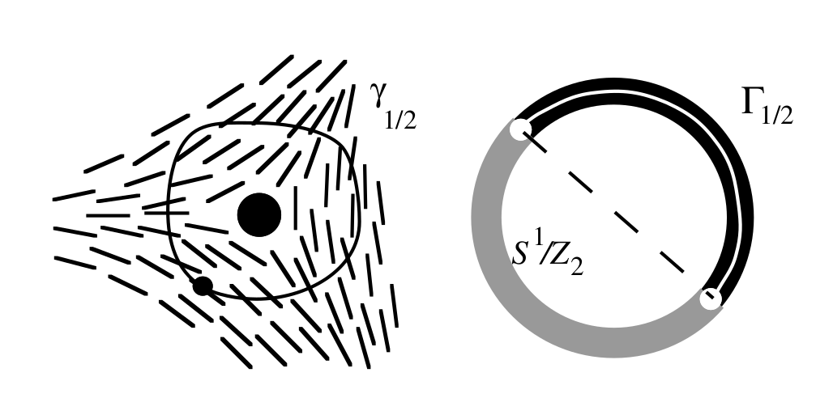
Defect k = −1/2 in a 2D, nonpolar nematic
The OP space of the 2D nonpolar nematic ferromagnet is a circle $S^{1}/Z_{2}$
The contour $γ_{1/2}$ in real space is mapped by the director field onto contour $Γ_{1/2}$in $S^{1}/Z_{2}$. $Γ_{1/2}$connects antipodal points of the circle and as such is closed and cannot be contracted into a point.

Slide 56
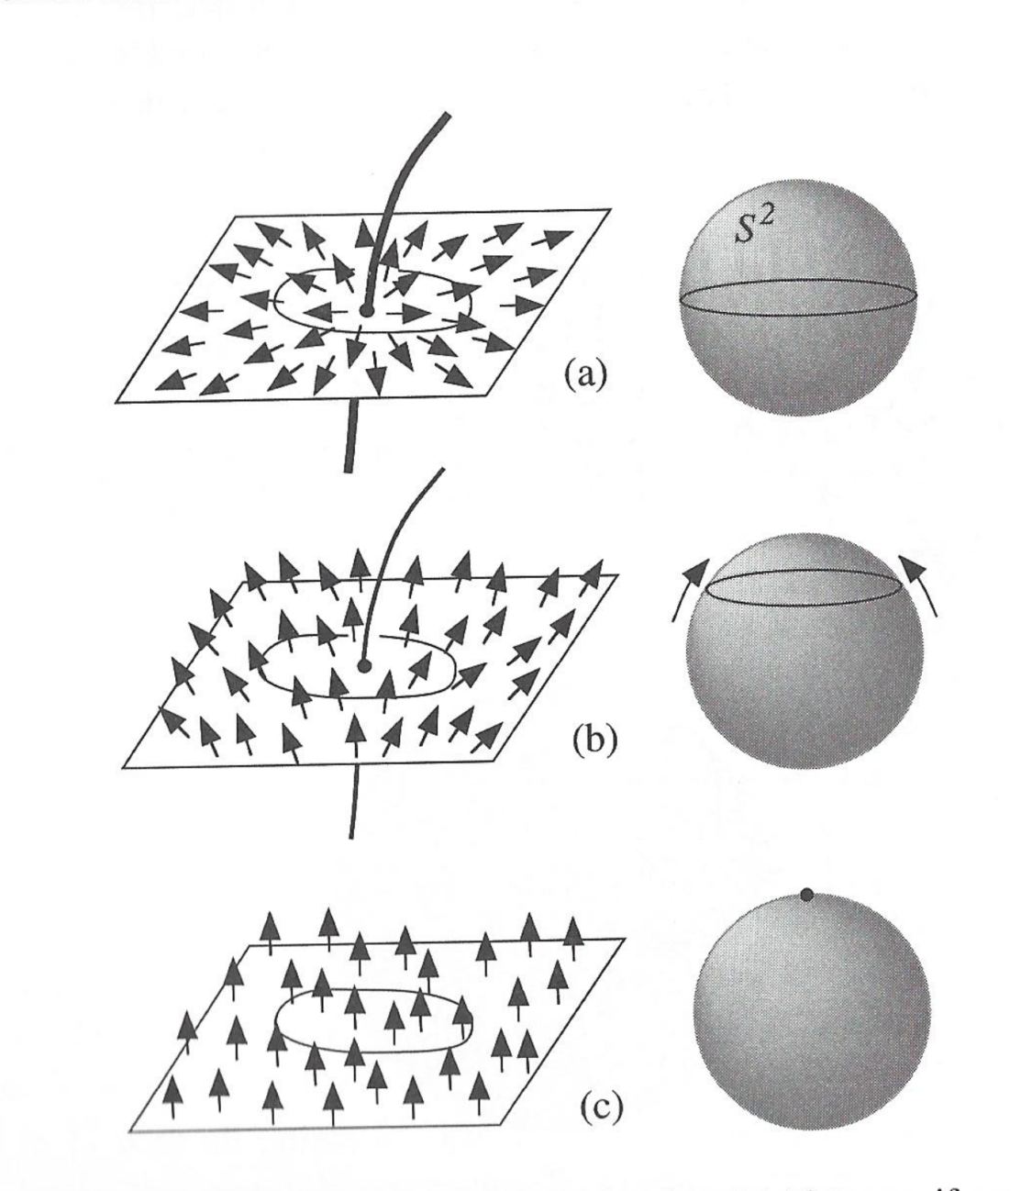
Instability of a k=1 defect line in a 3D ferromagnetic phase
The OP space of the Heisenberg isotropic ferromagnet is a sphere $S^{2}$
Consider a disclination in the magnetization vector field
An oriented loop surrounding the disclination core in real space is mapped by the vector field into the OP space and, thus, produces a contour on $S^{2}$
Obviously, any contour drawn on a sphere can be contracted into a point.

Slide 57
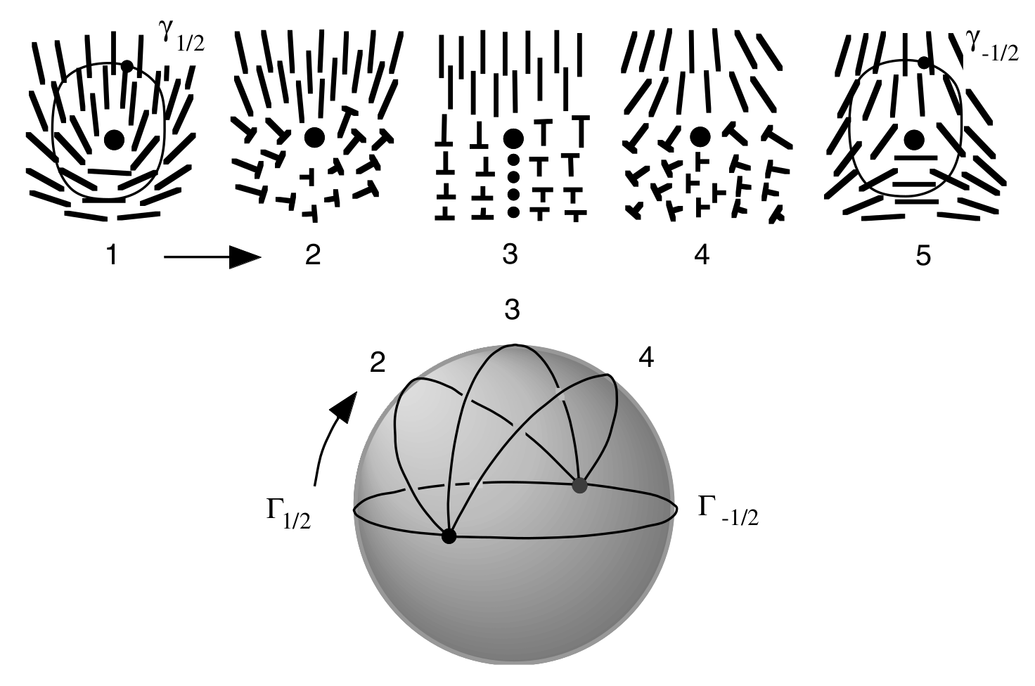
Stability of a k=1/2 defect line in a 3D nematic phase
The OP space of the 3D nonpolar nematic is $S^{2}/Z_{2}$ or the real projective plane ${RP}^{2}$
Contours that are terminating at two diametrically opposite points are not contractible to a point under any continuous deformations.
Such contours correspond to disclinations of half-integer k.

Slide 58
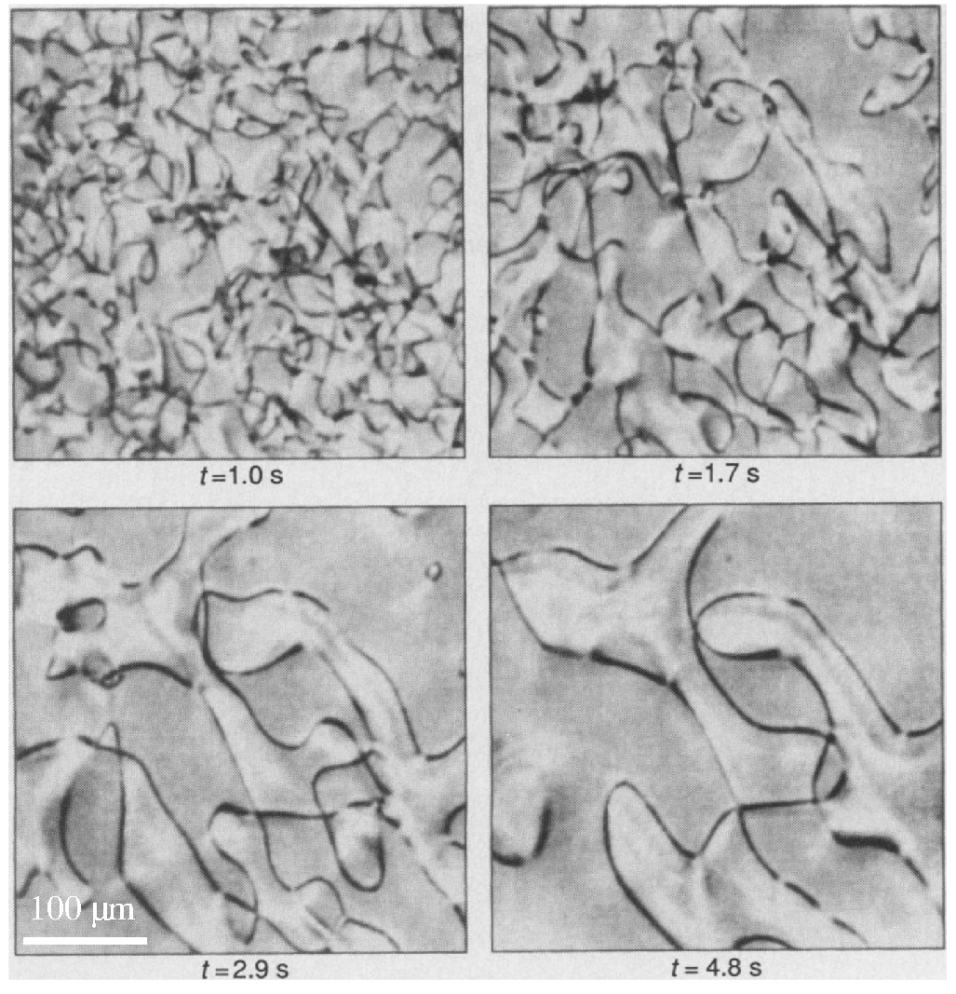
Coarsening dynamics of a network of defect lines
defects are formed via Kibble-Zurek mechanism [I. Chuang et al., Science 251, 1336 (1991)].

Slide 59
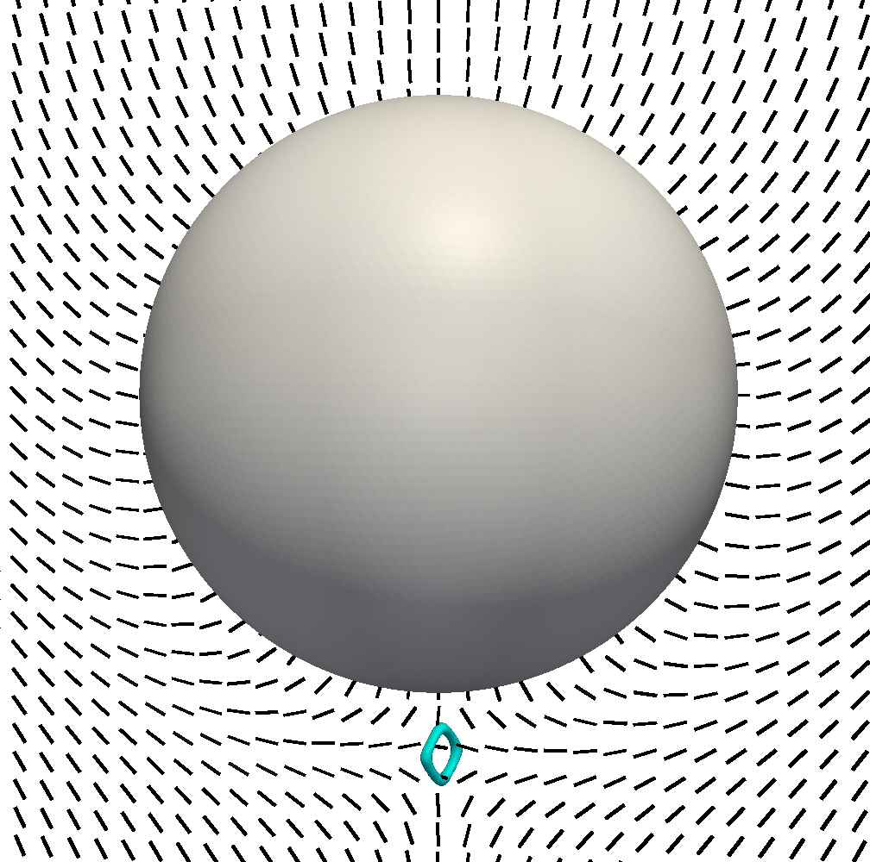
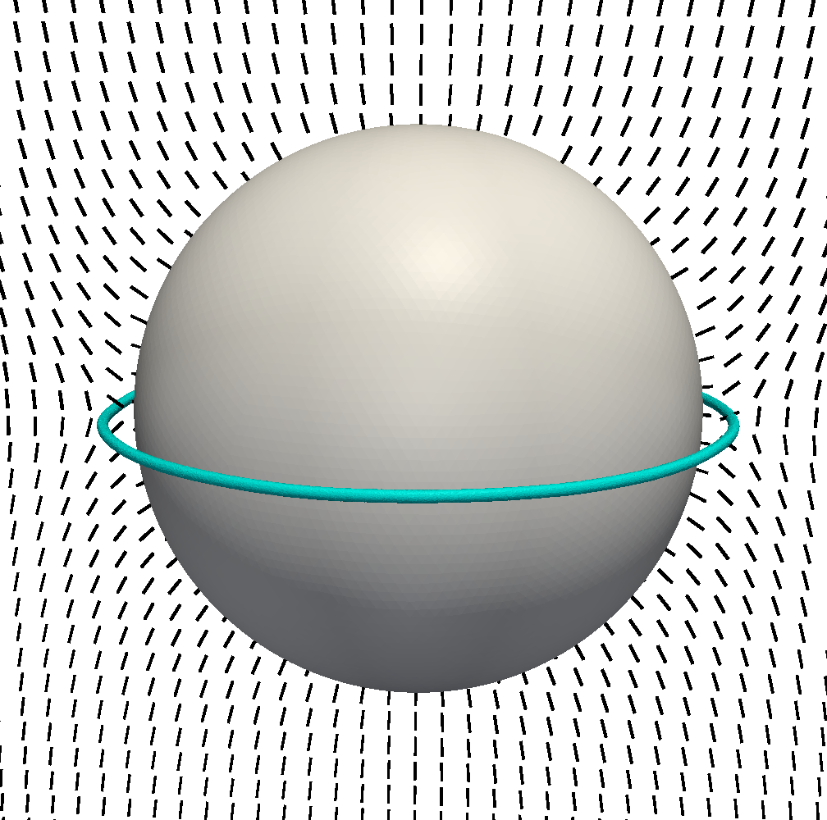
Particle-induced topological defects
$$R↘$$
point defect
“Saturn ring” line defect
topological charge $k$ of induced defects $k=±1/2$

Slide 60
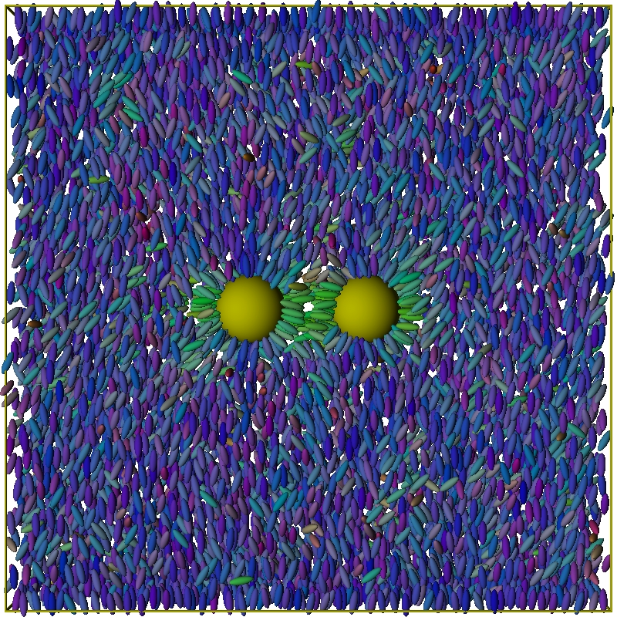
LC as s host fluid for colloidal particles: Anisotropic tunable effective interactions
n
n
anisotropic effective interaction: range $∼O(R)$
snapshot: courtesy of Dr. Andrienko MPI Mainz
Notes:
If particles of a host fluid have anisotropic shape and are, on average, aligned along some axis (called a director, n) then the host liquid has long-range orientational ordering. Note, that translational ordering is still short-ranged (i.e. it is still a liquid, not a solid). In this case the host liquid forms a nematic phase, the simplest of the liquid crystals mesophases, and we call the colloidal system a liquid crystal colloid.

Slide 61
Asymptotic analysis

Slide 62
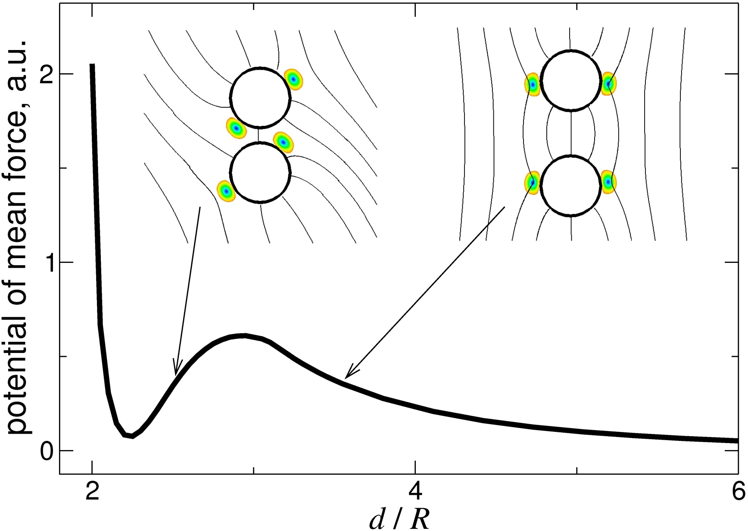
Defect-mediated formation of colloidal “molecules”
M. Tasinkevych and D. Andrienko, Condens. Matter Phys. 13, 33603 (2010)

Slide 63
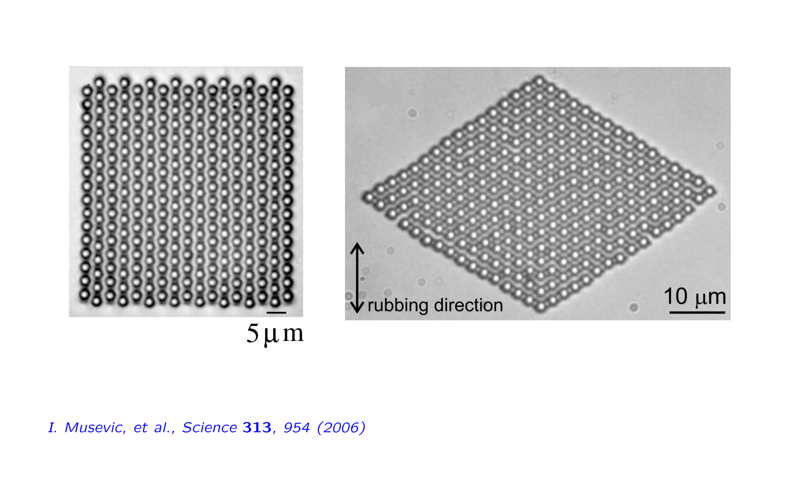
2D colloidal crystals

Slide 64
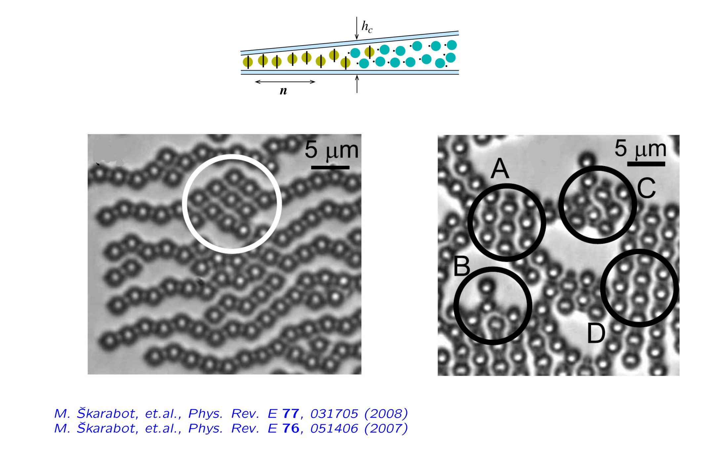
Colloidal crystallites

Slide 65
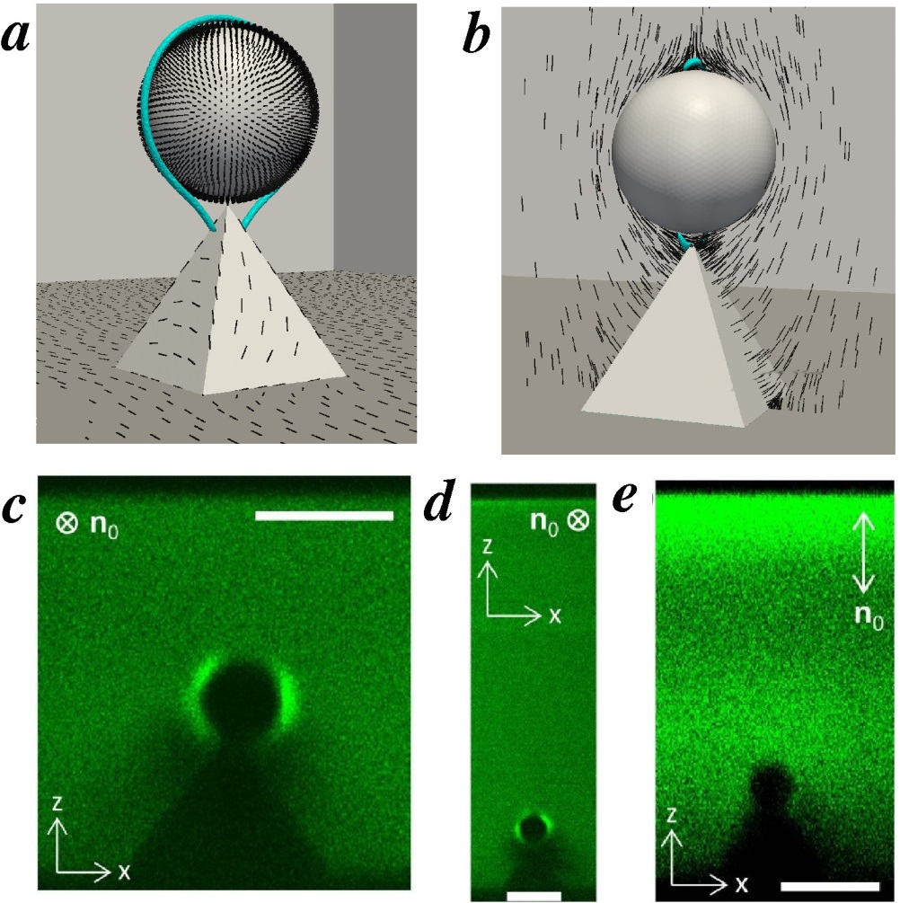
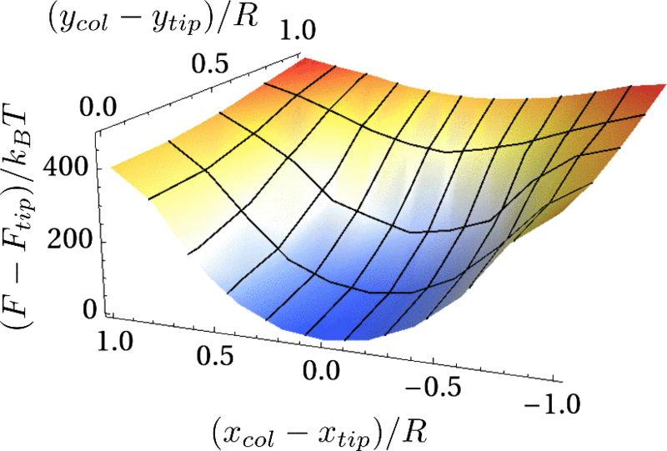
Template-assisted colloidal assembly
pyramid like protrusions as efficient trapping points for colloids
scale bar $=5$ μm
N. M. Silvestre, Q. Liu, B. Senyuk, I. I. Smalyukh, and M. Tasinkevych, Phys. Rev. Lett. 112, 225501 (2014)

Slide 66
Quasi-particle excitations in LC: topological solitons
A 2D soliton (“skyrmion”) with continuous n(r) twisting by 180° from its center in all radial directions
P.J. Ackerman et al., Nat. Commun. 8, 673 (2017)

Slide 67
Out-of-equilibrium assemblies of “active” skyrmions
Skyrmions “swim” in a square-wave electric field oscillating with a period $T_{m}$
Out-of-equilibrium self-assembly and re-assembly of skyrmion super-structures. The video is sped up approximately 100 times
H.R.O. Sohn et al., Nat. Commun. 10, 4744 (2019)

