Slide 1
AuLA 18 10 2018
Modelação EcoLÓGICA
Aula 3 TP 2

Slide 2
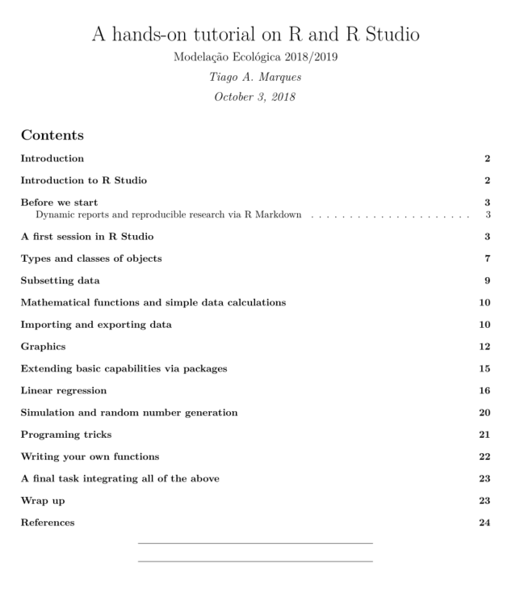
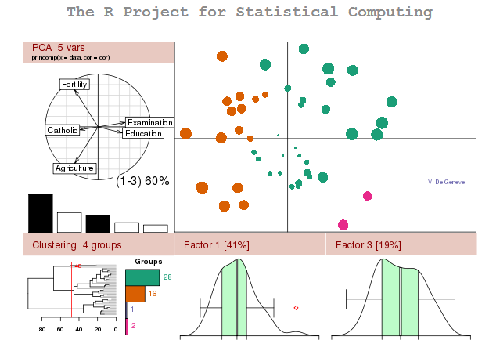
WE CONTINUE ON the hands-on tutorial

Slide 3
TIPS AND TRICKS IN R MARKDOWN
Check out a dynamic report live!
We can add dynamic values within the text
`r nrow(data)` or `r 4+5`
We can tell R not to show some code
We can tell it to evaluate but not evaluate (but show) the code

Slide 4
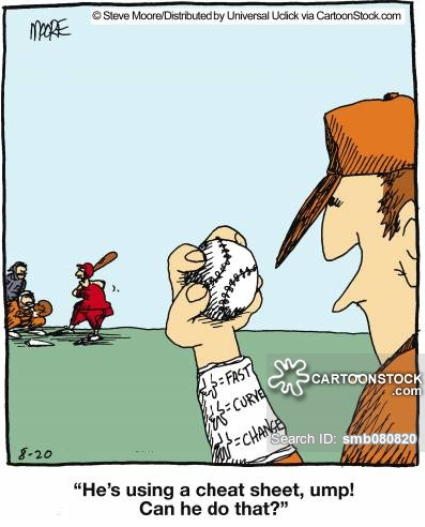
Use the cheat sheets!

Slide 5
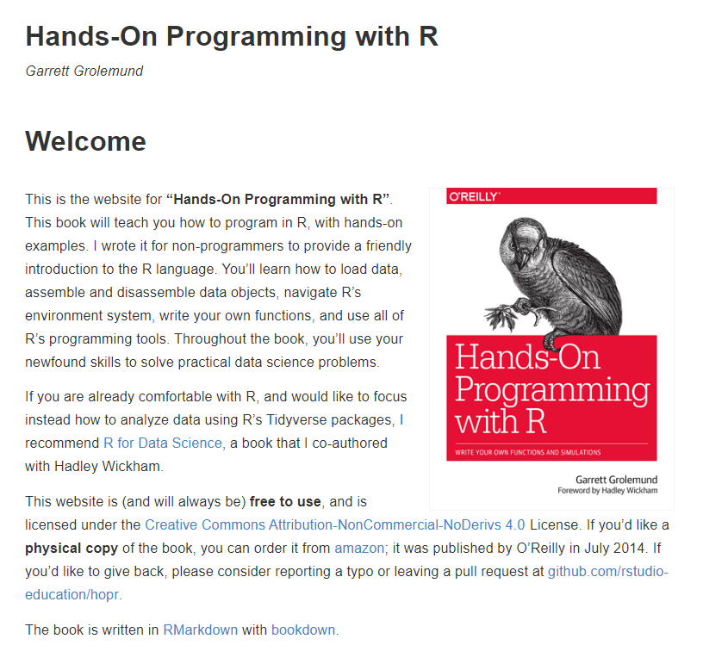
https://rstudio-education.github.io/hopr/

Slide 6
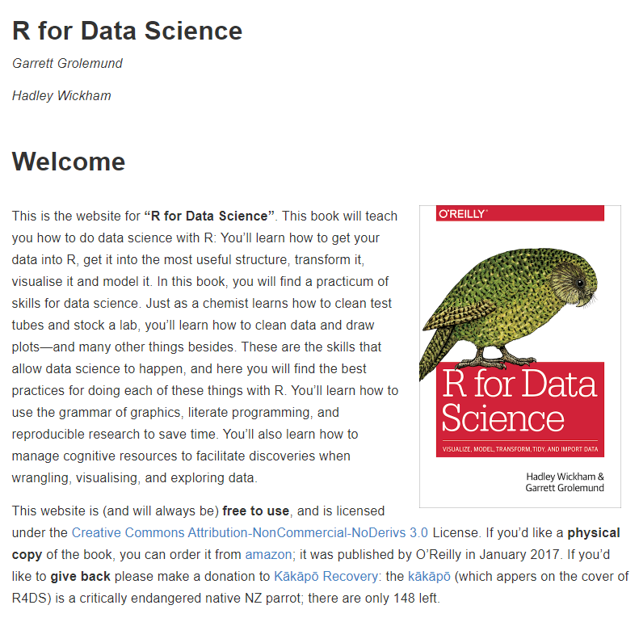
http://r4ds.had.co.nz/

Slide 8
