Slide 1
Week #1
Day 1: R; species data and environmental variables
Day 2: species data and environmental variables; SDMs (GLM, Maxent)
Day 3: SDMs – Maxent
Day 4: Group work
Day 5: Group work – Delivery 3 pp report. Presentation (~10 min + 5 min QA)?
Evaluation
Theoretical questions (25%) – individual component - Quiz Friday
Work group (65%) – 3 pp report
Participation/attitude + punctuality + effective work (10%)
Worth ⅓ of the final grade

Slide 2
Report
3 pages!
[title:] Modelling the distribution of [your species] for Iberian Peninsula
Introduction (1/2 pp)
Objective
Methods
Results
Discussion
Annexes: R code […]
Add disclaimer:
Author permission and reuse disclaimer (FCUL, non-commercial) I, the author(s) of this report, grant Faculdade de Ciências da Universidade de Lisboa (FCUL)
permission to publish and make this work available on an FCUL website as an example of student work.
I also allow third parties to copy and redistribute the work and to create extracts, abstracts, revised versions, adaptations,
and derivative works (including translation), to include it in a collective work (e.g., an anthology),
and to perform text and data mining.
These uses are permitted only for non-commercial purposes and provided that the user:
gives appropriate credit to the author(s);
indicates if changes were made; and
does not imply endorsement by the author(s) and does not modify the work in a way that harms the author(s)’ honor or reputation.
Author(s): ____________________ Student number(s): ____________________ Course/Unit: ____________________ Date: ____ / ____ / ______
To be sent to fjascensao@edu.ulisboa.pt

Slide 3
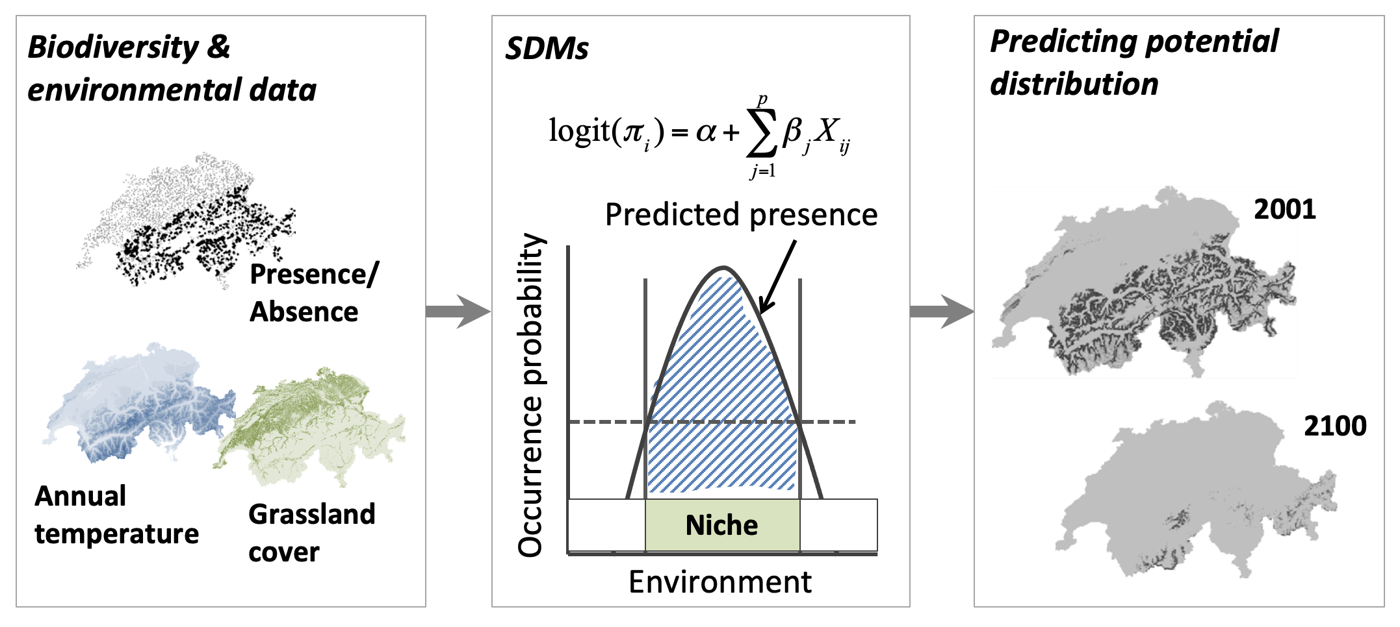
Day 1
Day 2
Day 2, 3

Slide 4
Day 1
R and R studio
Species and maps
Mapping species occurrence
Environmental variables

Slide 5

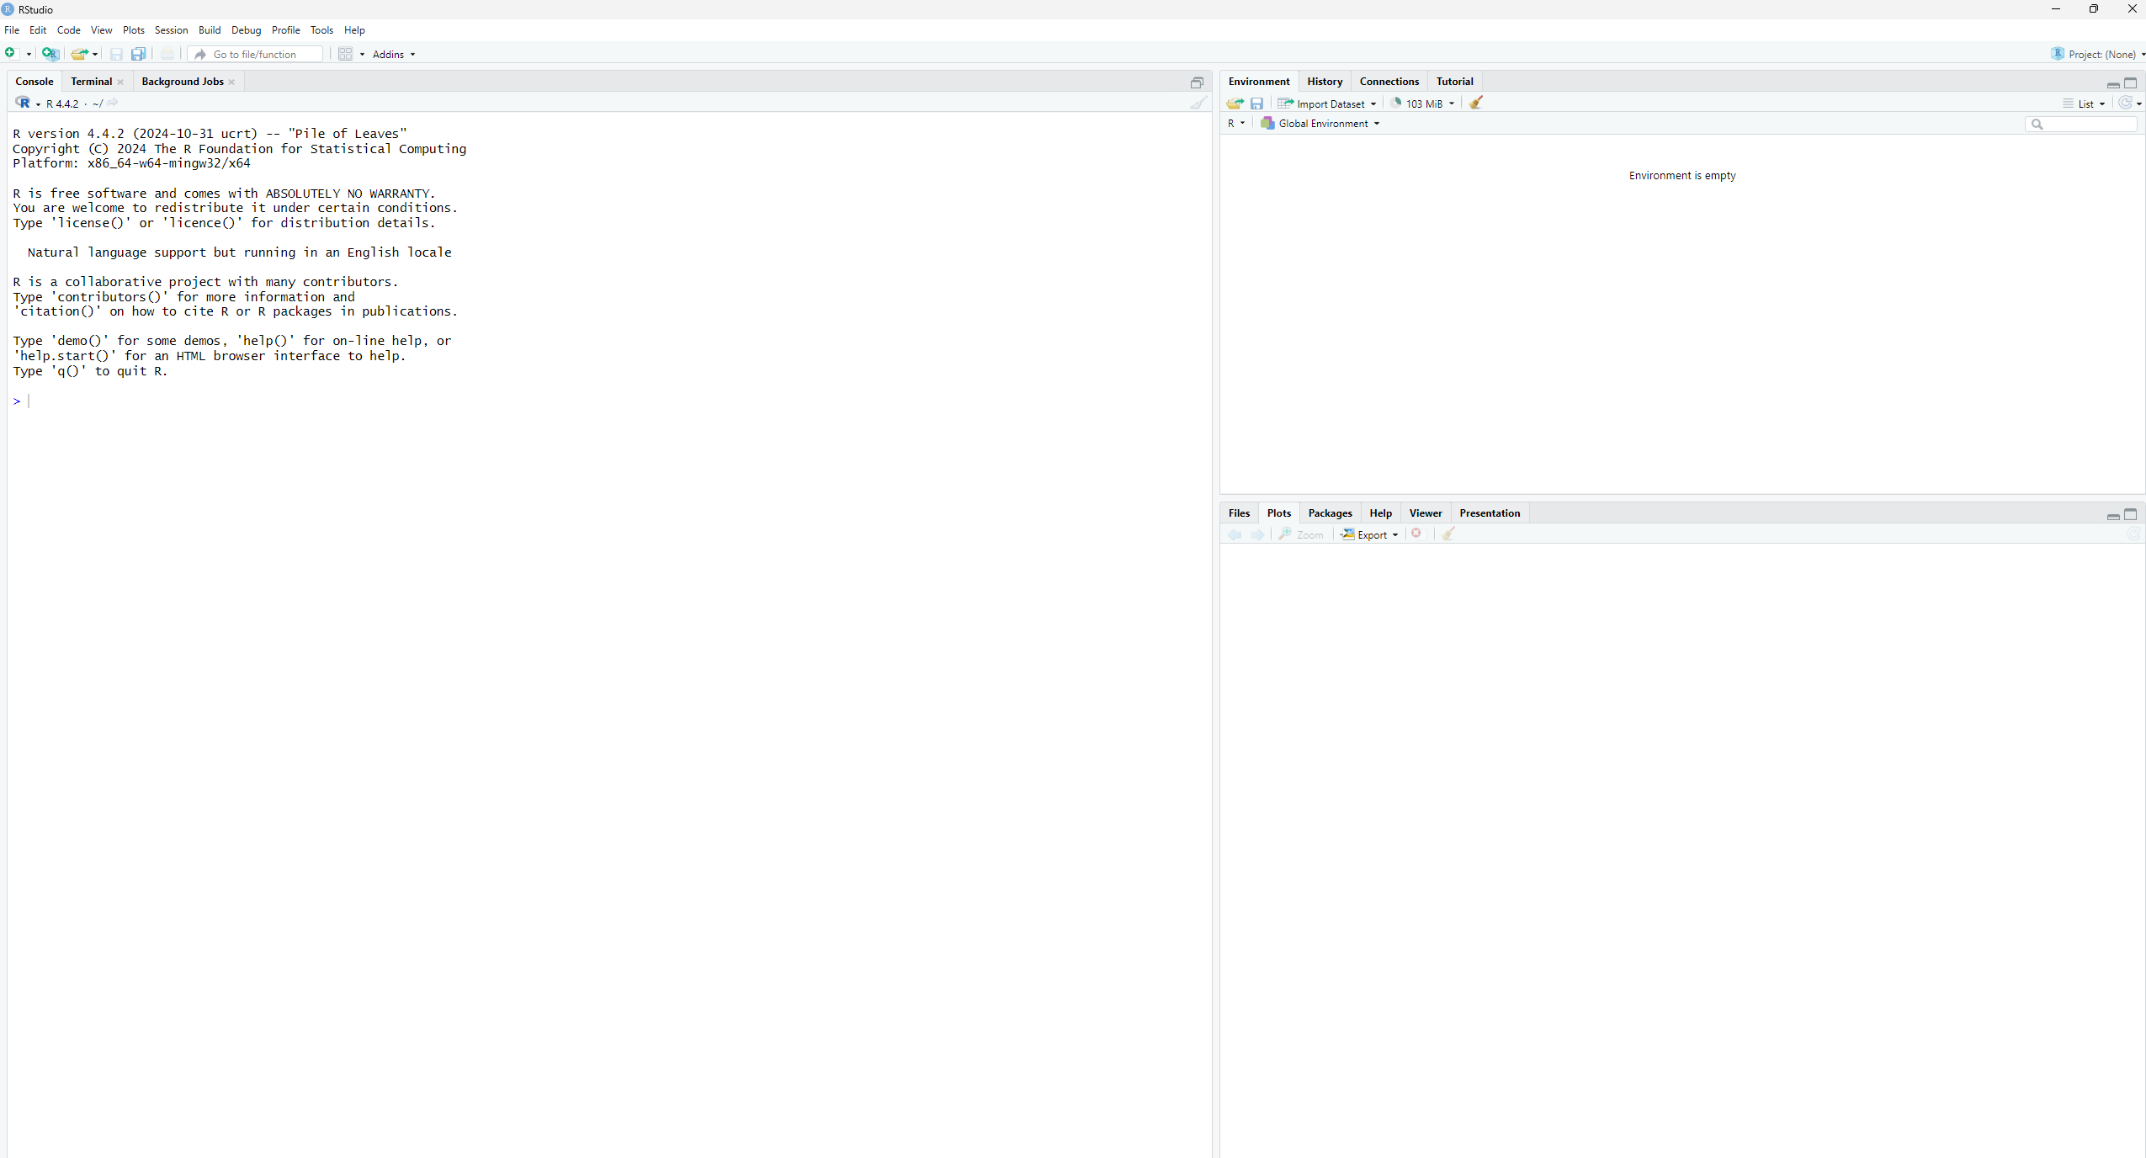
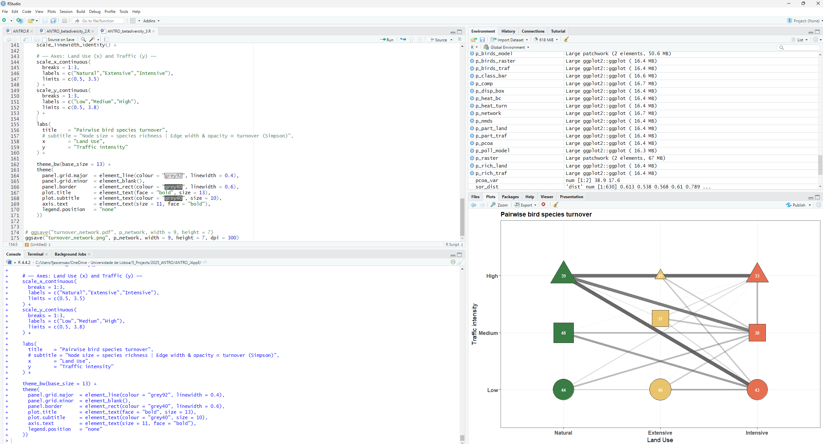

Slide 6
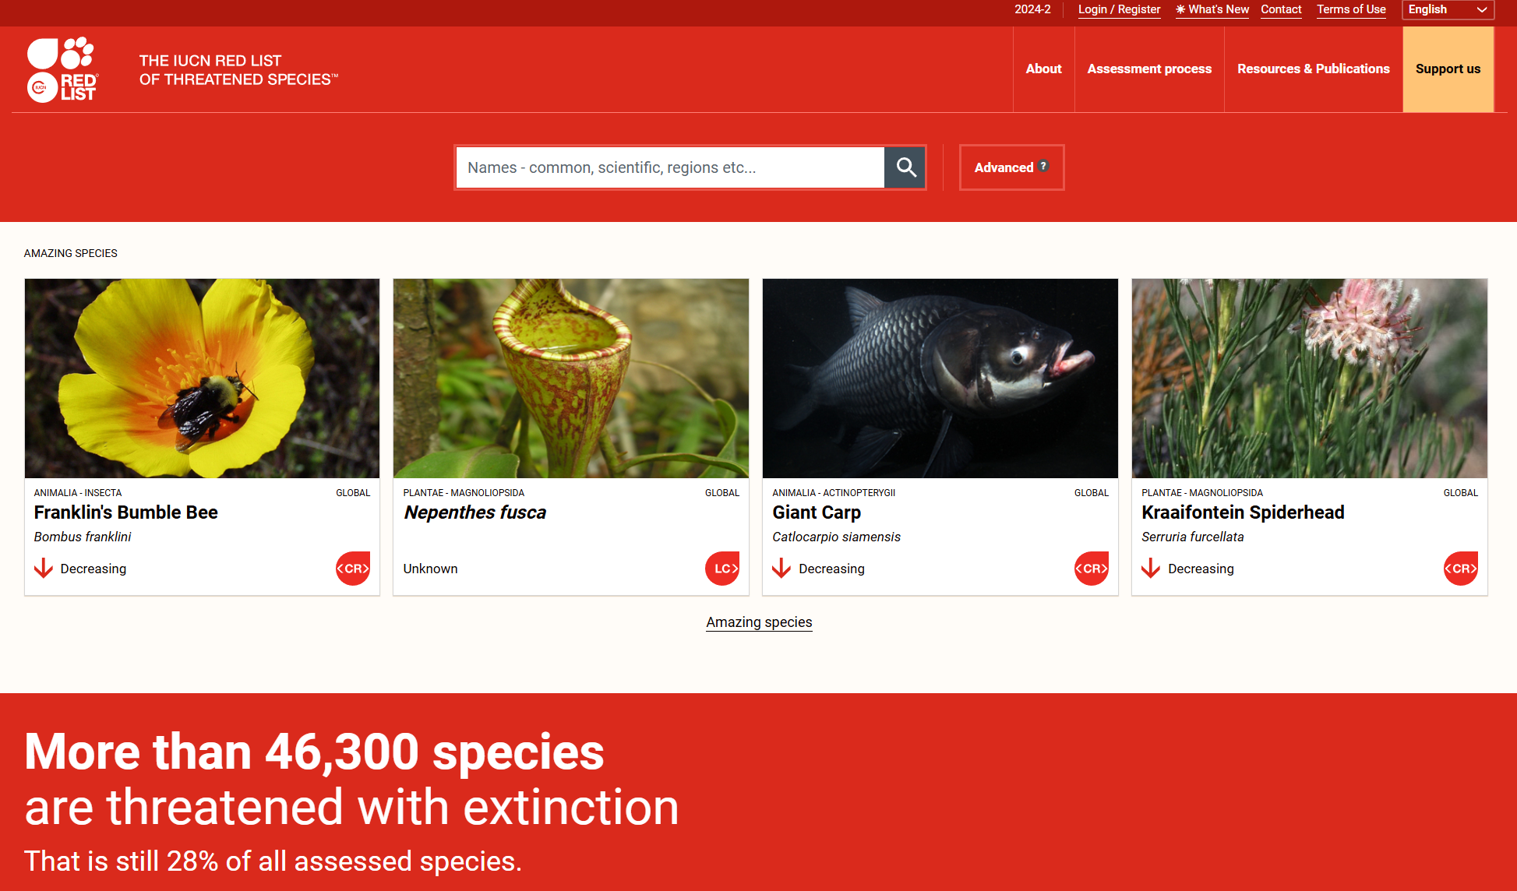
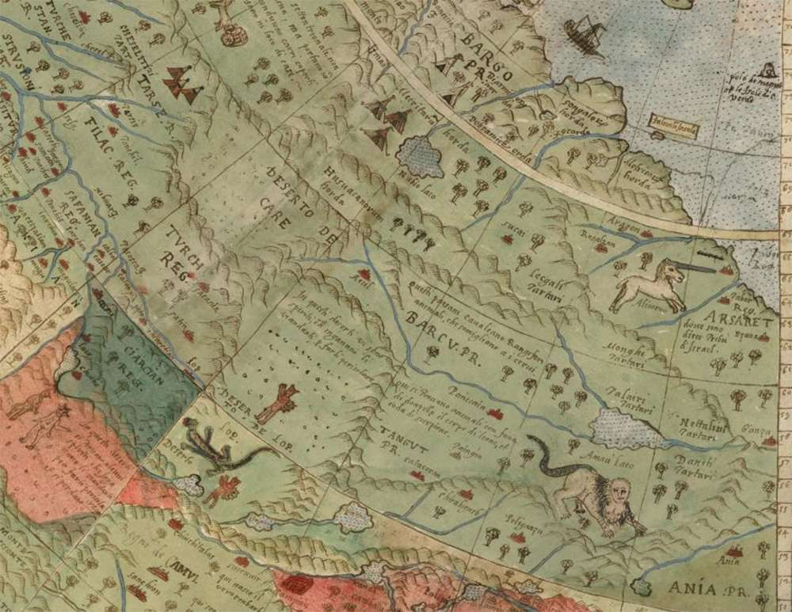
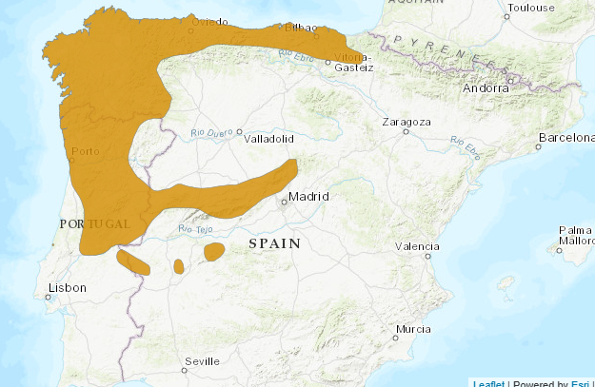
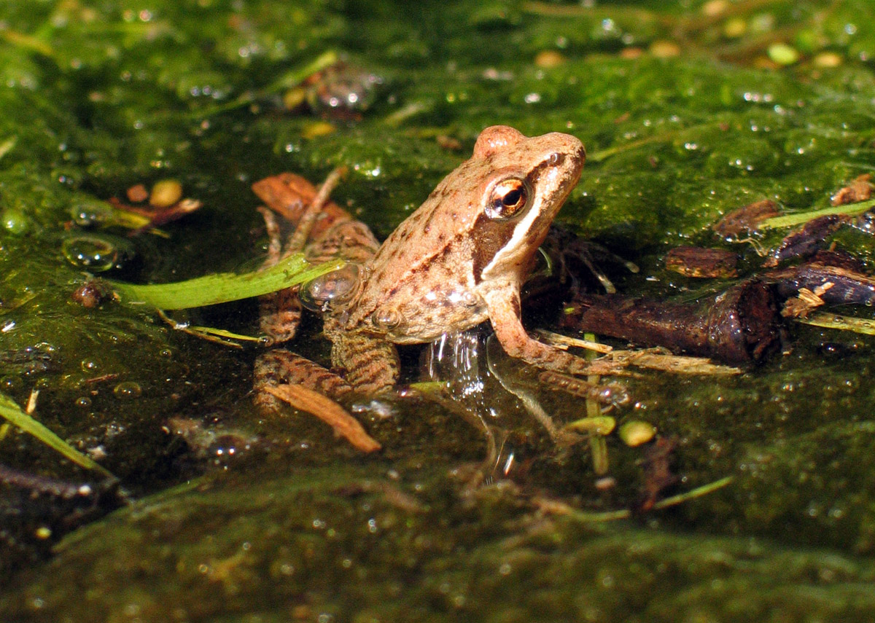
Spatial representation of species distribution data
https://www.iucnredlist.org/
Urbano Monte 1587.
A unicorn, several devils, and a lizard man roam across the land in this colorful depiction of Siberia.
Rana iberica

Slide 7
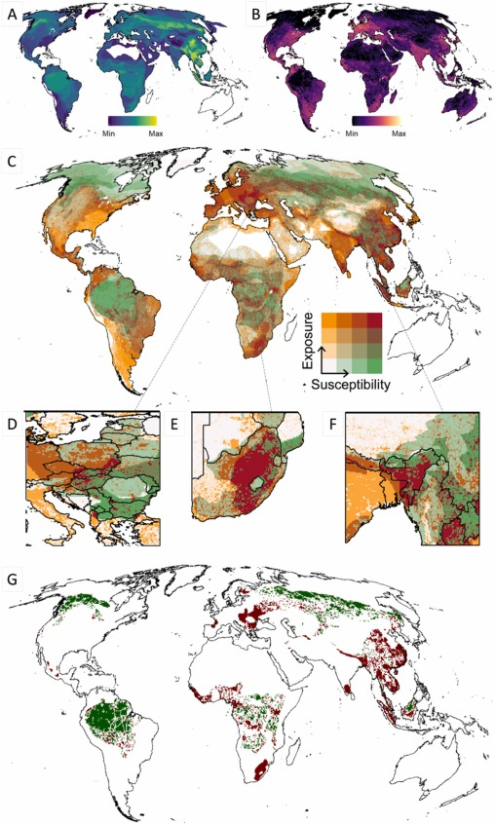
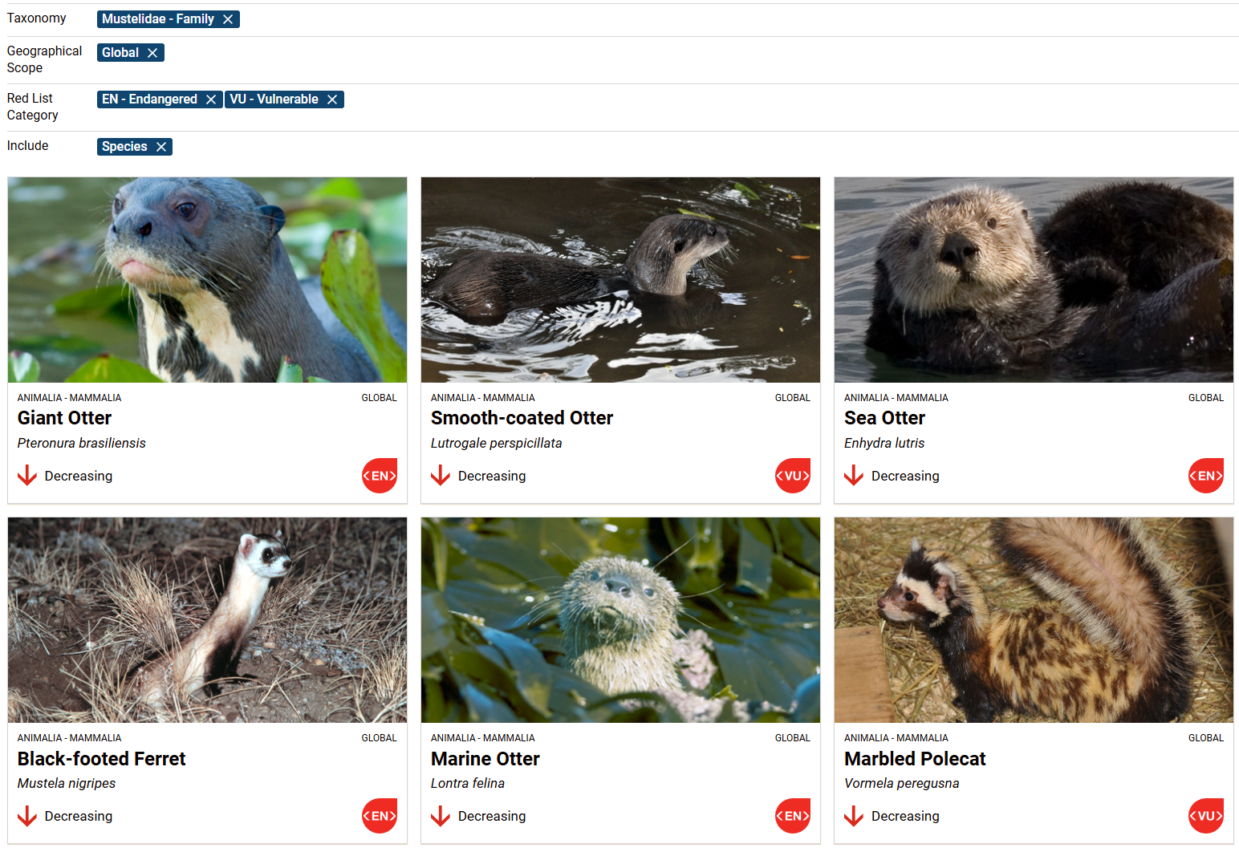

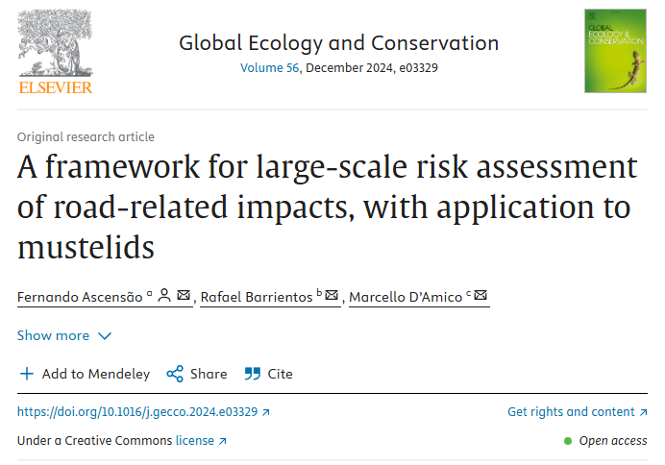

Slide 8
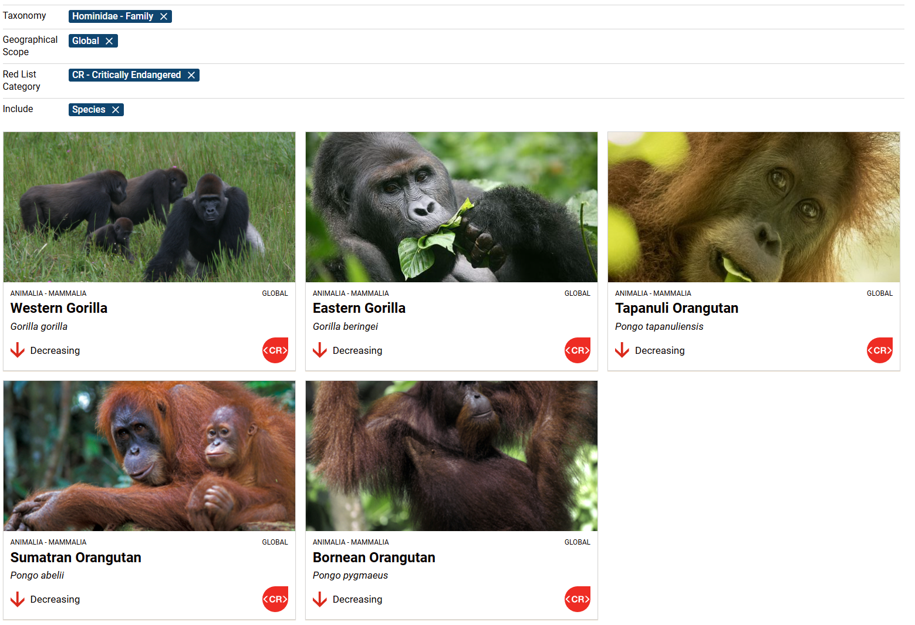

Slide 9
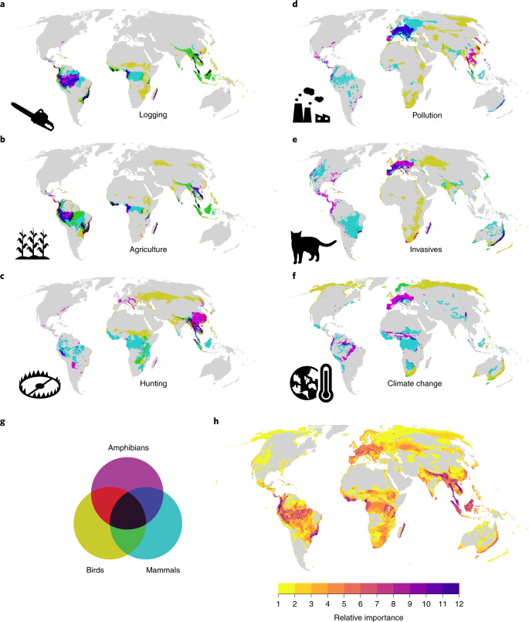
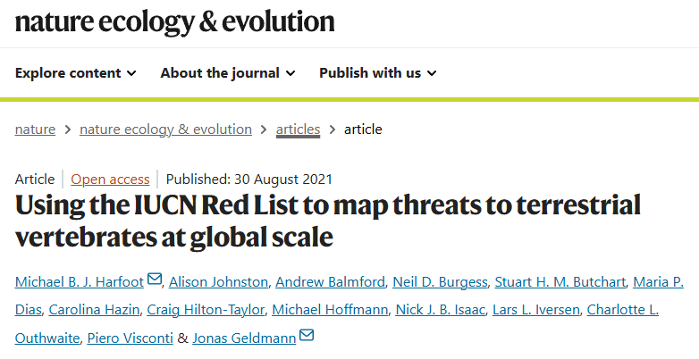
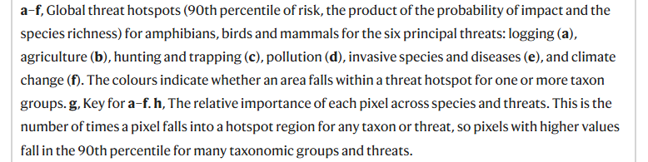

Slide 10
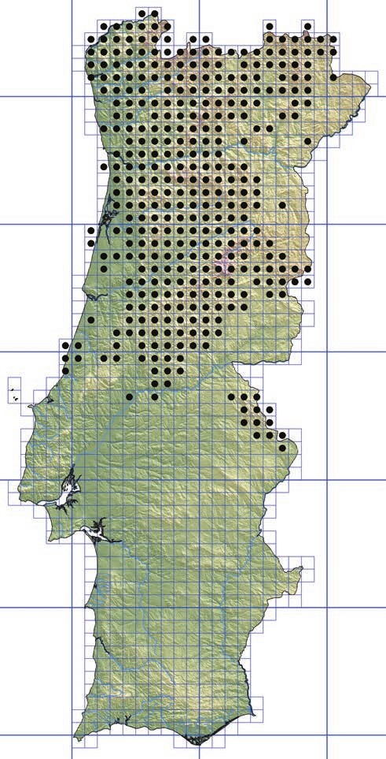
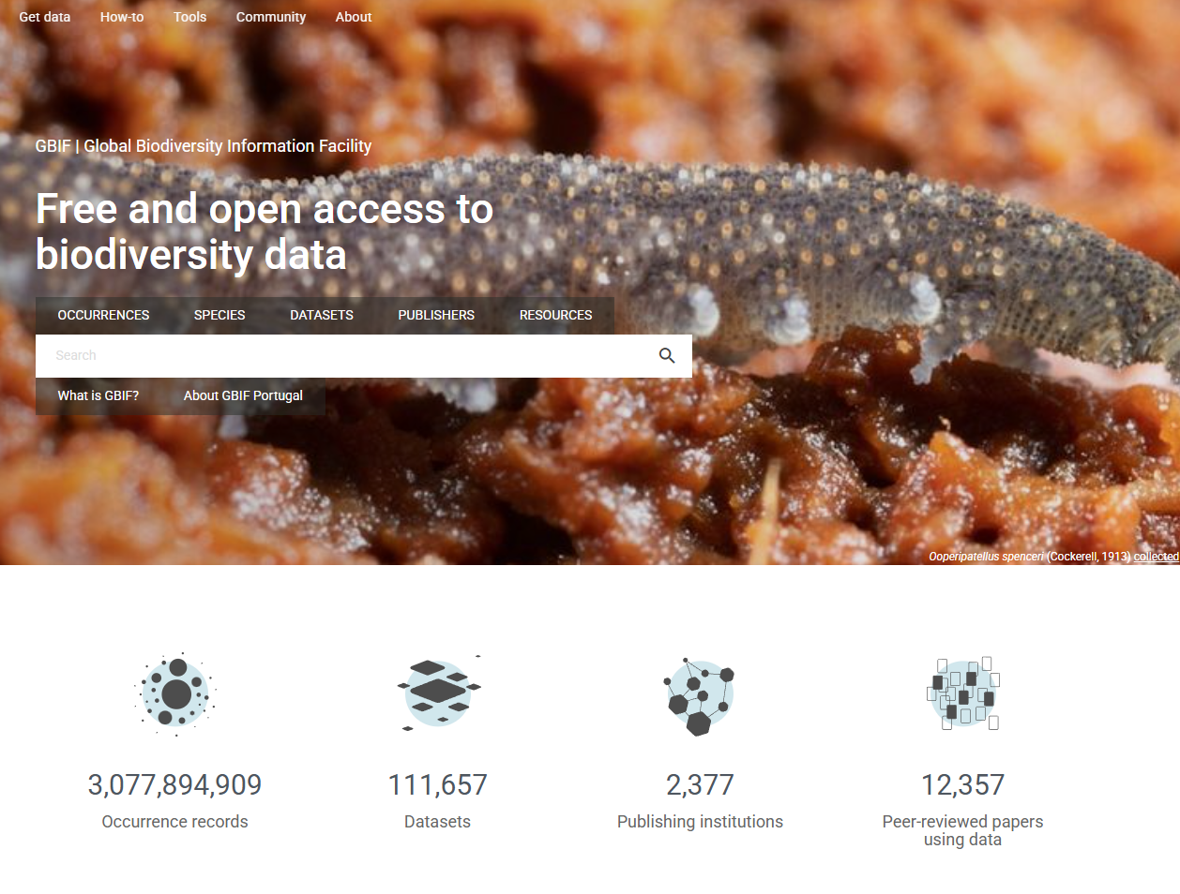

Spatial representation of species distribution data
https://www.gbif.org/
Atlas de anfíbios e répteis de portugal
Rana iberica Boulenger, 1879
Rã-ibérica
Estatuto de Conservação: LC - Pouco Preocupante

Slide 11
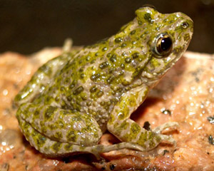
Spatial representation of species distribution data
Let’s try to catch some data
1 – go to https://www.iucnredlist.org/
2 – select a species you’re interested (your choice: present in Iberia, not extinct, not rare => not reduced distribution)
3 – download the spatial polygon (yes, you’ll have to create an account)
Open the shapefile in QGIS
4 – now go to https://www.gbif.org/
5 - select the same species
6 – download the records (yes, again, you’ll have to create an account)
(open with Notepad -> copy paste in Excel -> save as .csv)
Open in csv in QGIS
Pelodytes ibericus
Notes:
https://hatarilabs.com/ih-en/how-to-add-a-google-map-in-qgis-3-tutorial
https://www.icnf.pt/api/file/doc/a9a517554d153c71

Slide 12
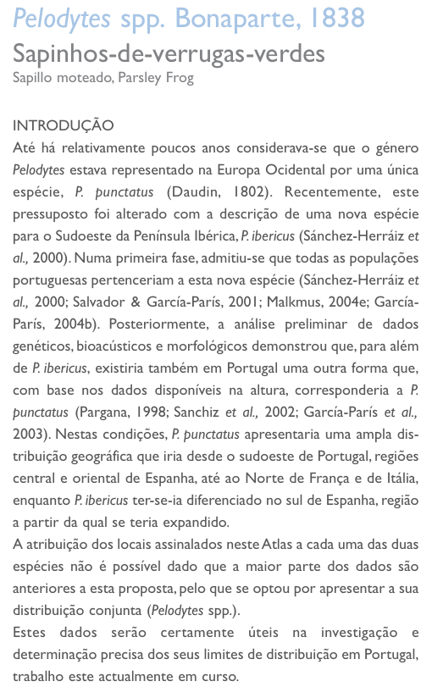
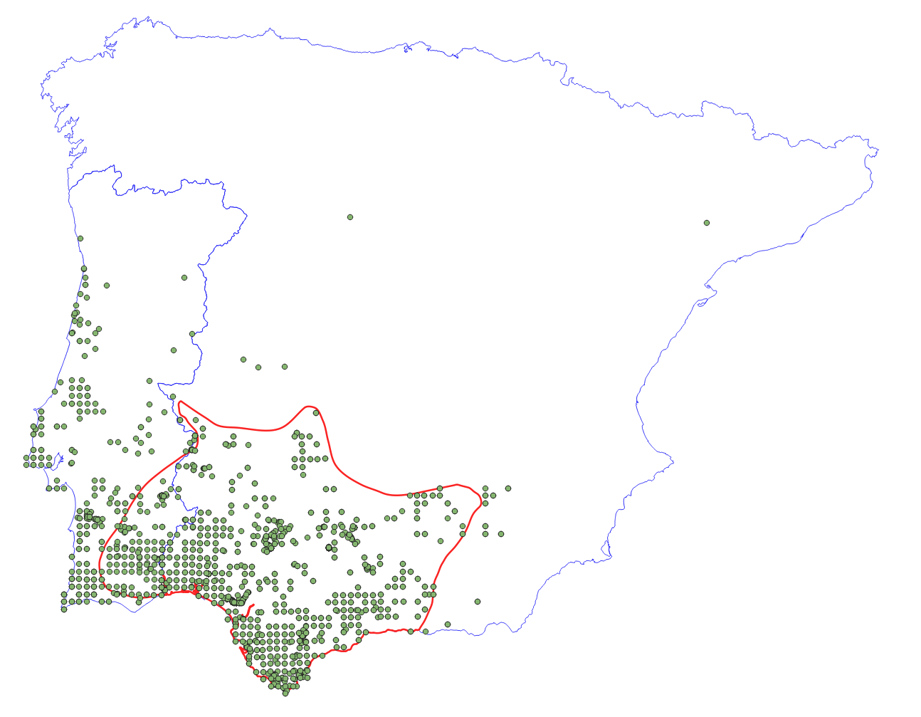


Slide 13
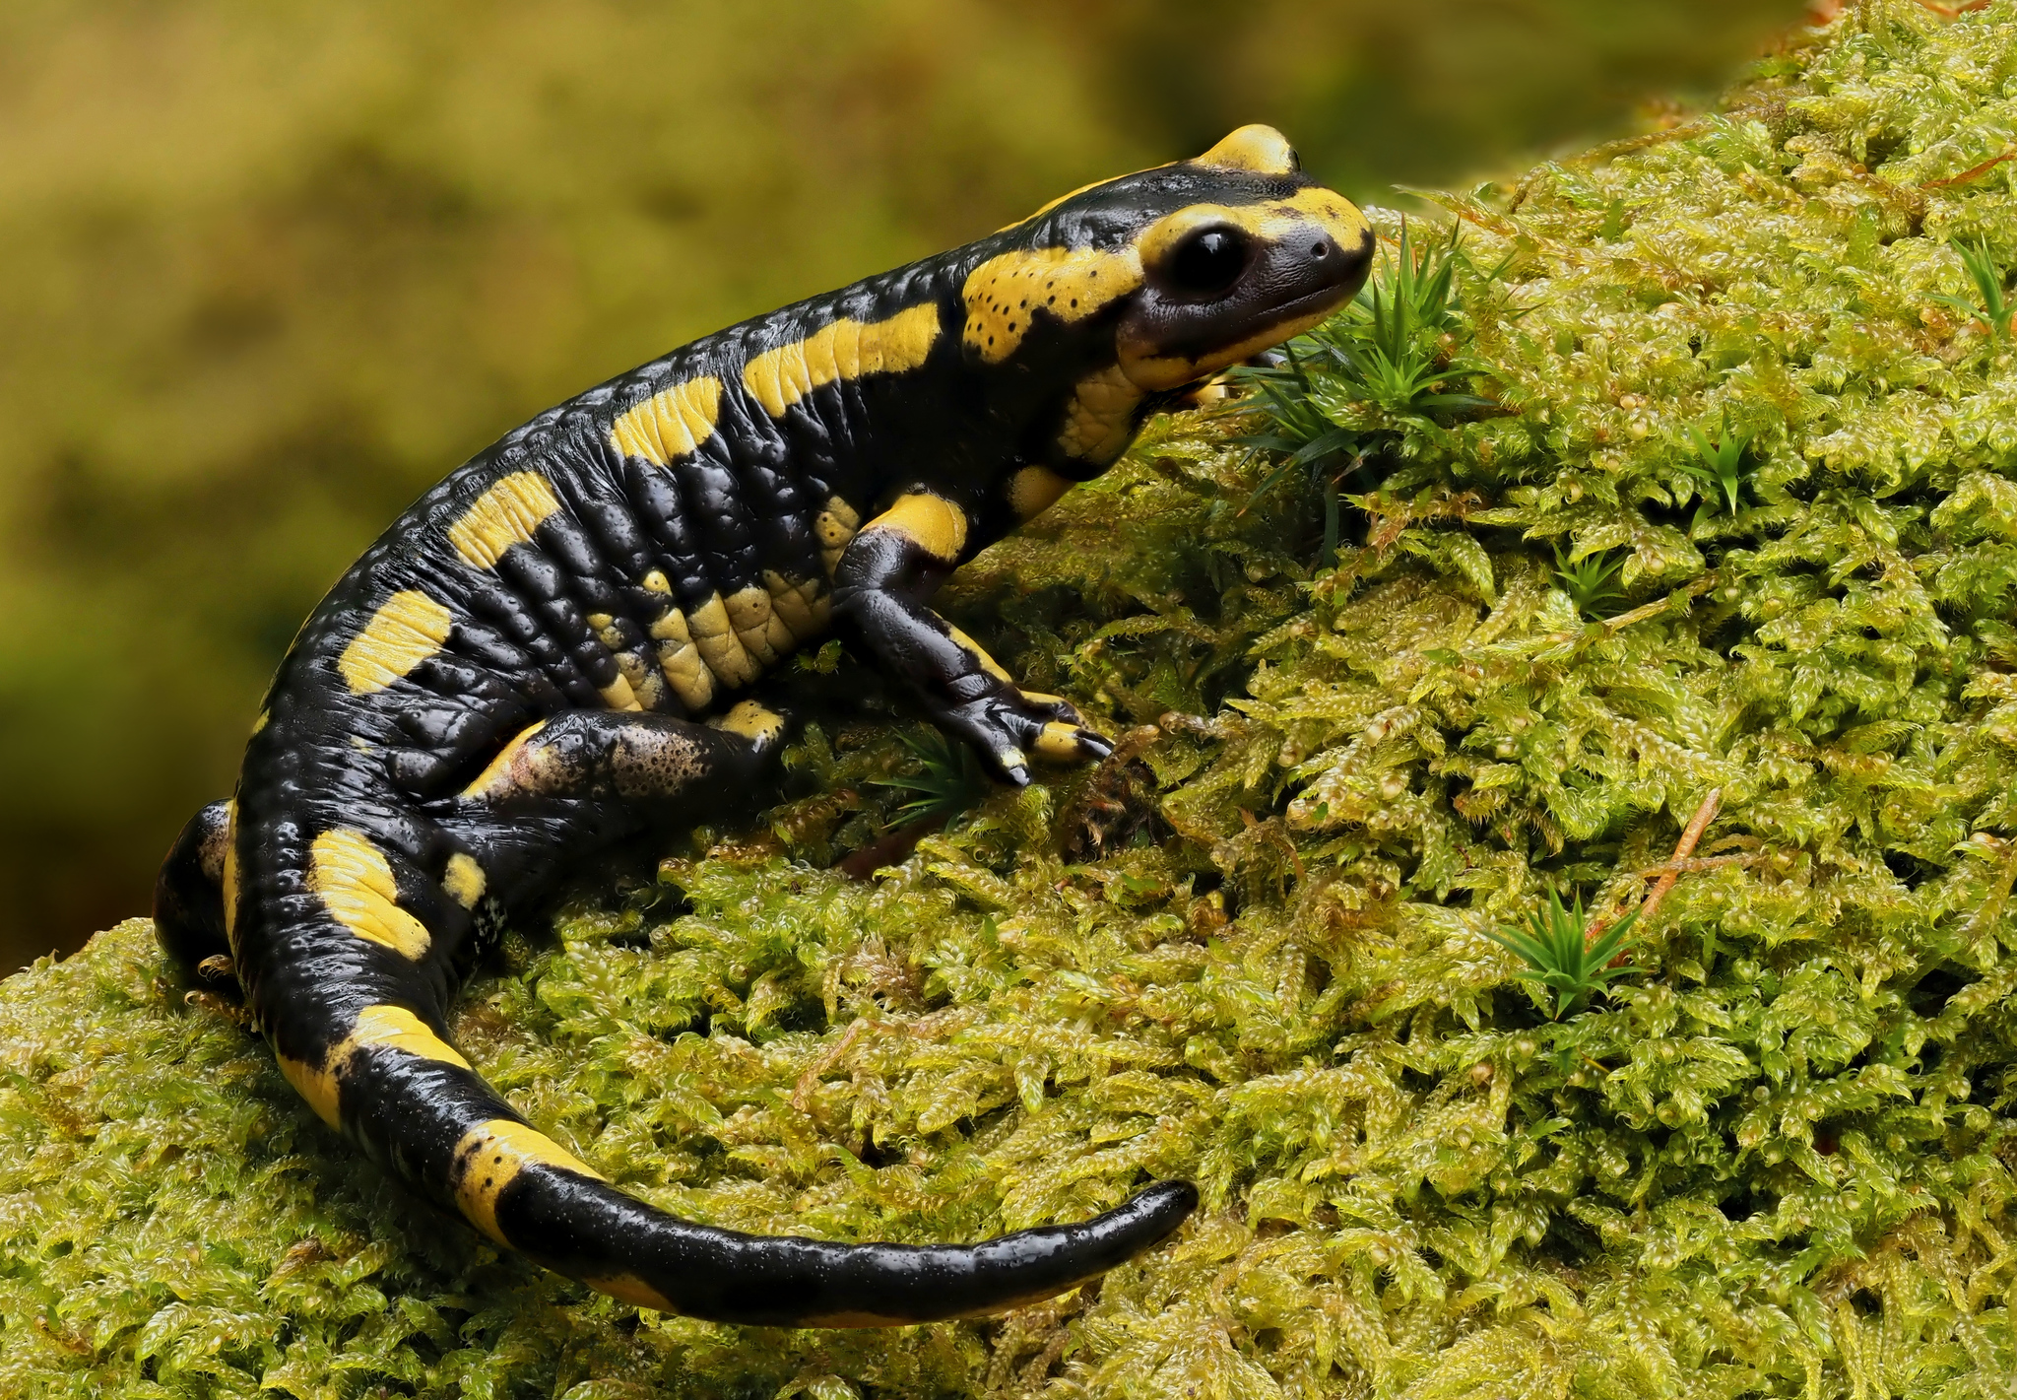
Spatial representation of species distribution data
Let’s try in R
- Focal species: Salamandra salamandra
- Open “1 - Get info RGBIF.r”
Notes:
What is a raster, what is a vector

Slide 14
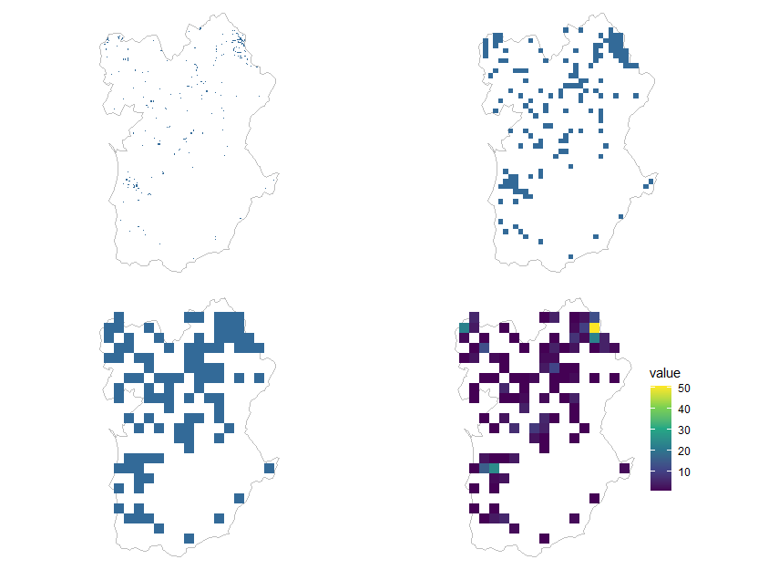
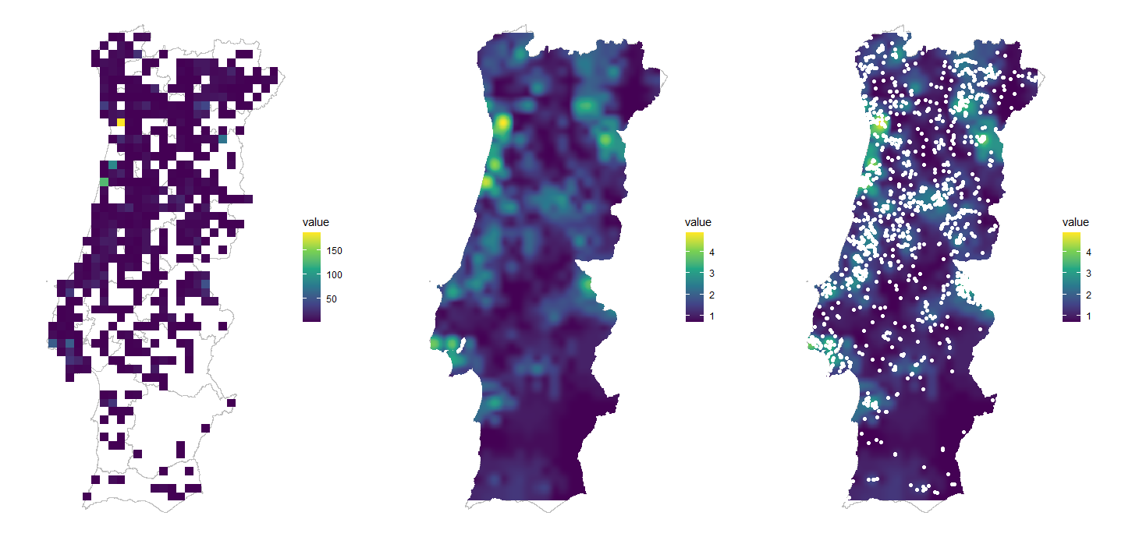
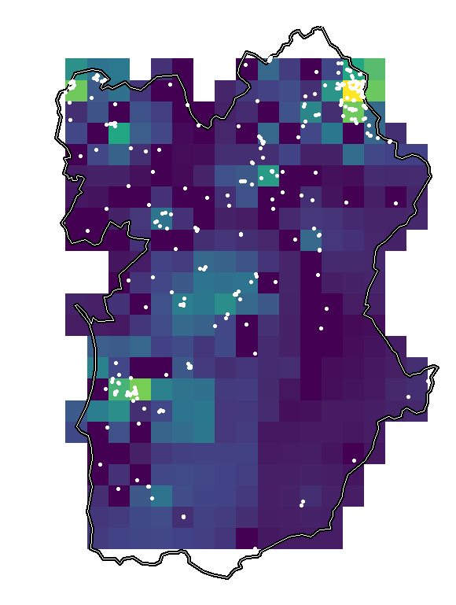
This is not an SDM, yet!

Slide 15
Distinction Between Heatmaps and Species Distribution Models (SDM)
Feature | Heatmaps 🌡️ | Species Distribution Models (SDM) 🌍
Purpose | Visualize density or intensity of data (e.g., species occurrences, temperature). | Predict species presence based on environmental variables.
Data Used | Raw occurrence points (e.g., GPS locations of observations). | Occurrence data + environmental predictors (e.g., climate, land cover).
Analysis Type | Descriptive (shows where species are observed most frequently). | Inferential (estimates where species could occur based on habitat suitability).
Spatial Interpolation | Uses kernel density estimation (KDE) or similar techniques to smooth point data. | Uses statistical or machine-learning models (GLM, MaxEnt, Random Forest, etc.).
Outputs | A gradient of colors representing concentration (e.g., more observations = hotter areas). | A probability or suitability map predicting species presence.
Biological Meaning | May reflect observer bias (more effort in some areas). | Attempts to control for bias and predict true species distributions.
Example Uses
Heatmaps: Where do people observe Podarcis hispanicus the most?
SDM: Where could Podarcis hispanicus survive based on climate and habitat?

Slide 16
Spatial representation of species distribution data
eBird
https://ebird.org/home
iNaturalist
https://www.inaturalist.org/
GBIF
https://www.gbif.org/pt/
Explore (you’ll have to register / sign in)

Slide 17



Slide 18
Environmental information
climate data from WorldClim : https://www.worldclim.org/data/index.html
(let try in R also, open “2 - Get WORLDCLIM.r”)
land cover from Copernicus: https://land.copernicus.eu/en/products/corine-land-cover
new repositories and tools: e.g. Google Earth Engine
(e.g., https://nlang.users.earthengine.app/view/global-canopy-height-2020)
Notes:
Today, such datasets are widely available in digital repositories. For example, species distribution data can be accessed via GBIF, and climate data from WorldClim, and land cover information from remote sensing products like Copernicus.
Various statistical and machine-learning algorithms are used to analyze the relationship between biodiversity observations and environmental conditions. Once this relationship is established, the model can be projected onto different spatial and temporal environmental layers to predict species distributions under current or future conditions.

