Slide 1
Class 2
Species Distribution Modeling - Generalized linear models

Slide 2
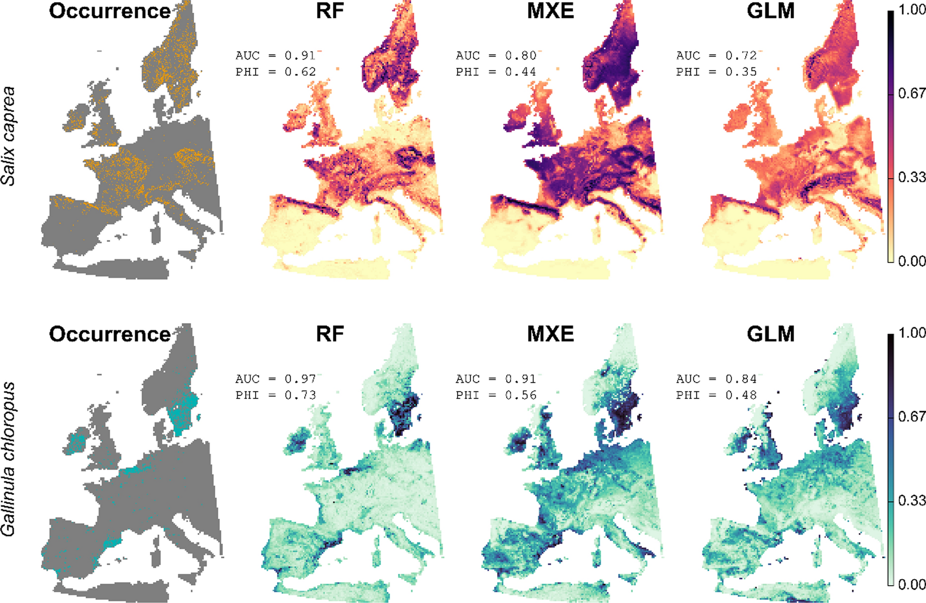
What is Species Distribution Modeling?
Species Distribution Modeling (SDM) is a widely used methodology for estimating the actual or potential geographic distribution of a species. It involves identifying the environmental conditions suitable for a species and mapping where these conditions occur geographically.
https://doi.org/10.1007/s10980-022-01465-1

Slide 3
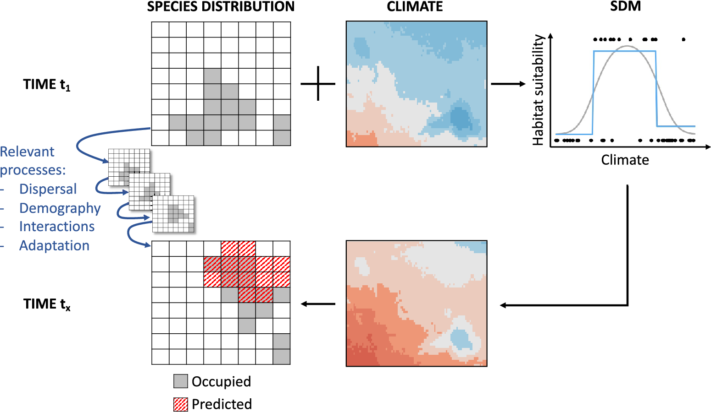
What is Species Distribution Modeling?
Correlative SDM (a.k.a. habitat suitability model, ecological niche model and environmental envelope model) has become an essential tool in conservation planning and ecological research, particularly in assessing the impacts of global change on biodiversity. For example, these models help project potential future range shifts of species and are fundamental to global change impact assessments.
https://doi.org/10.1017/ext.2023.5

Slide 4
What is Species Distribution Modeling?
One reason for their popularity is their relative ease of use —various software packages and methodological guidelines are readily available.
Thuiller et al. 2009
Phillips, Anderson, and Schapire 2006
Elith, Leathwick, and Hastie 2008
Elith et al. 2011
Merow, Smith, and Silander Jr. 2013
Guisan, Thuiller, and Zimmermann 2017
Additionally, SDMs have relatively low data requirements, making them accessible for a wide range of ecological applications.

Slide 5
Examples of applications of Species Distribution Models (SDMs) in conservation biology
Application | Description | Example
Identifying Suitable Habitats | Locating current and potential habitats for endangered species. | SDMs have helped identify reintroduction sites for the Iberian lynx (Lynx pardinus).
Predicting Climate Change Impact | Forecasting shifts in species distributions due to climate change. | Studies predict habitat contraction for cork oak (Quercus suber) due to rising temperatures.
Guiding Protected Area Designation | Prioritizing regions for conservation efforts. | Used in the Amazon rainforest to define biodiversity hotspots.
Invasive Species Management | Predicting the spread of invasive species for early intervention. | SDMs track silver wattle (Acacia dealbata) invasion in Iberia.
Assessing Habitat Fragmentation | Understanding how habitat loss affects species movement and genetic diversity. | Used in Europe to study urban expansion impacts on bumblebee (Bombus spp.) populations.

Slide 6
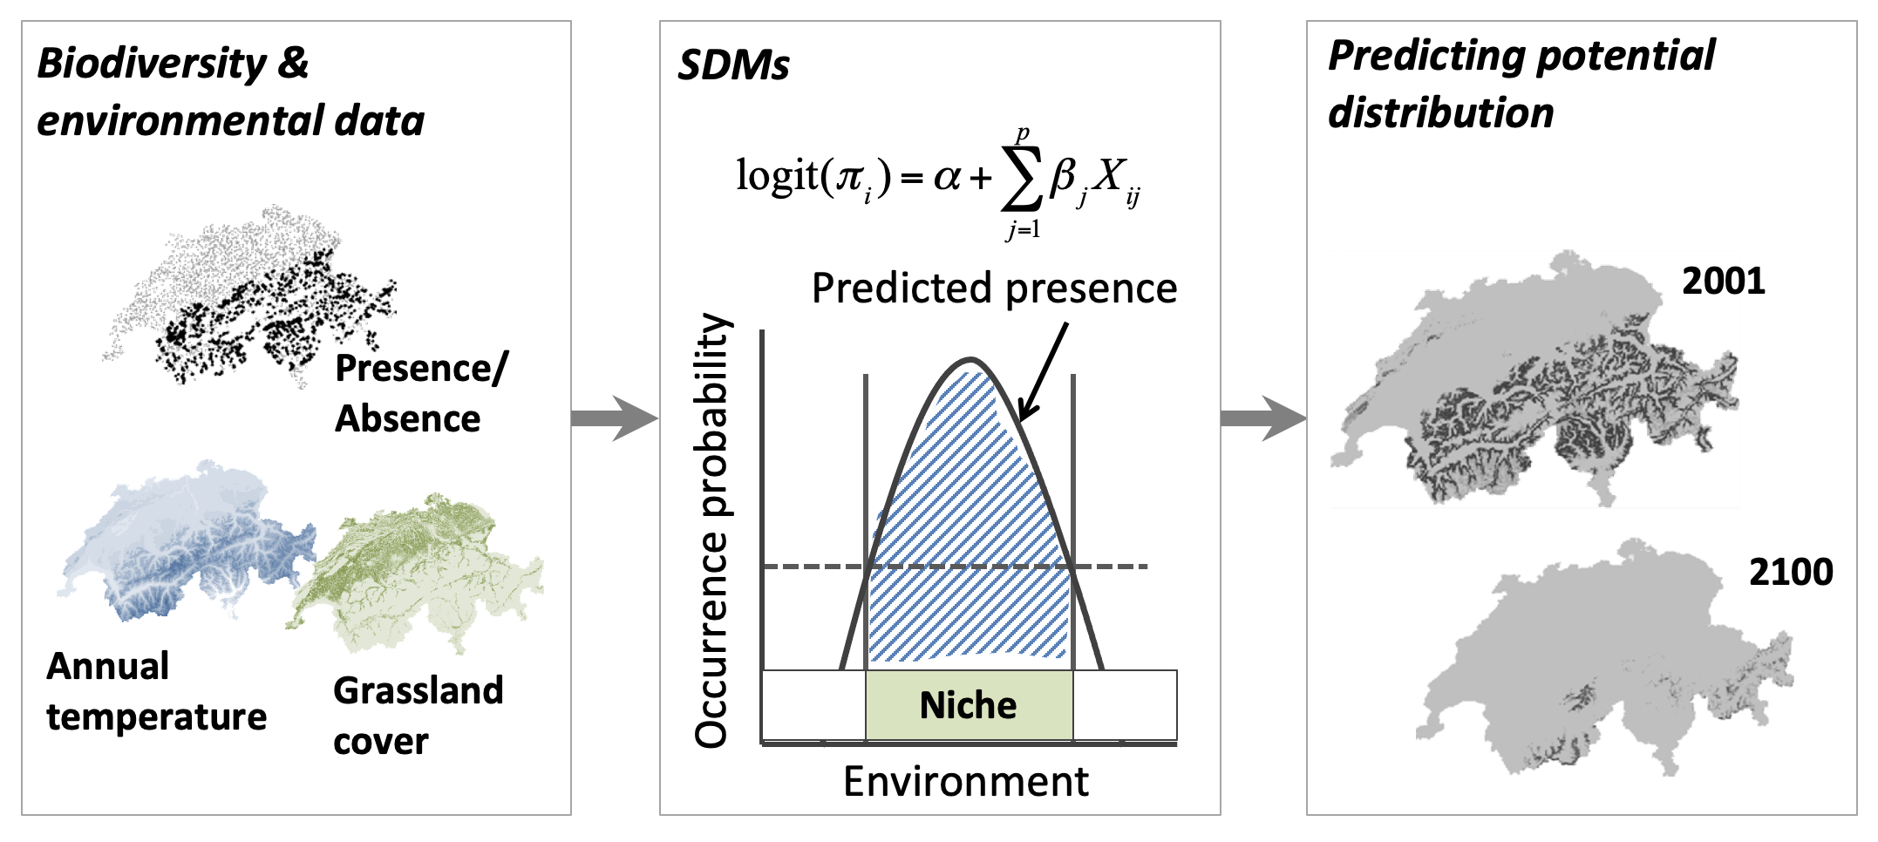
What do we need to build SDMs?
To build an SDM, researchers use georeferenced biodiversity observations as response variables. These are then related to geographic layers of environmental information, which serve as predictor variables.
Schematic representation of the species distribution modelling concept. First, biodiversity and environmental information are sampled in geographic space. Second, a statistical model (here, generalized linear model) is used to estimate the species-environment relationship. Third, the species–environment relationship can be mapped onto geographic layers of environmental information to delineate the potential distribution of the species. Mapping to the sampling area and period is usually referred to as interpolation, while transferring to a different time period or geographic area is referred to as extrapolation.
https://damariszurell.github.io/SDM-Intro
Notes:
To build an SDM, researchers use georeferenced biodiversity observations—such as species presence, counts, or richness—as response variables.
These are then related to geographic layers of environmental information (e.g., climate, land cover, soil attributes), which serve as predictor variables.

Slide 7
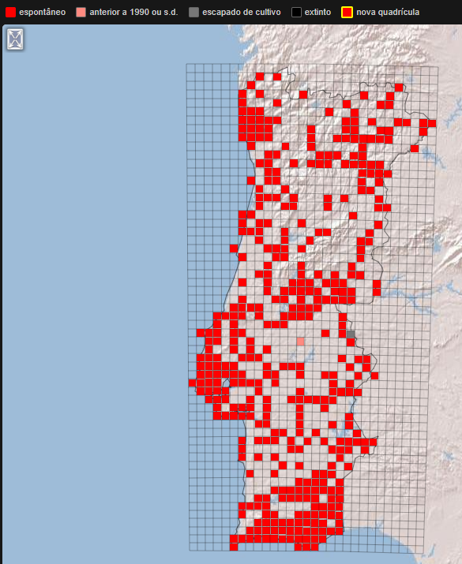

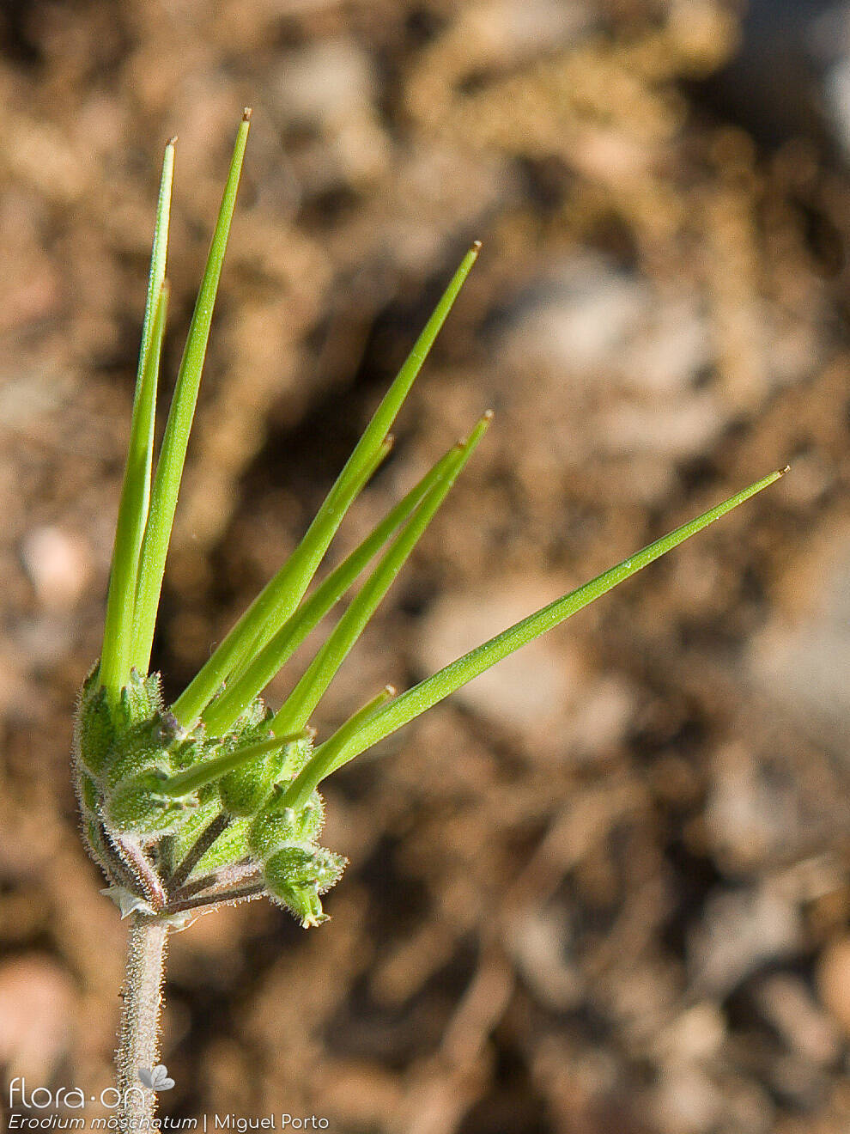
Geographic Space 🌍
Represents real-world locations (latitude & longitude)
A map-based perspective of species occurrence
Influenced by topography, dispersal, and biogeographic history
Example: A map showing where Erodium moschatum is found

Slide 8
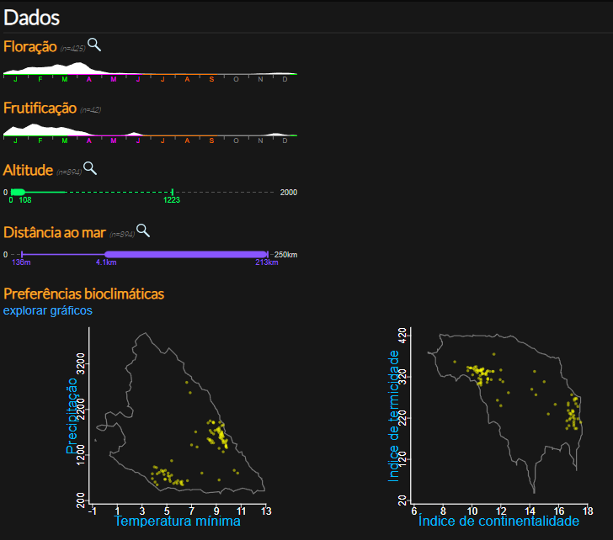
Environmental Space (E-Space) 🌱
Represents species distributions based on ecological conditions
A multidimensional space (e.g., temperature, precipitation)
Used to define the species' niche (Hutchinson’s n-dimensional hypervolume)
Example: A plot showing temperature and moisture ranges for Erodium moschatum

Slide 9
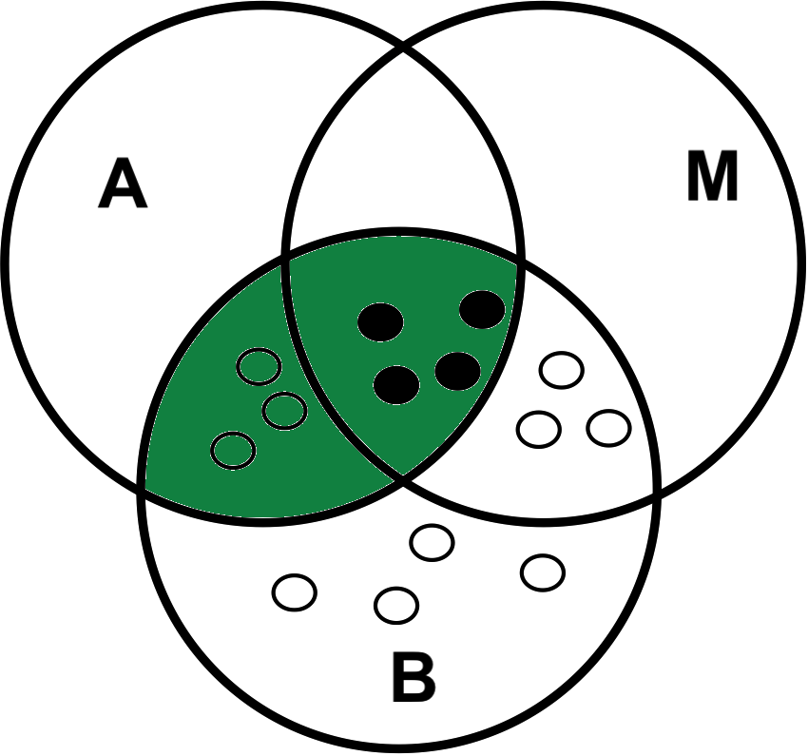
Theory and concepts
The BAM Framework: Biotic, Abiotic, and Movement Constraints
The BAM framework (biotic-abiotic-movement) offers a conceptual model to understand how these three factors—environmental conditions (A), biotic interactions (B), and movement ability (M)—interact to shape species distributions.
A species can only persist in regions where both abiotic conditions (A) and biotic interactions (B) allow positive population growth. The intersection of A and B defines the potential distribution, equivalent to the realized niche. The movement capacity (M) determines which geographic areas are accessible to the species within the relevant timeframe.
The final occupied distribution is the intersection of A, B, and M, representing the actual areas where the species is found.
Source populations thrive in areas where conditions support positive growth, while sink populations es) persist in suboptimal areas due to immigration.
The intersection of A and B defines the realized niche (green ellipse). Movement capacity (M) determines the accessible geographic range, and the intersection of A, B, and M represents the occupied range, where source populations (filled circles) are found. Sink populations (open circles) persist in unfavorable areas due to dispersal.
Linking Niche Theory to Species Distribution Models
Although SDMs are grounded in niche theory, there is ongoing debate about whether the estimated species-environment relationship corresponds to the fundamental niche (A), the realized niche (A ∩ B), or the occupied niche (A ∩ B ∩ M). This debate is reflected in the various terms used for distribution modeling, including climate envelope models, habitat models, resource selection functions, and species distribution models.
The part of the niche captured by an SDM depends on several factors:
Scale Dependence – Ecological processes vary across spatial and temporal scales, influencing how species-environment relationships are modeled.
Data Collection Biases – Biodiversity and environmental data are often collected in different ways, introducing potential biases.
Modeling Approaches – The choice of statistical or machine-learning algorithms and model complexity significantly affects SDM outcomes.
Given these complexities, careful consideration of assumptions, data quality, and methodological choices is crucial for interpreting and applying SDMs effectively.
(adapted from damariszurell.github.io/SDM-Intro;
Soberón 2007, Soberón and Paterson 2005)

Slide 10
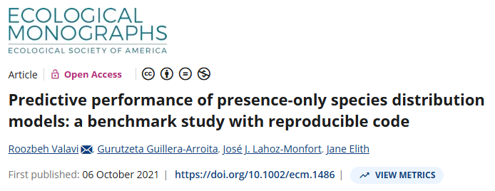
Araújo, M. B., R. P. Anderson, A. M. Barbosa, C. M. Beale, C. F. Dormann, R. Early, R. A. Garcia, et al. 2019. “Standards for Distribution Models in Biodiversity Assessments.” Science Advances 5: eaat4858.
Elith, J., S. J. Phillips, T. Hastie, M. Dudik, Y. E. Chee, and C. J. Yates. 2011. “A Statistical Explanation of Maxent for Ecologists.” Diversity and Distributions 17: 43–57.
Franklin, J. 2010. Mapping Species Distributions: Spatial Inference and Prediction. Cambride University Press.
Guisan, A., and W. Thuiller. 2005. “Predicting Species Distribution: Offering More Than Simple Habitat Models.” Ecology Letters 8: 993–1009.
Merow, C., M. J. Smith, and J. A. Silander Jr. 2013. “A Practical Guide to Maxent for Modeling Species’ Distributions: What It Does, and Why Inputs and Settings Matter.” Ecography 36: 1058–69.
Phillips, S. J., R. P. Anderson, and R. E. Schapire. 2006. “Maximum Entropy Modeling of Species Geographic Distributions.” Ecological Modelling 190: 231–59.
Soberon, J. 2007. “Grinellian and Eltonian Niches and Geographic Distributions of Species.” Ecology Letters 10: 1115–23.
Thuiller, W., B. Lafourcade, R. Engler, and M. B. Araujo. 2009. “BIOMOD - a Platform for Ensemble Forecasting of Species Distributions.” Ecography 32: 369–73.
…in general, nonparametric techniques with the capability of controlling for model complexity outperformed traditional regression methods, with MaxEnt and boosted regression trees still among the top performing models.

Slide 11
Hands on – GLM
1 - Open ‘GLM.r’
2 - Exercises GLM1 and GLM2

