Slide 1
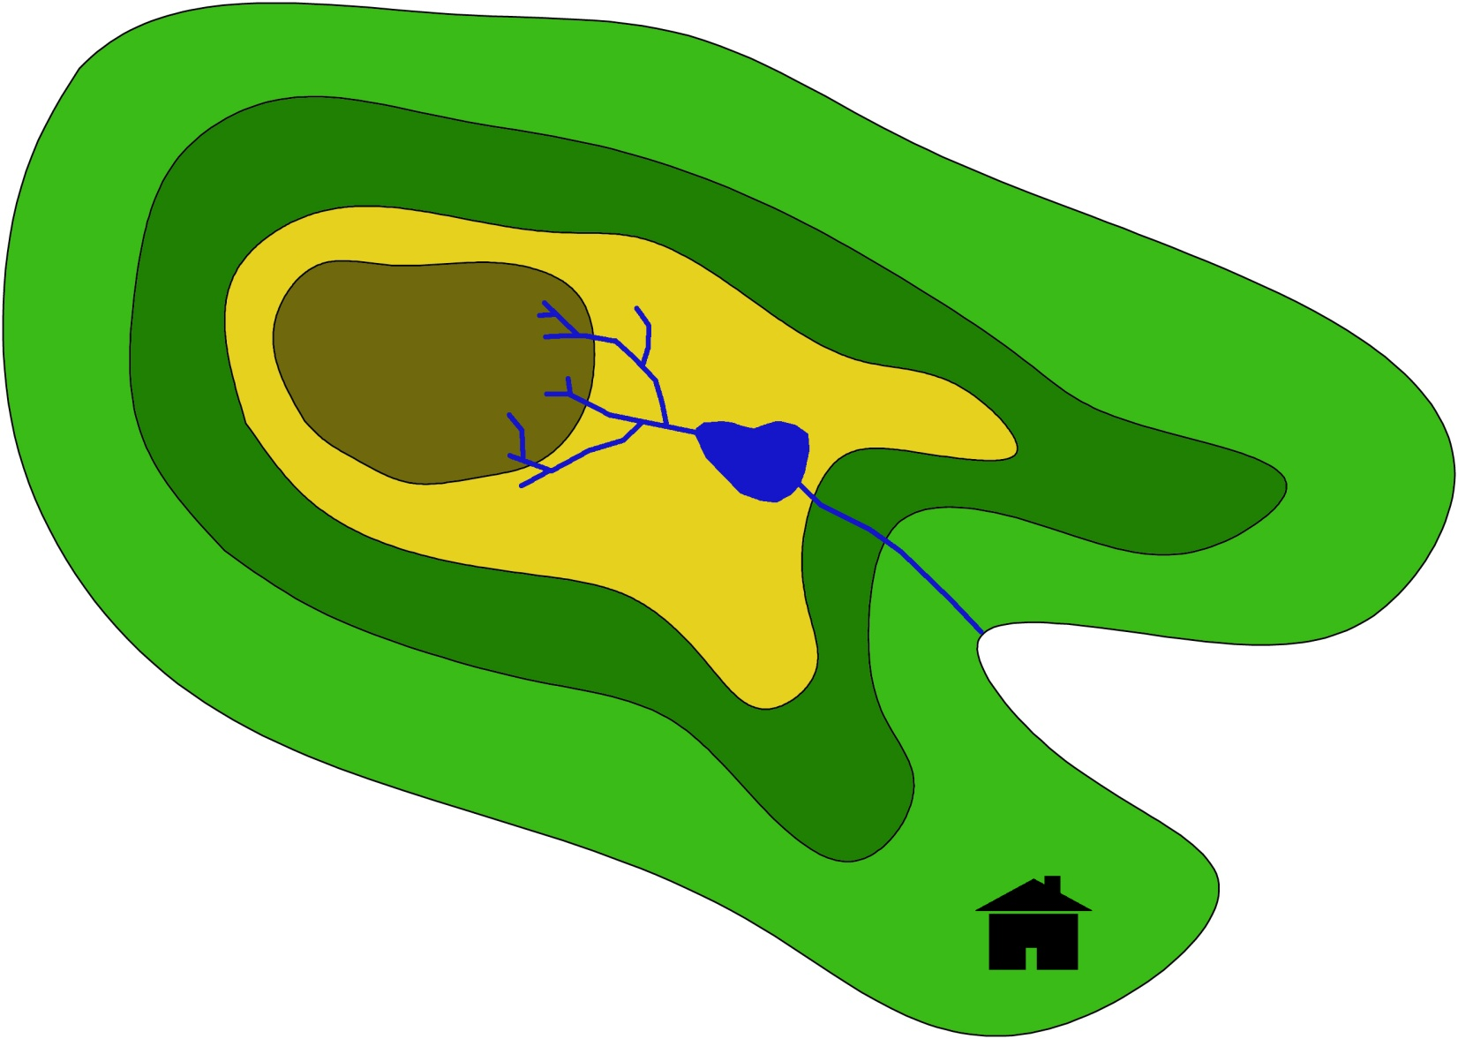
Energy systems
Miguel C Brito

Slide 2
Class | Topics | Deliverables
1 | Energy Supply.
2 | Tutorial work | Biblio revision
3 | Students’ presentations (1). | PPT1 & DOC1
4 | Students’ presentations (2).
5 | Energy demand. | DOC1_final
6 | Tutorial work | Biblio revision
7 | Students’ presentations | PPT2 & DOC2
8 | Energy storage and transmission
9 | Students’ presentations | PPT3 & DOC3
10 | Energy system
11 | Tutorial work
12 | Students’ presentations | PPT4 & DOC4

Slide 3
Application | Details | Questions
Mobility | Individual and public transport using EV and biofuel cars | kWh/year
 |  | kWh(t)*
Electricity | Load diagram and instruments for energy demand management
Heat | Shower hot water
 | Thermal comfort

Slide 4
Mobility
Objectives:
Estimate demand (kWh and kWh/person)
Demand elasticity for different mobility scenarios
Effect of electrification of transports
Individual transport
How much energy does a person need for transport?
20 km/person/day
10 litres/100km
10kWh/litre
How much embodied energy
in a car?
25k€
0.05 €/kWh
10 years

Slide 5
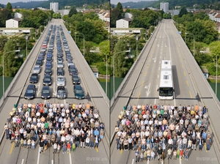
Mobility
Objectives:
Estimate demand (kWh and kWh/person)
Demand elasticity for different mobility scenarios
Effect of electrification of transports
Public transport
How much energy does a person need for transport?
20 km/person/day
40 litres/100km
10kWh/litre
30 passengers
Usually presented as kWh/100 p-km
Underground?
Trolley/tram?
Bicycle?

Slide 6
TRANSPORTES
Objectives:
Estimate demand (kWh and kWh/person)
Demand elasticity for different mobility scenarios
Effect of electrification of transports
Further questions (1)
if we replace individual cars by electric vehicles, what is the increment to the daily electricity load? (kWh/day/person)
Assume 10, 50 and 100% replacement
Eletric vehicles electricity demand, cost and battery capacity and lifetime.

Slide 7
TRANSPORTES
Objectives:
Estimate demand (kWh and kWh/person)
Demand elasticity for different mobility scenarios
Effect of electrification of transports
Further questions (2)
using biofuels, how much land is required for 10, 50 and 100% of penentration of EV?

Slide 8
Heat
Objectives:
Estimate demand for hot water and thermal comfort (kWh and kWh/person)
Effect of electrification of heat production
Hot water
60 litres @ 45ºC /day/person
Calculate and discuss
electricity/biogas/heat from CHP
demand to complement solar thermal.

Slide 9
Heat
Objectives:
Estimate demand for hot water and thermal comfort (kWh and kWh/person)
Effect of electrification of heat production
Thermal comfort
Each house 2x10x10 m³.
Q=A ∆T/R
(average R-value 2 m²K/W)
+ ventilation: 1 renovation per hour
COP = 3
Degrees-hour from Temperature time series

Slide 10
Heat
Objectives:
Estimate demand for hot water and thermal comfort (kWh and kWh/person)
Effect of electrification of heat production
Thermal comfort
Electricity demand: 100 units of energy today:
50% gas + 25% electric Joule (COP=1) + 25% electric AC (COP=3)
Replacing all heating/cooling by heat pumps (COP = 3),
0% gas + 0% electric Joule (COP=1) + 100% electric AC (COP=3)

Slide 11
Electricity
Objectives:
1) Estimate the load diagram
2) Identifity and discuss electricity demand sectors
2) Elasticity of electricity demand
Load diagram
Annual e weekly, for typical weeks
REN/EDIA
- Correct for population and island (e.g. Madeira & Açores)
Calculate:
Energy (MWh), Average power (MW), Peak power (MW), Capacity factor

Slide 12
Electricity
Objectives:
1) Estimate the load diagram
2) Identifity and discuss electricity demand sectors
2) Elasticity of electricity demand
Main electricity usage
Annual estimates only
How much electricity for heat production (talk to the ‘heat’ group)
Residencial night demand (2 lamps x 3 hours+ ½ TVh/person x ½ population)?
Public lighting
Industry and services (ERSE?)

Slide 13
Electricity
Objectives:
1) Estimate the load diagram
2) Identifity and discuss electricity demand sectors
2) Elasticity of electricity demand
Electricity demand management
Pricing (10% reduction at all times)
Daylight saving (explain, probably already included in load diagram)
Variable pricing (10% peak demand shifts to more favourable times)
Demand response (discuss; can only be modelled when we know the production)

Slide 14
NEXT CLASS
Bibliographic search
Preliminary analysis
Interaction between groups (e.g. biofuels & mobility, heat and demand, etc)

