Slide 1
ASTROFÍSICA EXTRA-GALÁCTICA: FORMAÇÃO E EVOLUÇÃO DE GALÁXIAS
Fernando Buitrago
fabuitrago@fc.ul.pt

Slide 2


Slide 3
Our classes:
  When?
  Where?
  Which language?
Material:
  You will have available all presentations and extra resources via moodle

Slide 4
ASSESSMENT CRITERIA
Final exam: from 0 to 20
Continual evaluation:
  Bring material for discussion + participation: 0-4
  Deliverables: 0-8 (including your master class)
  Exam: 0-8 (just for getting your final mark)

Slide 5
"We are trying to unravel the Mighty Infinite using a language which was designed to tell one another where the fresh fruit was."
Sir Terry Pratchett
The total amount of energy ever received by all the radio telescopes in planet Earth is less than energy of a single snowflake striking the ground.
Carl Sagan – Cosmos “The edge of eternity” chapter

Slide 6
“Stars are ageless, aren’t they?”
Norma Desmon after killing her ex-boyfriend in Sunset Boulevard
This is an example of the evils of specialization: a man must not write on Plato unless he has spent so much of his youth on Greek as to have had no time for the things that Plato thought important.
The history of Western Phylosophy – Bertrand Russell

Slide 8
RADIATION
B
www.chromoscope.net
www.mwmw.gsfc.nasa.gov/images/mwmw_11a.pdf

Slide 12
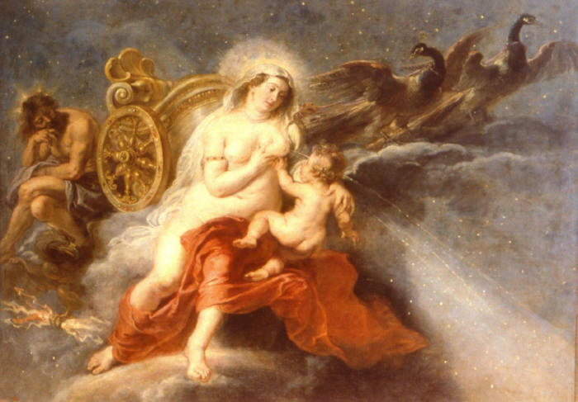
HISTORY OF THE GALAXY CONCEPT
The WOW factor
Why MW?
Geocentric vs Heliocentric
Galileo: MW is composed of stars
Halley: proper motions
Bessel: parallaxes
Kant: island universes
“”The infinity of creation is such big for a world, or a Milky Way of worlds, to look in comparison with it, as a flower or an insect in comparison with the Earth”.

Slide 13
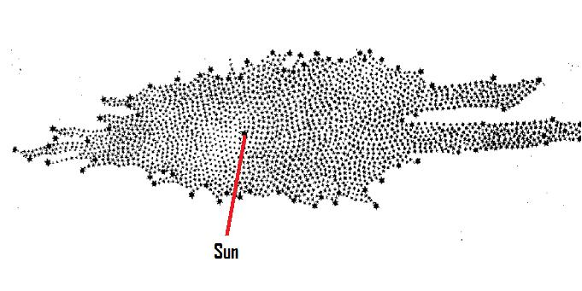
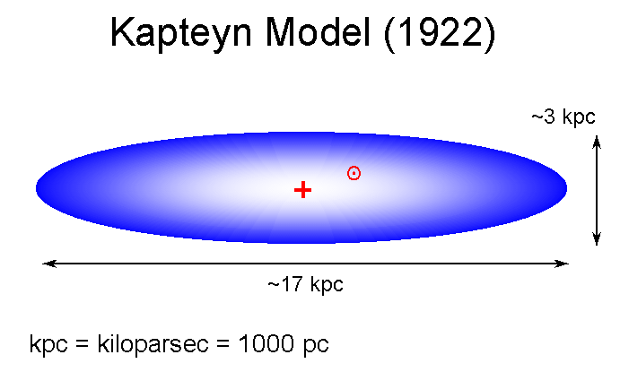
Laplace: nebular formation hypothesis
William Herschel: distribution of stars in the sky
Kapteyn Universe
Henrieta Swan Leavitt
Sharpley GCs and Barnard studies in extinction
Novas
THE GREAT DEBATE (1920): Sharpley vs Curtis
Hubble: Cefeids in Andromeda
Sharpley: No, it’s the Andromeda galaxy

Slide 14
Walter Baade and
the true size of MW
 | Mass (M☉) | Luminosity (M☉)
Disk | 60x10⁹ | 2x10⁹
Bulge | 20x10⁹ | 5x10⁹
Halo | 1x10⁹ | ?
From Sparke & Gallagher book

Slide 16
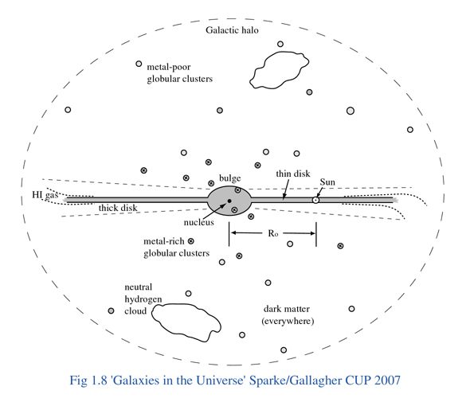
M_{stellar} ~4x10¹⁰ M_Sun
M_{dyn} ~5x10¹¹ M_Sun
(Ibata et al. 2012)
SFR ~1-3 M_Sun yr⁻¹
R_{e} ~2.5 kpc
(Van der Bergh 1999)
Bulge ~3 kpc in diameter

Slide 19
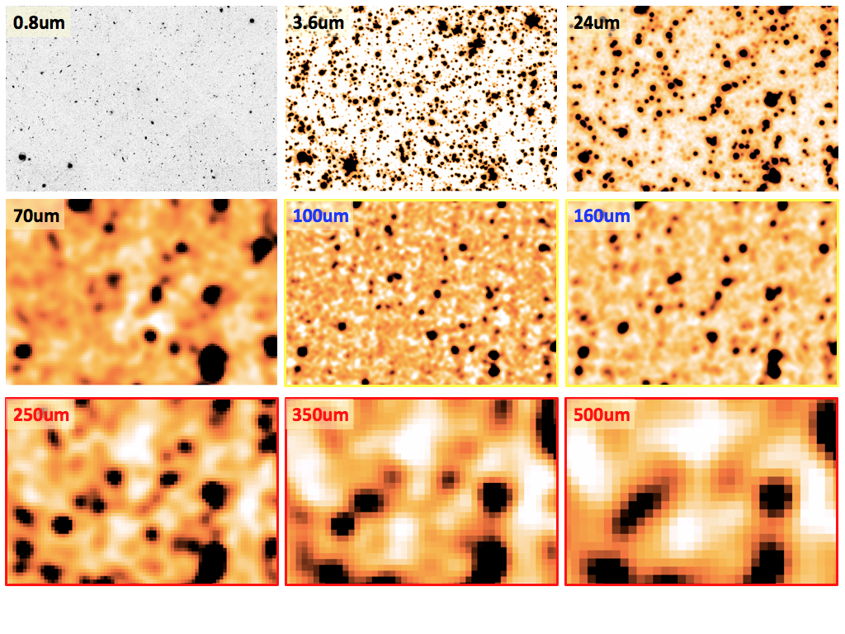
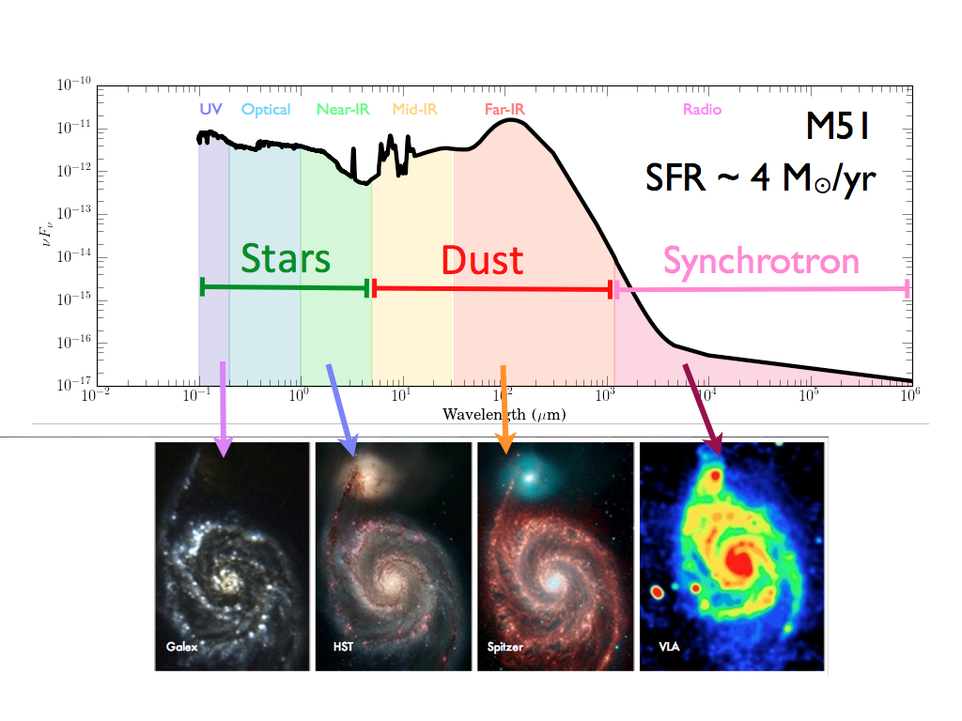
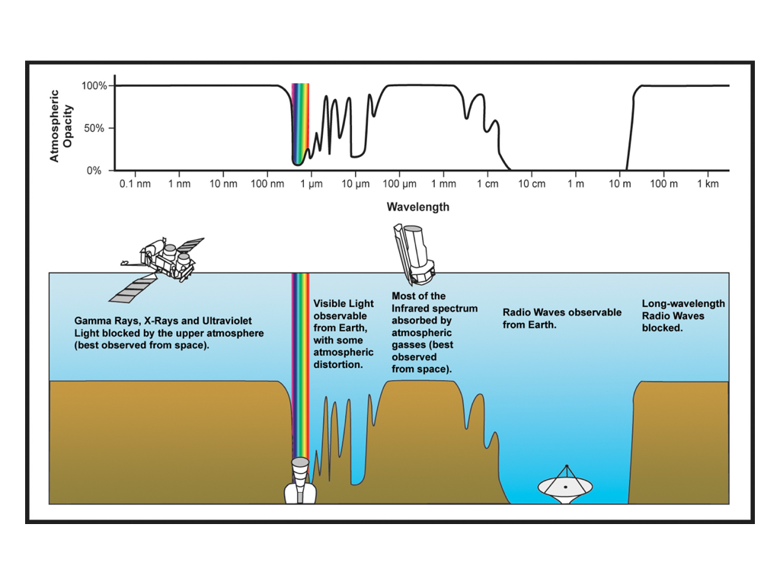

Slide 20
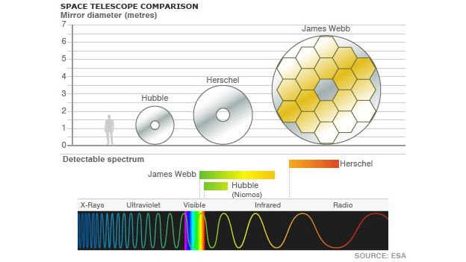
BEWARE: the formula is in radians

Slide 21
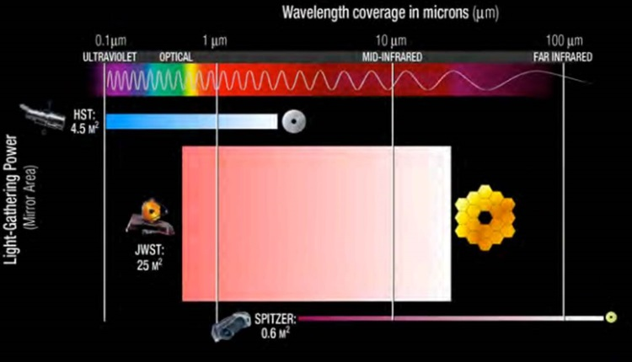

Slide 22
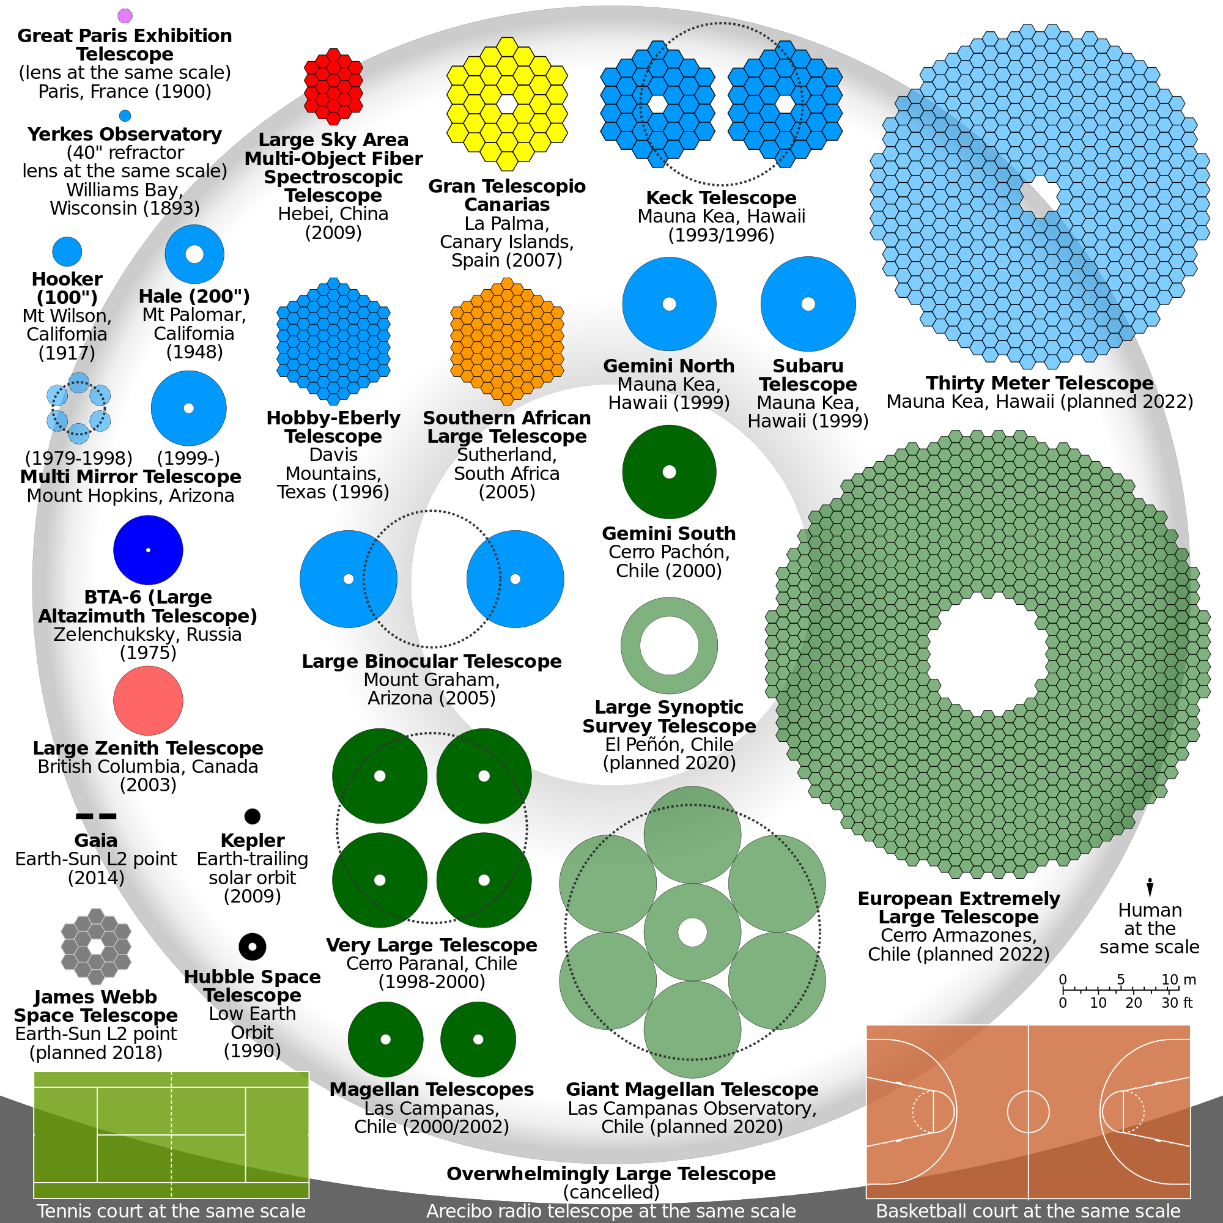

Slide 23
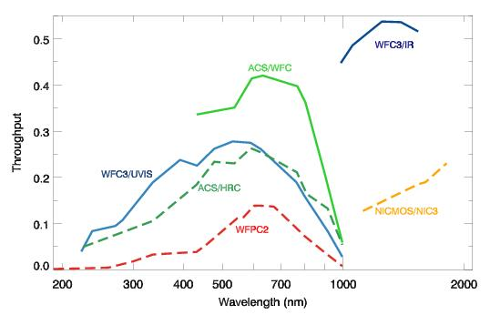

Slide 24
PHOTOMETRY
From Molino et al. 2013 for the ALHAMBRA survey

Slide 25
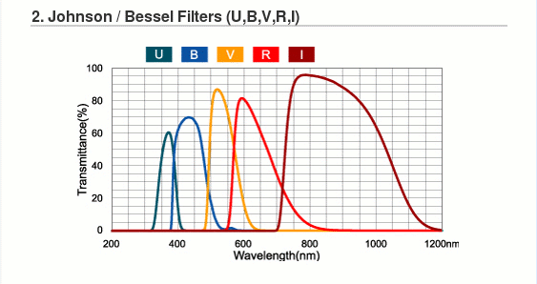

Slide 26
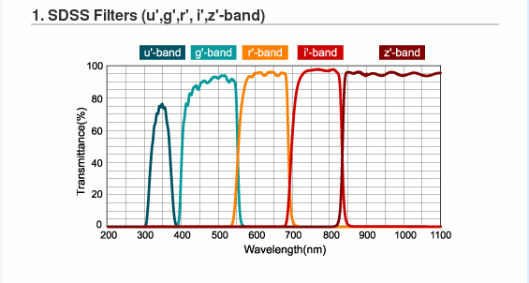
Numeric values (pivot wavelength, filter width, etc) in Ostlie & Caroll book

Slide 27
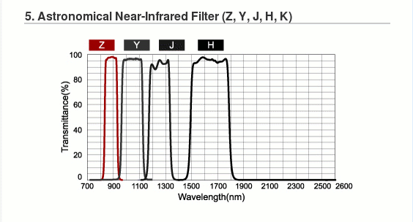

Slide 28
HST FILTER SET
Postman et al. 2012 CLASH survey

Slide 29
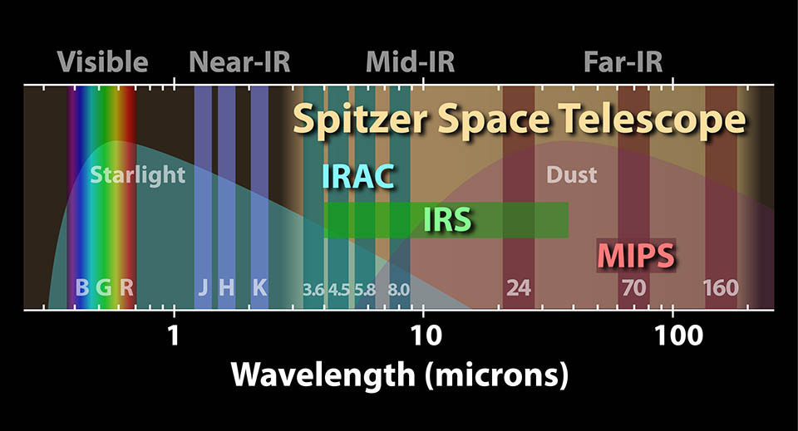

Slide 30
Spectral Energy Distribution (SED) => Photo-z, mass, …

Slide 31
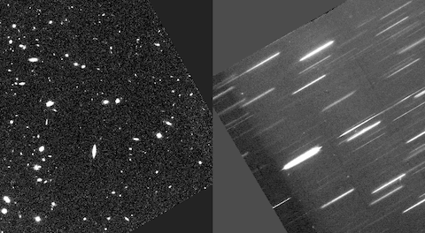
SLITLESS SPECTROSCOPY

Slide 32
3D SPECTROSCOPY
SINFONI, KMOS, MUSE, PPAK, MIRI, HARMONI, …
Notes:
----- Meeting Notes (02/10/2013 08:31) -----
all of our previous interpretations come from only photometry
IFU or 3D spectroscopic retrieves both spatial and spectral information (I'm sure you have seen these pictures of the blue- and red- shifted parts of the galaxy depending on it moves)
explain 3D spectroscopy
galaxy kinematics & merging

Slide 33
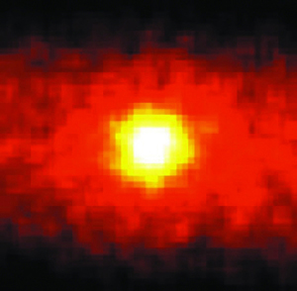
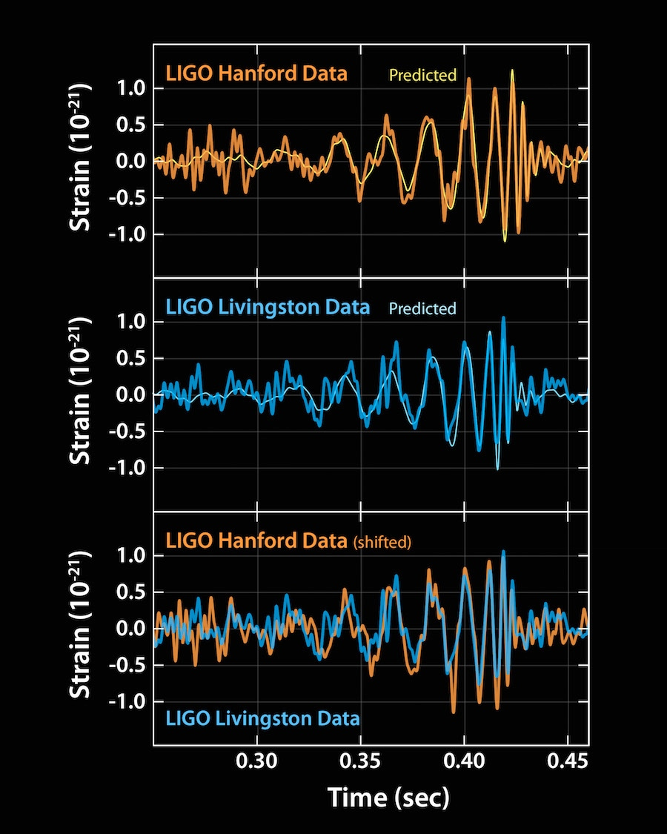
NON PHOTONIC ASTRONOMY
Neutrinos
Gravitational waves

Slide 34
OTHER TECHNIQUES
Polarimetry
(Interferometry)
((Adaptive optics))

