Slide 1

FUZZY LOGIC MODELS
Mestrados em Biologia da Conservação, Ecologia Marinha e Ecologia e Gestão Ambiental
Modelação Ecológica
2018 /2019
Inês Bento, 46283
Joana Araújo, 46766
Joana Pereira, 46125
Margarida Marques, 52399
Matilde Almodôvar, 47565
Morgan Casal Ribeiro, 53471
Pedro Afonso, 47594
Rita Pereira, 47662

Slide 2
model features
Fuzzy models are used when the data is fuzzy qualitative or semiquantitative
Handles PARTIAL truths truth value may range between 0 and 1
Linguistic variables are used to facilitate the expression of rules and facts
Notes:
São modelos que não dependem de medições precisas e reais, ou de valores exactos. Utilizam dados qualitativos, ou semiquantitativos.
Ao contrário da lógica mais tradicional, chamada lógica Boolean, onde os dados são “uma coisa ou outra”, zeros e uns, verdadeiros e falsos, os dados na lógica difusa não encaixam perfeitamente numa dada categoria. Fuzzy models lidam com verdades parciais, valores entre o zero e o um.

Slide 3
model features
Heterogeneity and uncertainty are characteristic properties of ecological data bases!
Uncertainty results from random variables, incomplete or inaccurate data, estimations and incomparability of data
Ecological data can be defined as fuzzy sets with no sharply defined boundaries, which better reflects the continuousness of nature

Slide 4
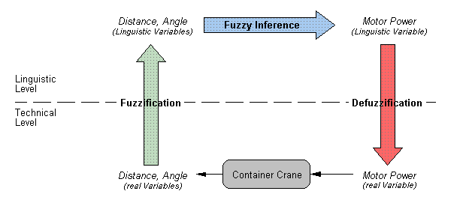
model features

Slide 5
model features
Real Values
Real Values
Rule Base
Fuzzify
Defuzzify
Input
Fuzzy set
Inference
Output
Fuzzy set

Slide 6
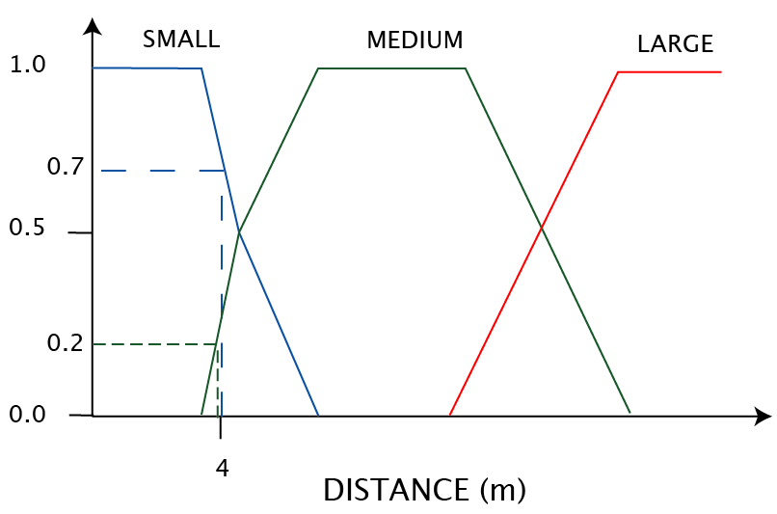
model features
Membership value

Slide 7
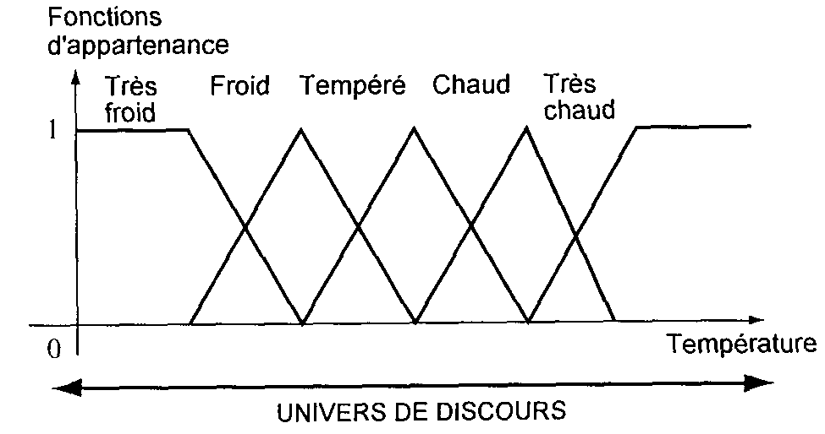
model features

Slide 8
model features
Input variables
Cold
Warm
Rain
Snow
Fedding
Wear a coat
Wear a t-shirt
Wear a raincoat
Wear boots
IF (Cold) THEN (Wear a coat)
IF (Warm) THEN (Wear a t-shirt)
IF (Cold) and (Rain) THEN (Wear a raincoat)
IF (Cold) and (Snow) THEN (Wear boots)

Slide 9
model features
Real Values
Real Values
Rule Base
Fuzzify
Defuzzify
Input
Fuzzy set
Inference
Output
Fuzzy set

Slide 10
model features
Kg of meat and bones
a - 5 kg
b - 10 kg
c -20 kg
d -30 kg
e - 40 kg
Energy gain
a – 100 kcal
b – 250 kcal
c – 500 kcal
d – 1000 kcal
e - no effort
Rule Base
Fuzzify
Defuzzify
Input
a - die of hunger
b - very hungry
c - hungry
d - a bit hungry
e - not hungry
Inference
Output
a - rat or anything
b - bunny or partridge
c - fox or dog
d - sheep or cow
e - don’t land

Slide 11
model features
e
d
c
b
a
Input Fuzzy set:
a - Die of hunger
b - Very hungry
c - Hungry
d - A bit hungry
e - Not hungry
Membership value
Progression of hunger

Slide 12
model features
Vulture
a - Die of hunger
b - Very hungry
c - Hungry
d – A bit hungry
e - Not hungry
IF (vulture is very hungry) | THEN (feeds on rabbit or partridge)
IF (vulture is hungry) | THEN (feeds on fox or dog)
IF (vulture is not hungry) and (Juvenile is very hungry) | THEN (feeds on rabbit or partridge)
IF (vulture is not hungry) and (Juvenile is fed) | THEN (don’t land)
Fedding
a – Rat or anything
b – Rabbit or partridge
c - Fox or dog
d - Sheep or cow
e - Don’t land
Juvenile
a - Juvenile fed
b - Juvenile hungry
c - Juvenile very hungry

Slide 13
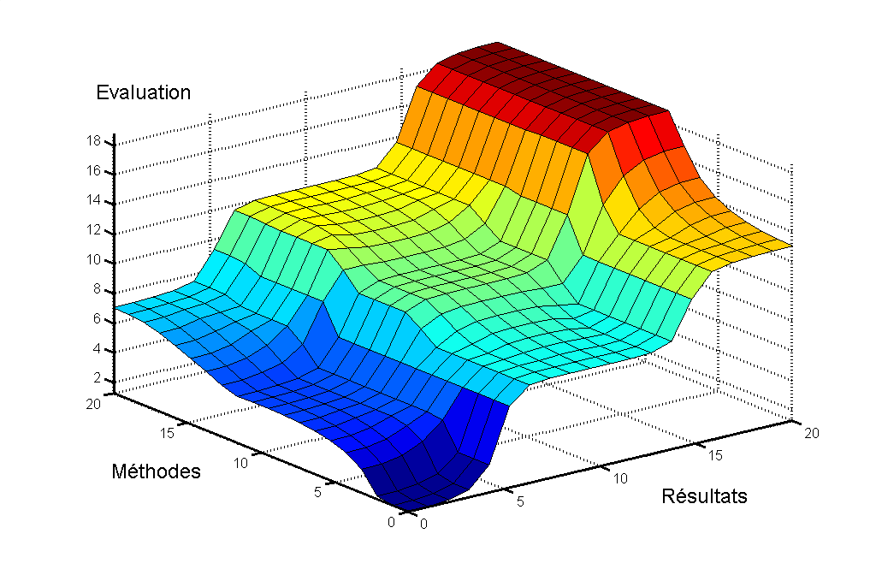
model features
Feeding
Vulture
Juvenile

Slide 14
advantages
  The representation and handling of imprecise data defined as fuzzy sets
  The representation and processing of vague knowledge in the form of linguistic rules with imprecise terms defined as fuzzy sets

Slide 15
disadvantages
    Hard to quantify predictions
    Applicable to simple situations with few variables
    Less credibility than other models
Fuzzy Models - 75,000
Steady-State – 923,000
Individual Based Models -2,810,000
Dynamic Models – 2,600,000

Slide 16

Case study 1
Prediction of abundance levels of Crustacean species (Asellus and Gammarus) in river basins in Flanders (Belgium)

Slide 17
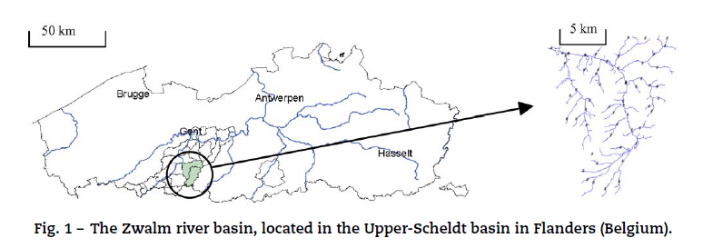
Case study 1 introduction
The aim of this study was the construction of fuzzy knowledge-based models for the prediction of the macroinvertebrate taxa Gammarus and Asellus in the Zwalm river basin
Gammarus and Asellus were chosen as representative taxa because of their highly variable presence in these headwaters and their use as bio-indicators in river quality assessment

Slide 18
Case study 1 results
SELECTION OF INPUT VARIABLES, CONSTRUCTION OF THE MEMBERSHIP FUNCTIONS AND THE FUZZY RULE BASE
Literature research allowed the formation of an ecological knowledge database that was used to select the (physical–chemical) input variables and to construct the fuzzy sets and rules of the model.
Input variables | Gammarus | Asellus
Conductivity | Low | Low
Dissolved oxygen concentration | High | High
Stream velocity | High | Low
Stream width | Low | High

Slide 19
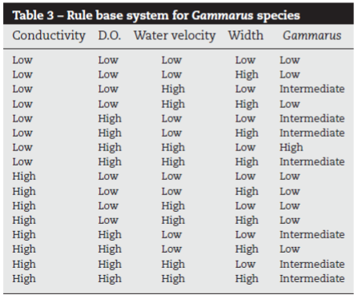
Case study 1 results
SELECTION OF INPUT VARIABLES, CONSTRUCTION OF THE MEMBERSHIP FUNCTIONS AND THE FUZZY RULE BASE
Literature research allowed the formation of an ecological knowledge database that was used to select the (physical–chemical) input variables and to construct the fuzzy sets and rules of the model.
Fuzzy sets
Input variables
(Conductivity, D.O., width and stream velocity)
High
Low
Output variable
(Abundance classes for each species)
High
Medium
Low

Slide 20
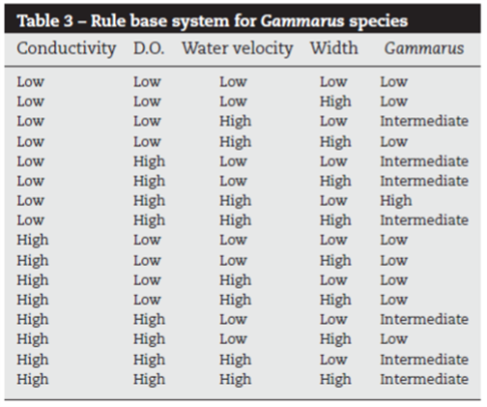
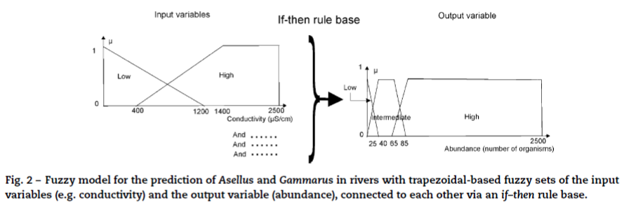
Case study 1 results
SELECTION OF INPUT VARIABLES, CONSTRUCTION OF THE MEMBERSHIP FUNCTIONS AND THE FUZZY RULE BASE

Slide 21
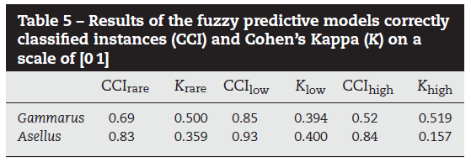
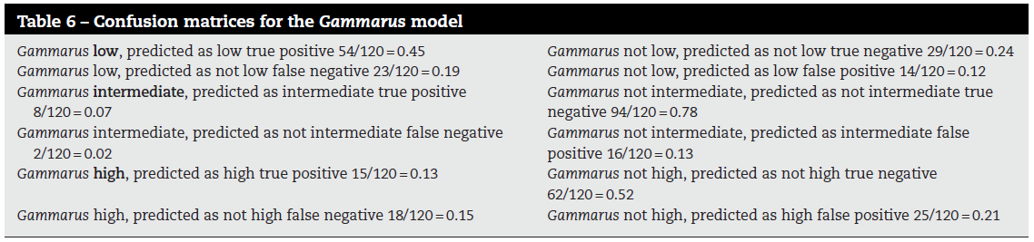
Case study 1 results
VALIDATION AND OPTIMIZATION OF THE FUZZY MODELS
CCI and Cohen’s Kappa (K) were used to evaluate the model based on the Zwalm river basin data set
By comparing the predicted with the measured results for the Zwalm river basin, matrices of confusion were constructed, identifying true positive, false positive, false negative and true negative cased for each model.

Slide 22
Case study 1 conclusion
The developed fuzzy models for the prediction of Gammarus and Asellus in rivers, as evaluated by CCI and Cohen’s Kappa K, seem to perform well and can have practical application in the decision support related to water management.
In comparison to other predictive modelling techniques, fuzzy models have the advantage to:
  allow the inclusion of large numbers of combinations of parameters into habitat simulation tools and therefore it is easy to include more parameters.
  be simple (relations between input and output variables can be explained in a linguistic-based rule base)
  be robust (performance is not depending on training and new input variables and rules can be easily added).
Notes:
Predictive models could be of practical use for decision support in river management. For river managers, knowledge of the environmental factors that favour key biota can guide their planning of restoration actions and conservation management.

Slide 23

Case study ii
Predict the coral reef development in response to anthropogenic perturbations in the next 10 years, in Curaçao coral reef.

Slide 24

Case study II
Coral reefs
Several ecological functions and an immense biodiversity
Anthropogenic perturbations
Take action now
Iborisoff (2012)
Notes:
https://www.sciencemag.org/news/2016/09/some-relief-great-barrier-reef
https://www.istockphoto.com/pt/foto/recife-de-coral-gm148788639-20398585

Slide 25
Case study II
Coral reefs
Predict the coral reef development in response to anthropogenic perturbations in the next 10 years, in Curaçao coral reef.
Ecossystems of high complexity.
Lack of exact data.
Fuzzy model
Iborisoff (2012)
Notes:
https://www.sciencemag.org/news/2016/09/some-relief-great-barrier-reef
https://www.istockphoto.com/pt/foto/recife-de-coral-gm148788639-20398585

Slide 26
Case study i1
variables
inpupts
outputs
Suspended particulate matter (SPM),
Dissolved inorganic nitrogen (DIN),
Soluble reactive phosphorus (P),
Diversity of hard coral (DIV),
Coral cover (COV),
Available substratum (SUBS),
Coral maximum colony size (SIZE).
Living cover of hard corals,
Species number.
HIGH
MEDIUM
LOW
Notes:
SPM - The SPM concentrations represent an instantaneous measure of the concentration of particles suspended in the water colum.
SUBS - The amount of substratum available for settlement of coral larvae is defined as that part of the bottom not covered by sand, macro-algae, or dense stands of algae turfs.
SIZE - Maximum colony size, measured as living surface area, is used here as an integrated measurement for disturbance intensity and frequency (Connell 1978; Done 1992). Small sizes reflect high-energy regimes in which colonies are frequently disturbed and do not attain large sizes (Done & Potts 1992). Large maximum sizes are interpreted as characteristic of more stable environments

Slide 27
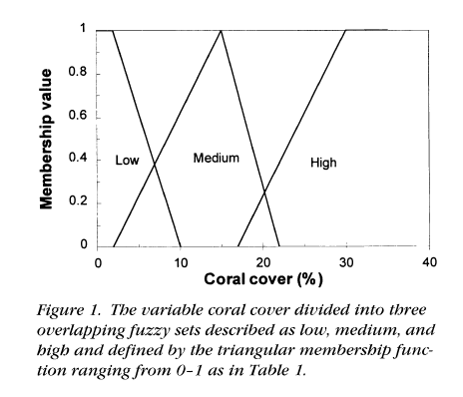
Case study i1
variables
The boundary values of each fuzzy set were based on the collected data and literature.

Slide 28
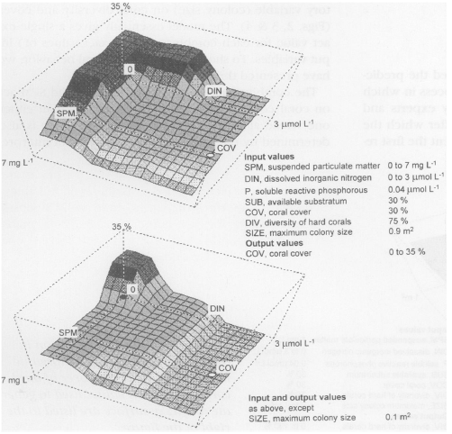
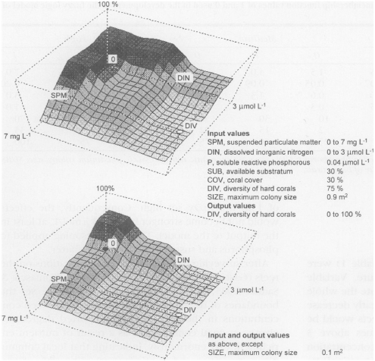
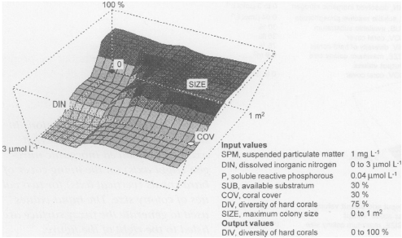
Case study i1
Results

Slide 29
Case study ii conclusion
Higher coral cover when SPM = 0 and DIN = 0 combined.
Smaller colonies are more susceptible to overgrowth by algae (DIN) than larger colonies.
Larger colonies will be less afected after 10 years, and if there is low levels of suspended particule mater and nitrogen, there will be higher levels of coral cover and diversity.

Slide 30
Case study II conclusion
Useful approximation of the reality.
Good method to deal with imprecise or unavailable data.
Although …
Coral reefs
Define the ideal number fuzzy sets.
More flexibility and detail in the output.

Slide 31
Fuzzy models conclusion
Good method to predict from imprecise data.
Diferent interpretation of data.
More flexible.
Inovation for ecological studies.
Subjective to the author’s interpretation.
Less accurate in some cases.

Slide 32
references
Adriaenssens, V., Goethals, P. L., & De Pauw, N. (2006). Fuzzy knowledge-based models for prediction of Asellus and Gammarus in watercourses in Flanders (Belgium). Ecological Modelling, 195(1-2), 3-10.
Meesters, E. H., Bak, R. P., Westmacott, S., Ridgley, M., & Dollar, S. (1998). A fuzzy logic model to predict coral reef development under nutrient and sediment stress. Conservation Biology, 12(5), 957-965.
Recknagel, F. (2006). Ecological informatics: scope, techniques and applications.
Image regerences
Iborisoff (2012) Coral Reef [Digital image]. In https://www.sciencemag.org/news/2016/09/some-relief-great-barrier-reef

